Slide 1
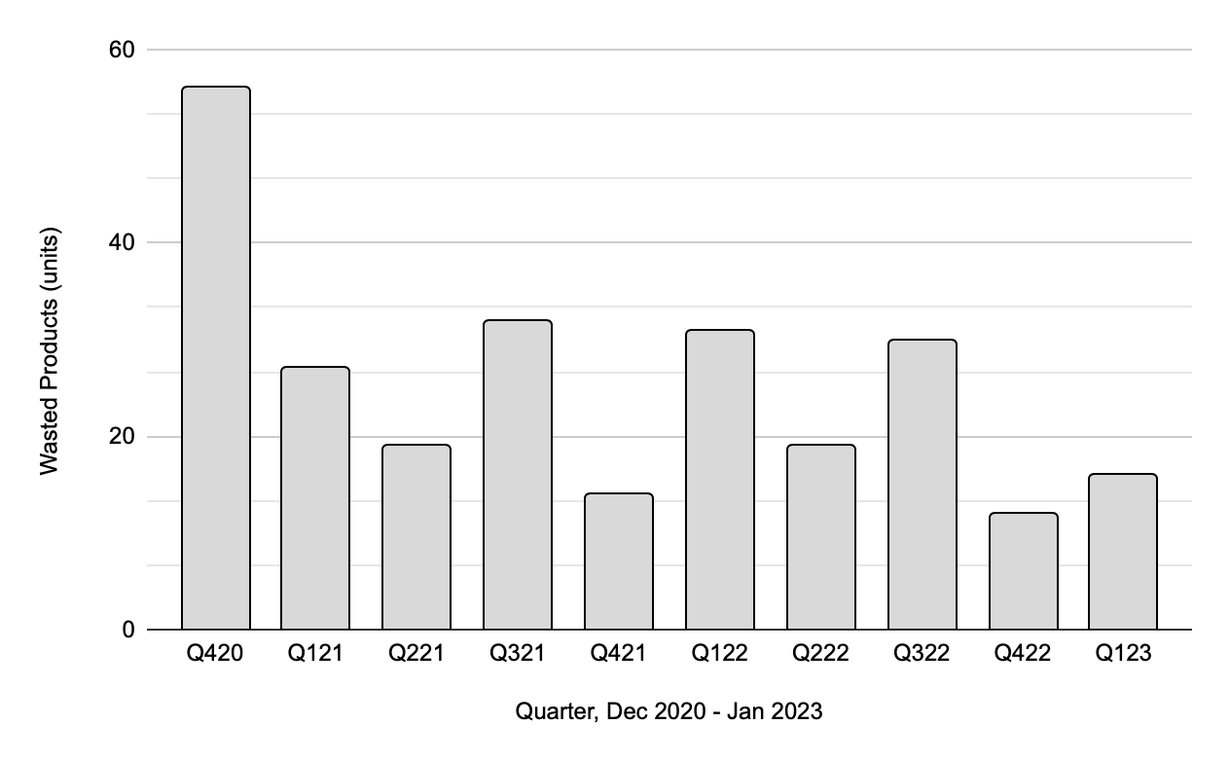
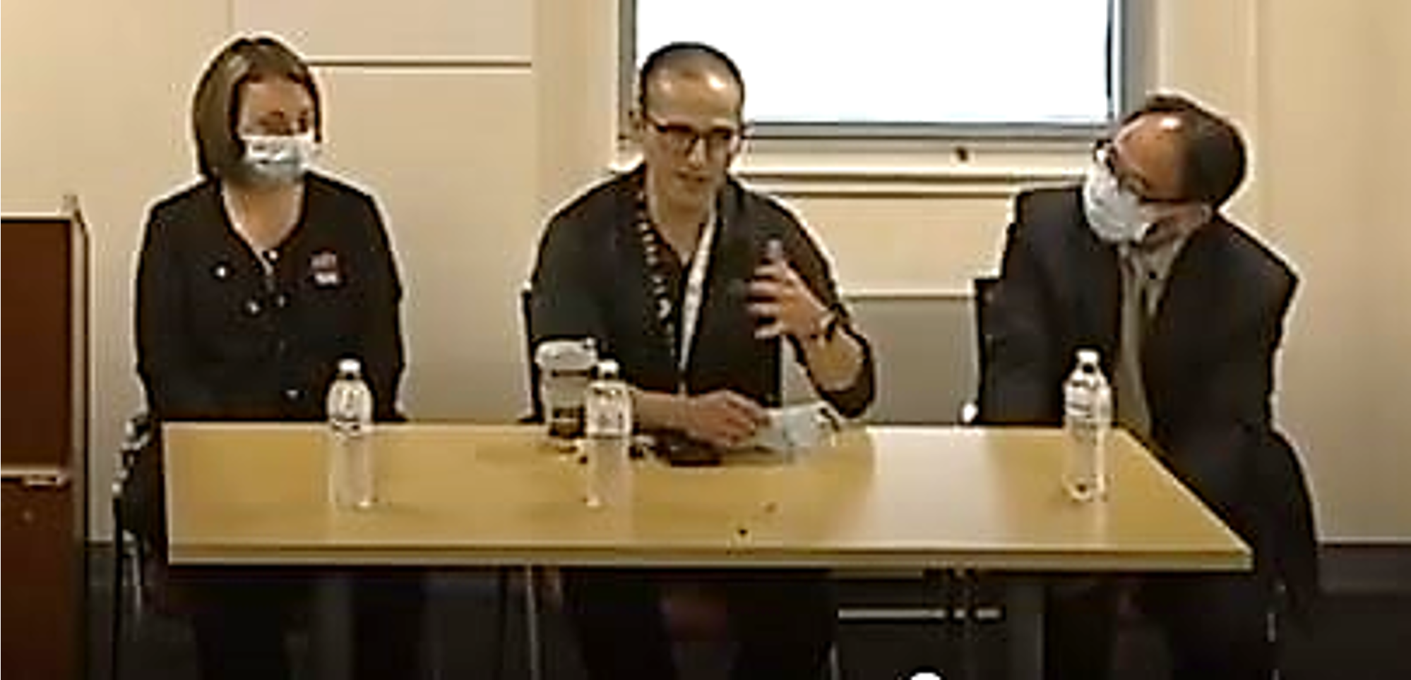
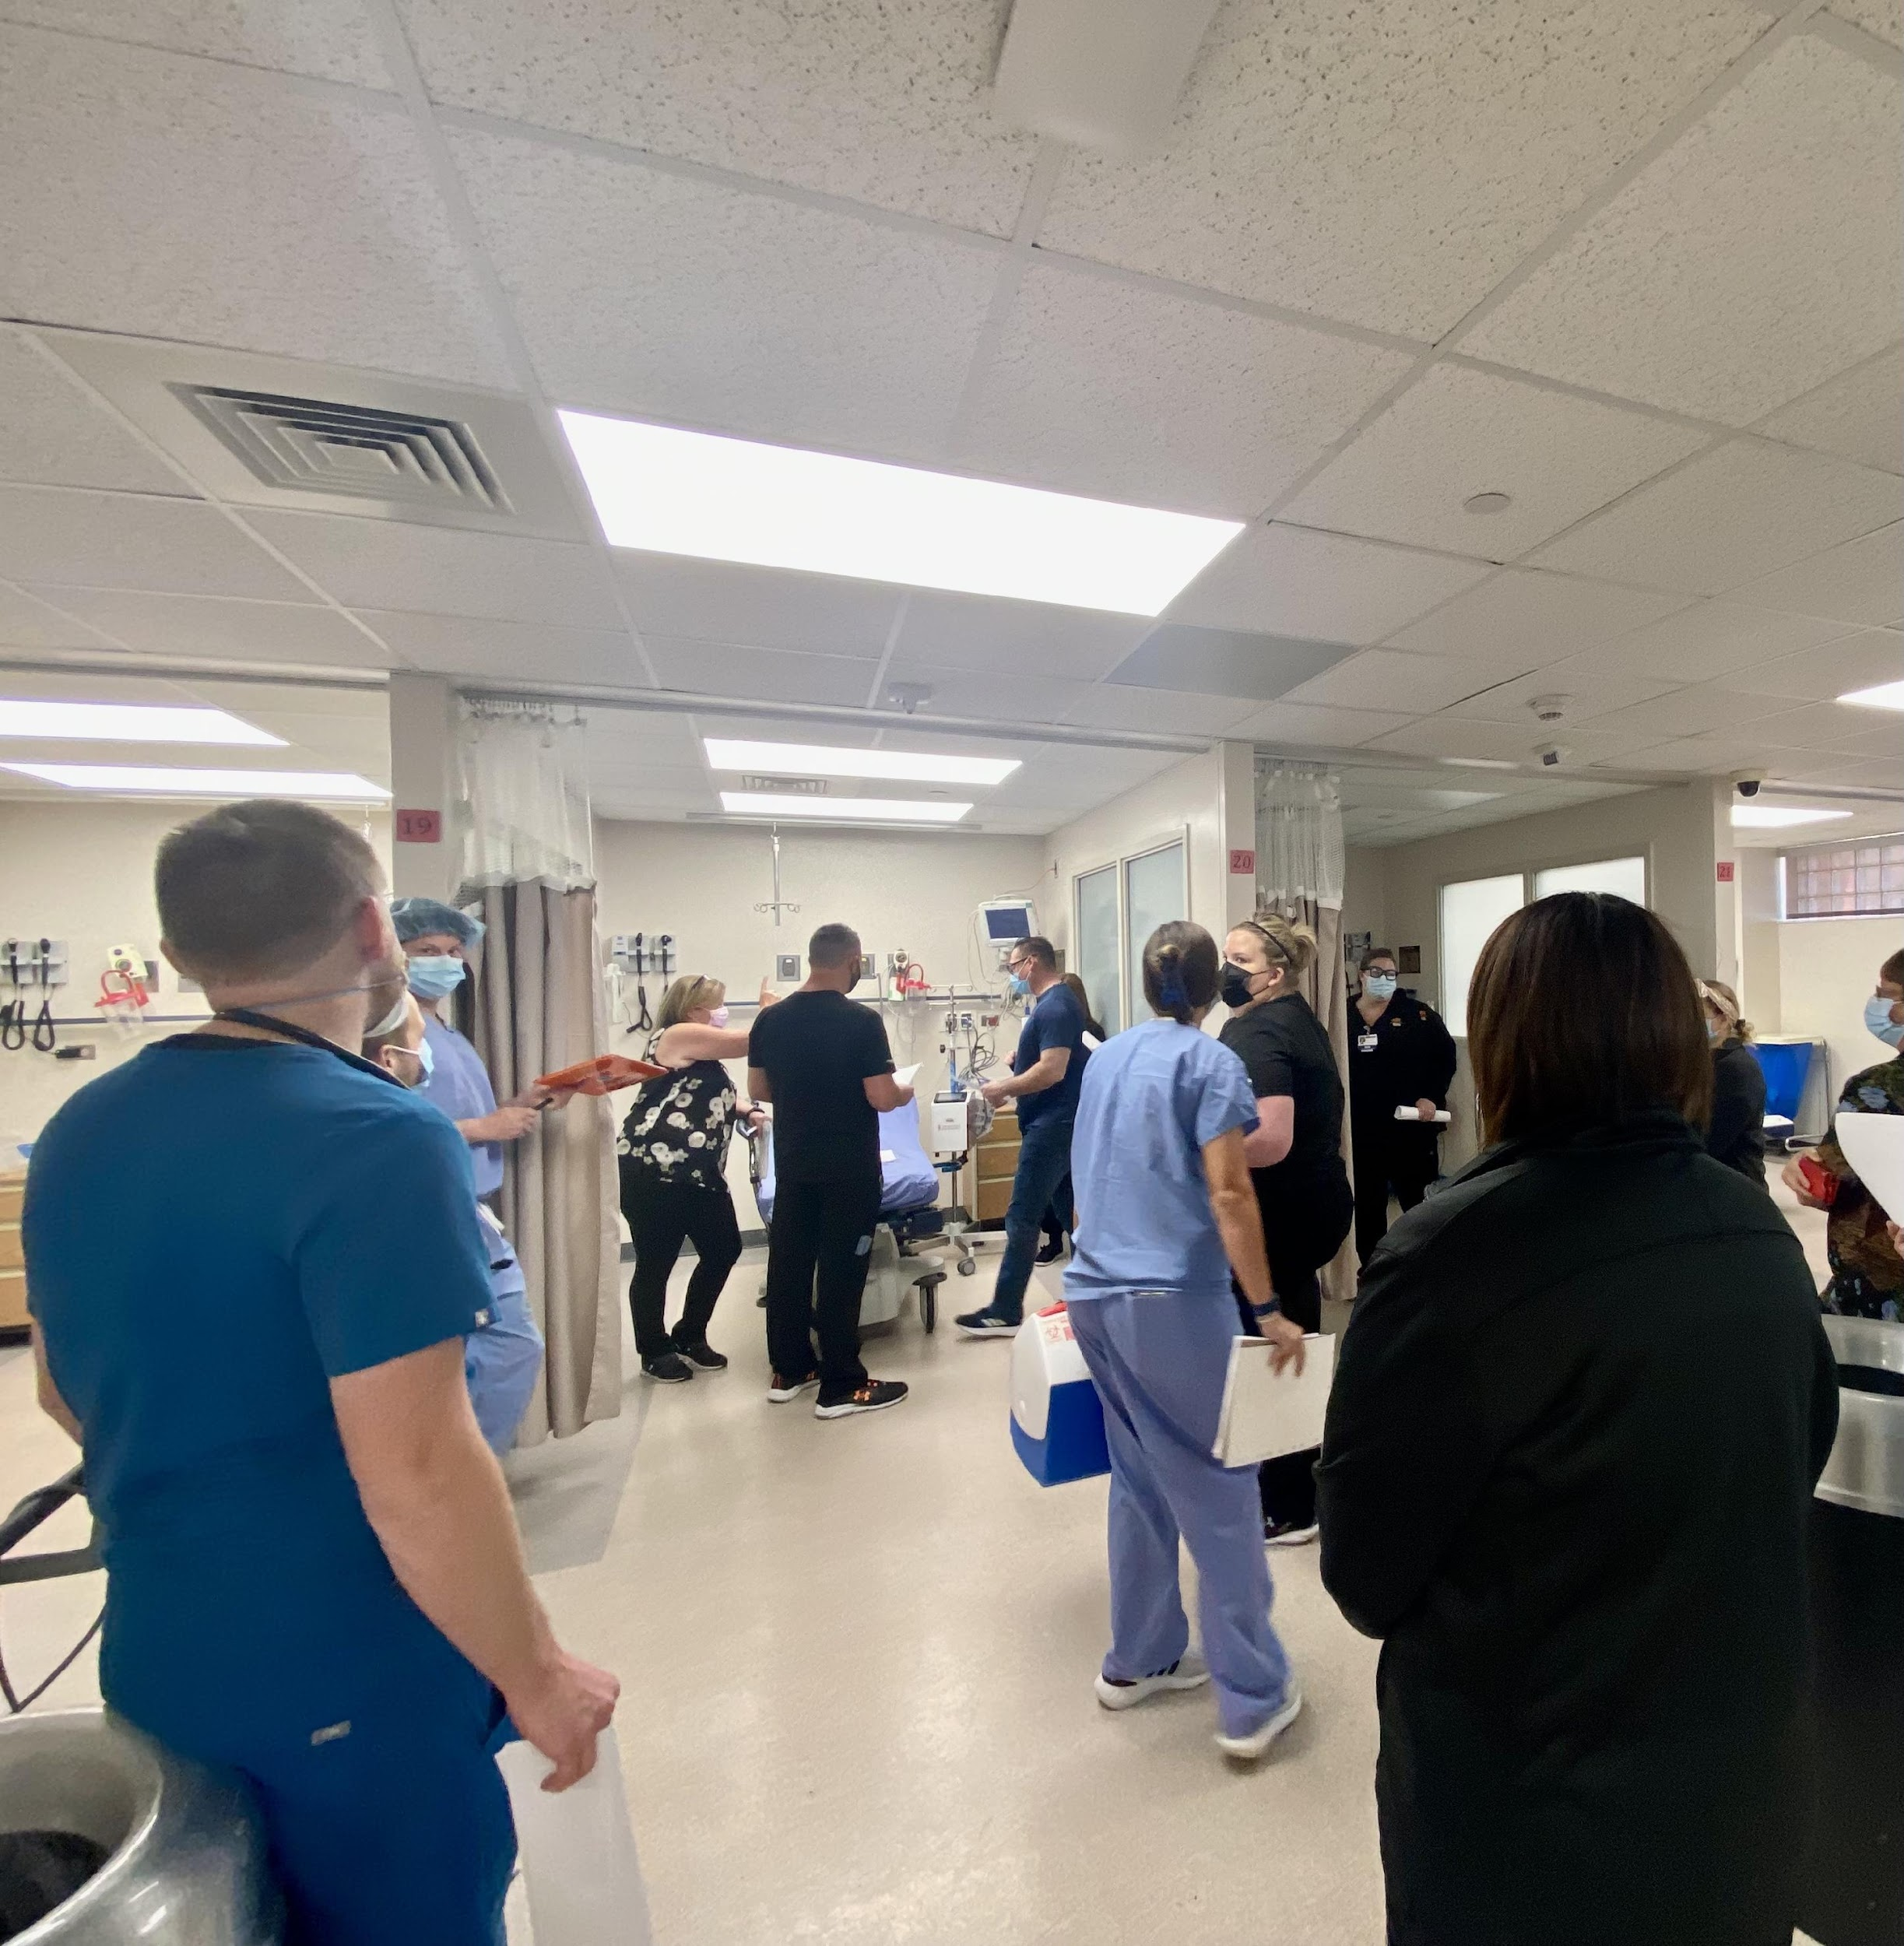
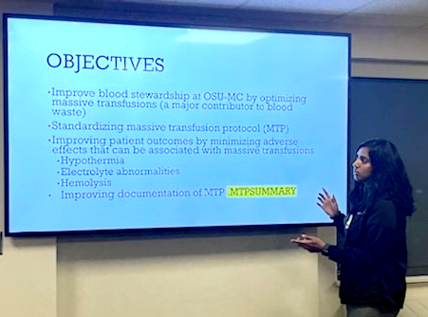
Oklahoma State University Medical Center Transfusion Committee
The Impact of Multidisciplinary Interventions on Transfusion Practices
Dr. Farzeen Syed, DO, PGY2, Dr. Travis Brachtenbach, DO, PGY3, Dr. Angela Clifton, DO, PGY1, Dr. Samantha Curran, DO, PGY1, Dr. Reagan Livingston, DO, PGY2,
OSU-MC Transfusion Committee; Faculty Advisor: Dr. Kathy Cook, DO
OBJECTIVES
METHODS
RESULTS
DISCUSSION
Project Aim: Determine how effective comprehensive education initiatives are in improving transfusion practices and reducing wastage of blood products.
Conduct a systematic review of multidisciplinary interventions aimed at optimizing transfusion practices.
Evaluate the impact of implemented multidisciplinary interventions:
Blood product wastage
Active MTP time via documented start and stop times
Identify opportunities for further improvement in transfusion practices.
To overcome gaps in transfusion practices, the OSUMC Transfusion Committee streamlined the MTP process and blood product usage. The committee consists of members from the Blood Bank, OSU attending and resident physicians across different specialties, and nursing. Monthly meetings were held to review transfusion cases with potentially inappropriate transfusions resulting in a letter requesting additional clarification and education for the ordering physician if needed.
Additional interventions were implemented to further improve OSUMC's transfusion practices.
Interventions:
In October 2020, the OSUMC Blood Bank received education on the age, sex, and appropriateness of transfusing RH negative blood products.
In Fall 2021, an annual hospital-wide Grand Rounds session was initiated to review transfusion practices with the Choosing Wisely Campaign, uncrossed match transfusions, and MTP. The panel included members from the OSU Transfusion Committee and OBI for questions.
In Spring 2022, the Transfusion Committee performed a quality improvement project to provide additional education about the proper utilization of MTPs and emphasized documentation to residents across different OSU specialties.
In Summer/Fall 2022, nursing staff worked with quality improvement and the physicians within the transfusion committee to standardize the MTP process via practice drills. These drills were held in the ER, ICU, MCH (maternal child health) and OR settings with respective staffing. The process emphasized interdisciplinary involvement with nursing staff, attending and resident physicians, Blood Bank, and quality assurance participation.
Data from OSUMC Blood Bank was obtained between 2021 - 2023 on transfusion practices, including discard reports, O negative blood usage, uncrossed matches, and MTP usage, both before and after implementing interventions. This data will be analyzed to evaluate the effectiveness of the interventions, particularly in relation to MTP and uncrossed matched blood usage.
In 2021, there was an increase in O negative blood usage and MTP use, along with wastage, which decreased in 2022 and 2023 after the implementation of our interventions. We also observed a decrease in overall blood product usage, indicating better awareness of appropriate orders among residents and staff. Through continued education and practice trials, we have seen a reduction in blood product wastage and MTP use. Our standardized MTP protocol has contributed to this success, leading to decreased wastage and fewer MTPs needed. Overall, our interventions highlight the importance of interdisciplinary collaboration and continued education in optimizing transfusion practices.
 | Ordered | Wasted | % of Total Blood Products
2021 | 66 | 7 | 27%
2022 | 58 | 4 | 20%
First Quarter of 2023 | 8 | 2 | 38%
INTRODUCTION
Table 1. O Negative Blood Usage Comparison, 2021-2023
Since 2021, both O negative usage and wastage has decreased hospital wide. In 2021, 27% of the total blood products ordered were O negative blood. This decreased to 20% of the total products ordered in 2022. Although the total percentage is numerically elevated for 2023, this number only reflects the first three months of 2023.
CONCLUSION
The comprehensive outlined education initiatives have resulted in substantial improvements in appropriate blood product usage, resulting in reduced waste of valuable resources and improved use of MTPs. The results underscore the importance of ongoing efforts to promote evidence-based transfusion practices and minimize the risk of adverse events associated with transfusions. Moving forward, the committee plans to maintain our educational efforts through grand rounds, interdisciplinary meetings, and practice drills to reinforce proper protocol usage.
Next Steps:
Further potential areas of investigation include assessing the impact of standardized transfusion protocols on patient outcomes, improving timing between orders and transfusions, and explore methods to reduce wastage across all blood products. The transfusion committee is dedicated to identifying gaps in transfusions and equipping our residents and staff with the knowledge and skills needed to deliver optimal patient care.
Appropriate transfusion practices are critical for patient care. However, improper use of blood products can lead to complications and mortality. Despite more restrictive transfusion practices and limited availability of O negative also known as uncrossed matched blood, there is still a high demand of use. The transfusion rate of O negative blood has increased since 2013, with Massive Transfusion Protocols (MTPs) being a significant source of usage. However, inappropriate MTP use can result in significant blood wastage, which is particularly concerning as MTPs involve transfusing over 10 units of RBCs within a 24-hour period.
In Spring 2020, the Oklahoma Blood Institute contacted Oklahoma State University Medical Center faculty about the high usage of O negative blood and the need for improvements in transfusion practices. This project aims to evaluate the effectiveness of interventions implemented to improve transfusion practices specifically in uncrossed match transfusions and Massive Transfusion Protocol (MTP).
Figure 1. Total hospital-wide blood product usage, 2021-2023
Blood product wastage has declined since 2020, but the data for that year only includes the last quarter, which may underestimate the total amount of wastage. For 2021 and 2022, data is available for all four quarters of the year. Total wastage in 2021 was 92. Total wastage in 2022 was 108. Q1 and Q3 were distinctly higher in wastage for both 2021 and 2022; however, following the interventions, Q1 of 2023 demonstrated a significant improvement in wastage reduction compared to previous years.
REFERENCES
AABB. Guidelines for patient blood management and blood utilization. Bethesda (MD): AABB; 2011. 52 p.
Callum JL, Waters JH, Shaz BH, et al. The AABB recommendations for the Choosing Wisely campaign of the American Board of Internal Medicine. Transfusion 2014;54:2344-52.
Hess, J. R. Massive Blood Transfusion. In: UpToDate, Post, TW (Ed), UpToDate, Waltham, MA, 2023.
Mowla, S. J., Sapiano, M. R. P., Jones, J. M., Berger, J. J., & Basavaraju, S. V. (2021). Supplemental findings of the 2019 National Blood Collection and Utilization Survey. Transfusion, 61 Suppl 2(Suppl 2), S11–S35. https://doi.org/10.1111/trf.16606
Murphy, M., & BenAvram, D. (2022, July). Association bulletin #19-02 Date: Updated July 2022 AABB. Recommendations on the Use of Group O Red Blood Cells. Retrieved April 3, 2023, from https://www.aabb.org/docs/default-source/default-document-library/resources/association-bulletins/ab19-02.pdf
Zbigniew M. Szczepiorkowski, Nancy M. Dunbar; Transfusion guidelines: when to transfuse. Hematology Am Soc Hematol Educ Program 2013; 2013 (1): 638–644. doi: https://doi.org/10.1182/asheducation-2013.1.638
 | 2021 | 2022 | 2023
MTPs called | 29 | 19 | 3
Start and stop times were documented | 14% | 79% | 66%
Total products used | 261 | 301 | 26
Total products wasted | 30 | 37 | 0
MTPs that required audits | 8 | 4 | ---
Table 2. MTP blood usage and wastage, 2021 - present
MTPs initiated decreased from 2021 to 2022. In 2022, 79% of the MTPs called were according to protocol with documented start and stop times whereas in 2021 only 14% followed this protocol. Of the 29 MTPs called in 2021, 8 of them required audits (27.5%) whereas of the MTPs called in 2022 only 4 of the 19 required audits (21%).
ACKNOWLEDGEMENTS
We would like to acknowledge OBI, OSUMC Blood Bank, Transfusion Committee members, attending and resident physicians, and staff that made this project possible.
Grand rounds presentation panel; Resident education from 2022 QI project
Multi-disciplinary MTP drills Fall 2022 - present
IRB status pending

