Slide 1

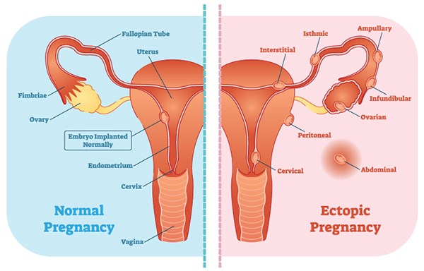
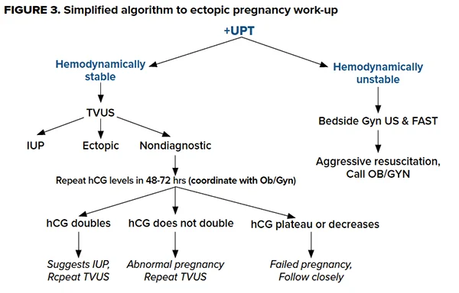
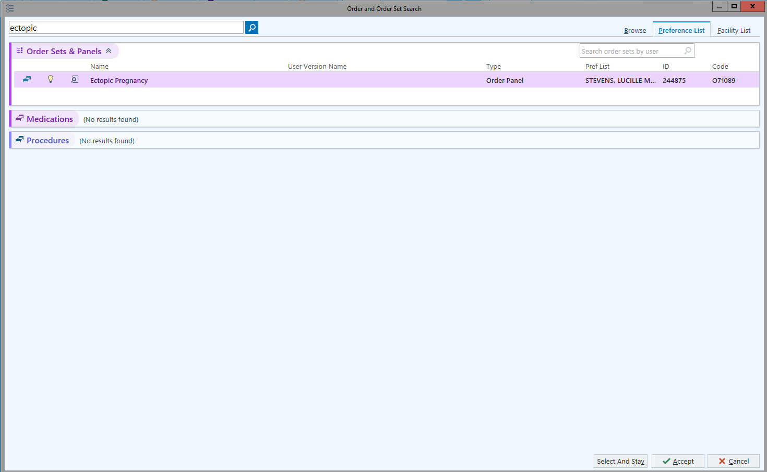

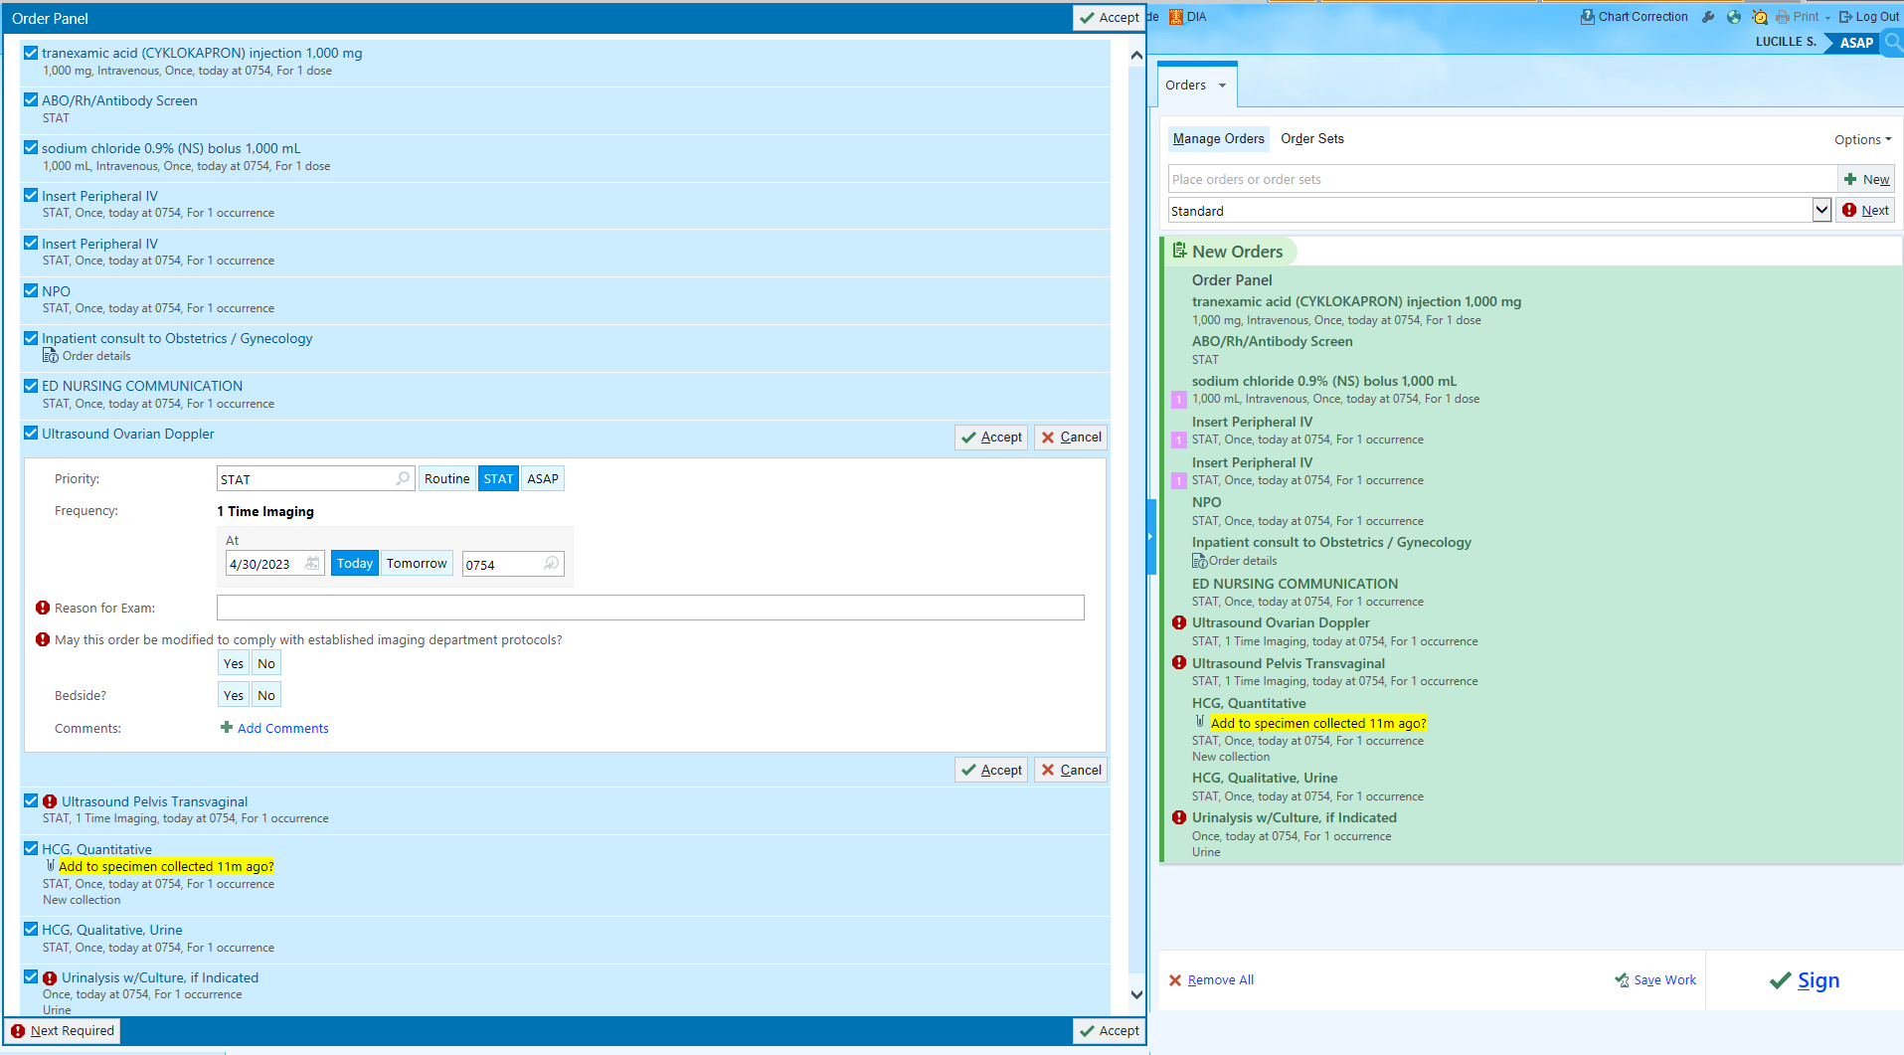
OSUMC Emergency Medicine
Evaluation for Ectopic Pregnancy
RESIDENTS: J. Peaster, DO-PGY4; L. Stevens, DO-PGY2; FACULTY ADVISORS: B. Roepke, DO; K. Murray, PharmD, T. Bryant, DO
OSU Medical Center Emergency Department
INTRODUCTION
RESULTS
CONCLUSION
Ectopic pregnancy is a condition that occurs when a fertilized ovum implants in tissues outside of the uterus, occurring in up to 2% of all pregnancies. Ectopic pregnancy is the leading cause of pregnancy-related death in the first trimester, accounting for up to 6% of pregnancy-related deaths. Timely diagnosis, resuscitation and definitive management are paramount in reducing morbidity and mortality. Ordering the proper diagnostic tests and supportive management products through EPIC is often time-consuming and difficult, requiring multiple searches.
Figure 1. Ectopic pregnancy implantation sites
Figure 2. Algorithm for ectopic pregnancy work-up
Before creation of the Ectopic Pregnancy order set, placing appropriate orders were subject to human error which could lead to delay in recognition and treatment of this potentially deadly medical condition.
This is an ongoing project which will measure time to diagnosis of ectopic pregnancy. Our study will attempt to decrease time to diagnosis by 40%. We will also attempt to decrease emergency department length of stay and improve accuracy of orders. This study will take place over the next 12 months.
OBJECTIVES
REFERENCES
To develop an effective order set to streamline the diagnosis and management of ectopic pregnancy
Reduce time to diagnosis by 40% within 12 months
Improve accuracy of ordering
Improve time to disposition
Figure 3. Epic Order set
Simplified Algorithm for Ectopic Pregnancy Work-up Accessed at https://www.emra.org/emresident/article/defusing-ectopic-pregnancy.
Pontius Elizabeth. Ectopic Pregnancy & Heterotopic Pregnancy. In: Mattu A and Swadron S, ed. CorePendium. Burbank, CA: CorePendium, LLC. https://www.emrap.org/corependium/chapter/reci4t2X66l3qk1SX/Ectopic-Pregnancy-and-Heterotopic-Pregnancy. Updated August 31, 2021. Accessed May 1, 2023.
Tulandi, T. Ectopic pregnancy: Clinical manifestations and diagnosis. In: UpToDate, Chakrabarti, A (Ed), UpToDate, Waltham, MA, 2023.
METHODS
The order set will be implemented into EPIC and placed under ‘Adult Order Sets’
The use of the order set will be tracked and time to diagnosis, length of stay, and accuracy of orders measured over 12 months
Retrospective analysis of previous patients for which ectopic pregnancy was evaluated prior to development of Ectopic Pregnancy order set will be used as control

