Slide 1

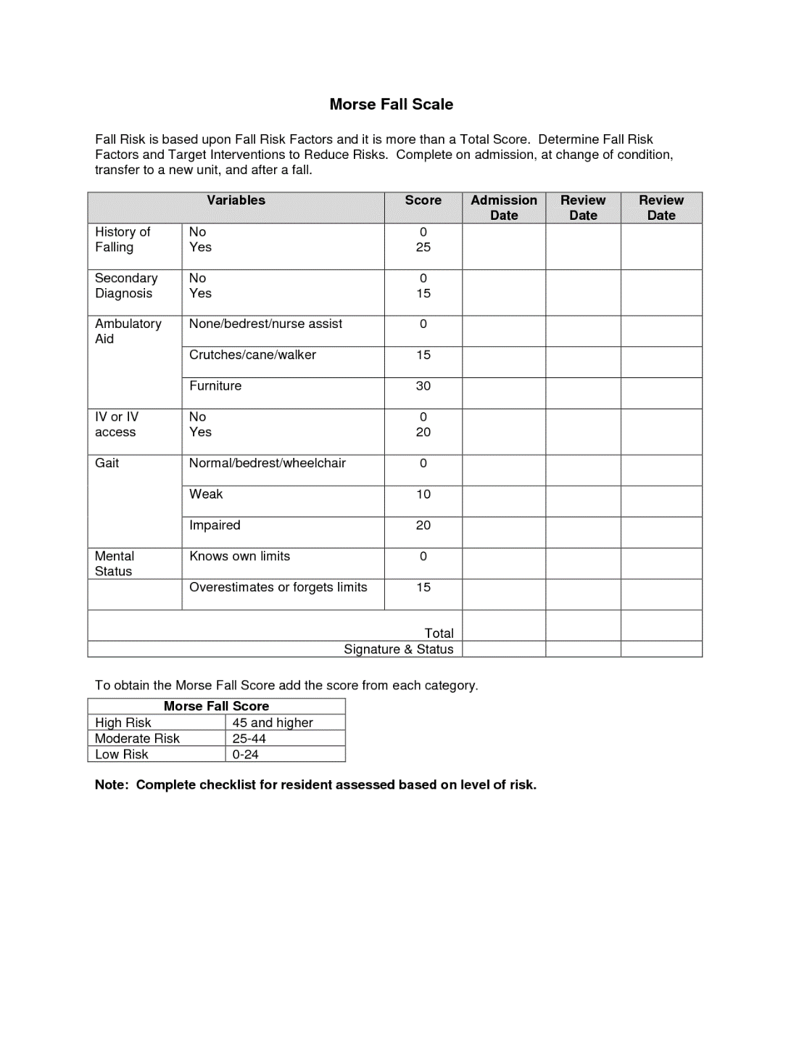
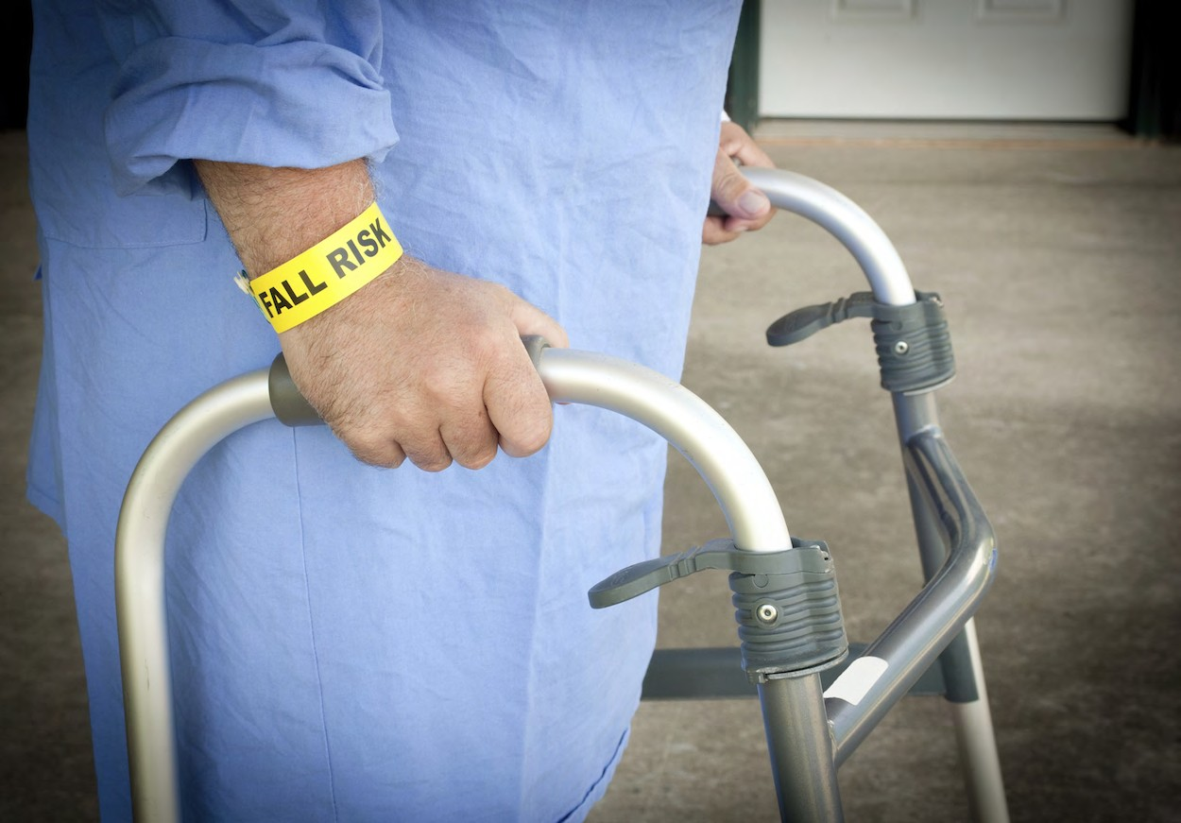
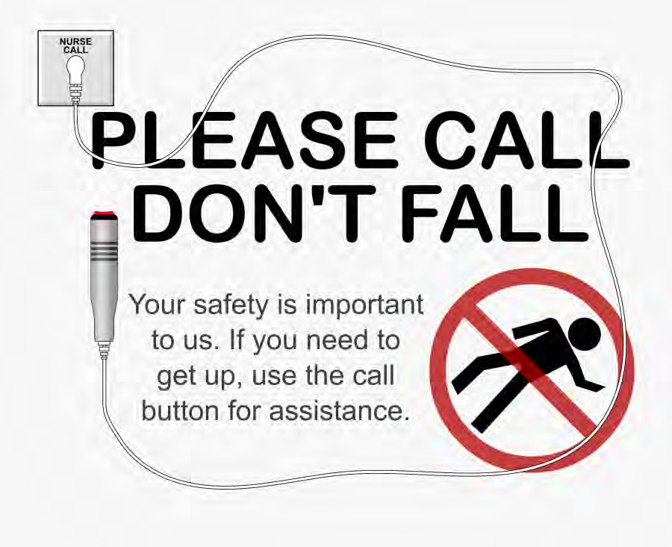
Screening for Fall Risk, Hospitalist Performance Improvement Activity
Chickasaw Nation Family Medicine Residency
Tony Wallen, D.O., PGY3; John Long, M.D.
“IRB Exempt”
INTRODUCTION
METHODS
Inpatient falls involving patients on acute care floors is a frequently reported safety event. No fall is harmless, & often there are subsequent psychological consequences. Identification of multiple risk factors & incorporating appropriate pragmatic interventions can potentially reduce the number of falls. There are available fall risk screening tools to assist in identifying those at higher risk. Risks include a history of falls, a secondary diagnosis, use of an aid to ambulate, IV attachment, impaired gait, impaired cognition & age. Evidence supports a coordinated multidisciplinary clinical approach as a team can potentially reduce the frequency of falls. However, implementation of multi-professional interventions can be challenging. Ultimately a team approach with a culture vigilance with strong leadership can be used to improve patient safety. Not all falls are preventable, but they are also not inevitable. This study was performed during inpatient hospital medicine to observe & record pertinent data to potentially improve our local patient population's safety.
The Morse Fall Scale was used during the Review of Systems to risk stratify patients over the age of 65 admitted to the hospital for fall risk & to implement appropriate precautions as indicated. This was done over 1-month in August 2022. It consists of 6 variables that are quick and easy to score & it has been shown to have predictive validity & inter-rater reliability. It is widely used in acute care settings both in the hospital & long-term inpatient settings. The scale should be calibrated for each particular health care setting so that fall prevention strategies are targeted to those at highest risk. Risk cutoff scores may be different depending on the setting. The score is tallied & recorded on the patient's chart. Risk level and recommendation actions are then identified, with consideration for ancillary services such as physical & occupational therapy. A scale of 0-25 is low risk, 25-44 is medium risk, & 45 or higher is high risk. See Figure 1.
Figure 1. Morse Fall Risk Scale.
RESULTS
Out of 30 patients admitted over the age of 65, 27 were screened. 18 were deemed ‘high risk’, 6 were deemed ‘medium risk’ and 3 were deemed ‘low risk’. This resulted in 90% screening rate. There were no reported falls during the month. See Figure 2.
CONCLUSIONS
OBJECTIVE & AIM
Over 1-month, 90% of patients admitted to CN FMR Inpatient Service over the age of 65, were screened with the Morse Fall Risk Scale. This allowed for patient risk stratification & the appropriate fall precautions to be implemented.
The aim of this project was to screen 95% of patients over the age of 65 admitted to the hospital over a 1-month period with the goal to increase fall risk assessment & implement appropriate precautions.
REFERENCES
Figure 2. Morse Fall Risk Scale.
Prevention of falls in hospital. Rob Morris, Shelagh O’Riordan. Clinical Medicine Aug 2017, 17 (4) 360-362; DOI: 10.7861/clinmedicine.17-4-360.

