Slide 1

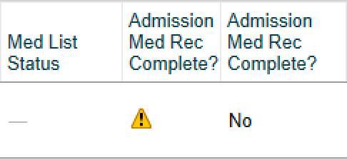
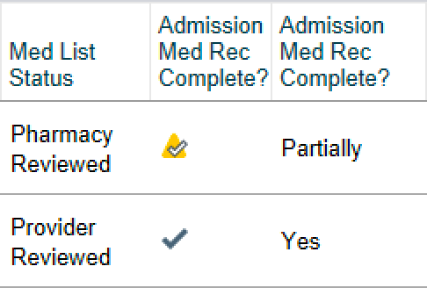
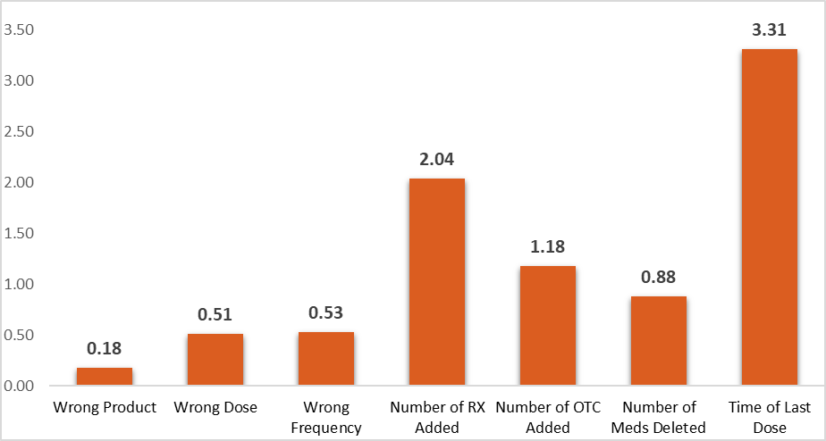
Dodging a Med-Wreck
Standardizing the Admission Medication Reconciliation Process
1 Department of Internal Medicine, Oklahoma State University Medical Center
2 Department of Family Medicine, Oklahoma State University Medical Center
3 Department of Pharmacy, Oklahoma State University Medical Center
Hallie Frederick, D.O., PGY III ¹; Kali Riley, D.O., PGY II ¹; Gentry Decker, D.O., PGY III ¹; Emil Kasmia, D.O., PGY III ²; Cole Eichelberger, PharmD, PGY I ³
Faculty Advisors: Kathy Cook, D.O. ¹; John Bury, PharmD³
INTRODUCTION
METHODS
The pharmacy department at OSUMC collected data identifying the magnitude of errors in the med rec process by documenting the changes they made to the med history after the med rec was completed by the provider.
The studies included 74 adult patients admitted to the Internal Medicine service at OSUMC in October 2018 and October 2022.
The percentage of medication reconciliations completed within 24 hours of admission between January 1 and December 31, 2022 was generated through Epic software.
After highlighting the gross deficiencies of the current med rec process, our team of physicians and pharmacists set out to implement interventions to improve both accuracy and efficiency.
INTERVENTIONS CONTINUED
It is estimated that 1.5 million Americans suffer injuries related to drug treatment harm every year [1]. Drug-related errors are among the most common and most expensive medical errors with estimated cost to the US healthcare system nearing $3.5 billion [1]. Training of non-dedicated staff directly contributes to increased errors in best possible medication reconciliation (BPMH). Additionally, implementation of a new electronic health record (EHR) has been found to be a major contributor to these discrepancies [2]. According to this data, OSUMC is at high risk for medication-related errors given lack of official training and dedicated staff in addition to transitioning from Meditech to Epic in 2020. The MARQUIS study concluded that clearly defining clinician roles, training dedicated staff, and establishing BPMH protocols led to a decrease in harmful drug-related errors [2].
Figure #4 indicates that neither the med history nor med rec have been completed.
Figure #5 Line 1 indicates that an MHT has completed med history. Line 2 indicates that the resident completed the med rec.
DATA
Percentage of Med Recs Completed within 24 Hours of Admission
Average Number of Med History Errors per Patient
NEXT STEPS
This project is part of a longitudinal endeavor to standardize and improve the admission medication reconciliation process at OSUMC. Following the application of our interventions in July 2023, the pharmacy department will collect new data in October 2023. This data will be presented at the 2024 QI Symposium. We expect to find a dramatic reduction in the number of med history errors with the implementation of our standardized method, numerous educational resources, and newly hired MHTs. This will remain a concerted effort among the Internal Medicine, Family Medicine, and Pharmacy departments to encourage interdisciplinary communication among the teams most directly impacted by these changes. We are confident that these interventions will lead to less medication errors and, most importantly, reduce the risk of harm to our patients.
AIM STATEMENTS
Reduce the number of errors in the medication reconciliation process by 75% within 1 year.
Increase the percentage of med recs completed within 24 hours of admission to 100% within 1 year.
Figure #1 illustrates the average number of errors in each category identified by pharmacy after the med rec had been completed.
Figure #2 shows that only 55.4% of med recs were completed within 24 hours of admission in 2022.
INTERVENTIONS
Clearly define roles for residents and MHTs, and limit nursing staff roles in the med rec process.
Design a step-by-step “how to” guide for residents and post them around the hospital for reference.
Create an instructional video demonstrating the steps on Epic to be shown during orientation for new residents.
Add “Med List Status” and “Admission Med Rec Complete” columns to the residents’ Epic dashboards. These will indicate when the MHTs have completed the med history, prompting residents to complete the med rec in a timely manner. (See Figures #4, #5)
BACKGROUND
Medication history (med history) = creating or editing a patient's home medication list and indicating time of last dose upon admission to the hospital.
Medication reconciliation (med rec) = ordering (or not ordering) home medications for a patient to continue taking while in the hospital.
The OSUMC pharmacy department recently began hiring Medication History Technicians (MHTs) whose sole responsibility is to complete medication histories when patients are admitted to the hospital.
¹Patient admitted to hospital
²Admitting resident obtains as much med history as they are able during H&P
⁴MHTs change "Med List Status" to "Pharmacy Reviewed"
³MHTs complete med history on all patients in chronological order from time of admission
⁵Resident sees "Pharmacy Reviewed" in Epic dashboard and completes med rec
⁶Check mark appears under "Admission Med Rec Complete" in Epic dashboard
REFERENCES
1. Makary MA, Daniel M. Medical error—the third leading cause of death in the US. BMJ 2016;353:i2139 doi:10.1136/bmj.i2139
2. Mixon AS, Kripalani S, Stein J, et al. An On-Treatment Analysis of the MARQUIS Study: Interventions to Improve Inpatient Medication Reconciliation. J Hosp Med. 2019;14(10):614-617. doi:10.12788/jhm.3308
Figure #3 illustrates a simplified sequence of events in the med rec process.
DISCLOSURES
The research team has no disclosures to present.
This study was determined to be IRB exempt.
Patient admitted to hospital
Admitting resident obtains as much med history as they are able during H&P
MHTs complete med history on all patients in chronological order from time of admission
MHTs change "Med List Status" to "Pharmacy Reviewed"
Resident sees "Pharmacy Reviewed" on Epic dashboard and completes med rec
Check mark appears under "Admission Med Rec Complete" on Epic dashboard

