Slide 1

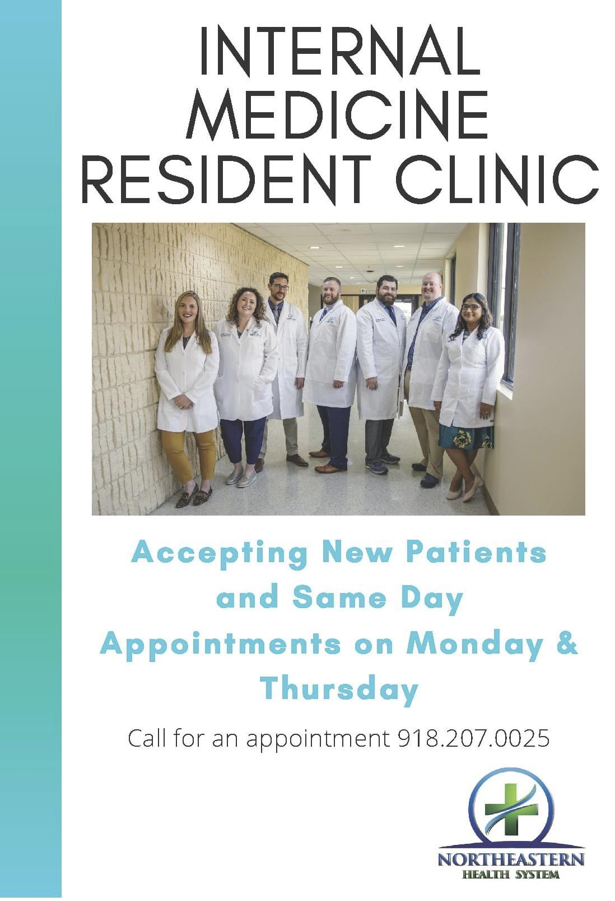
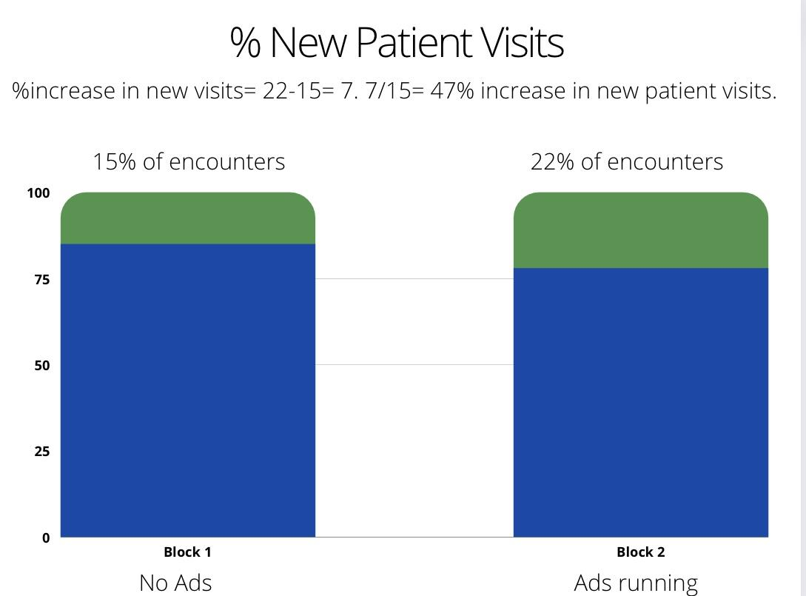
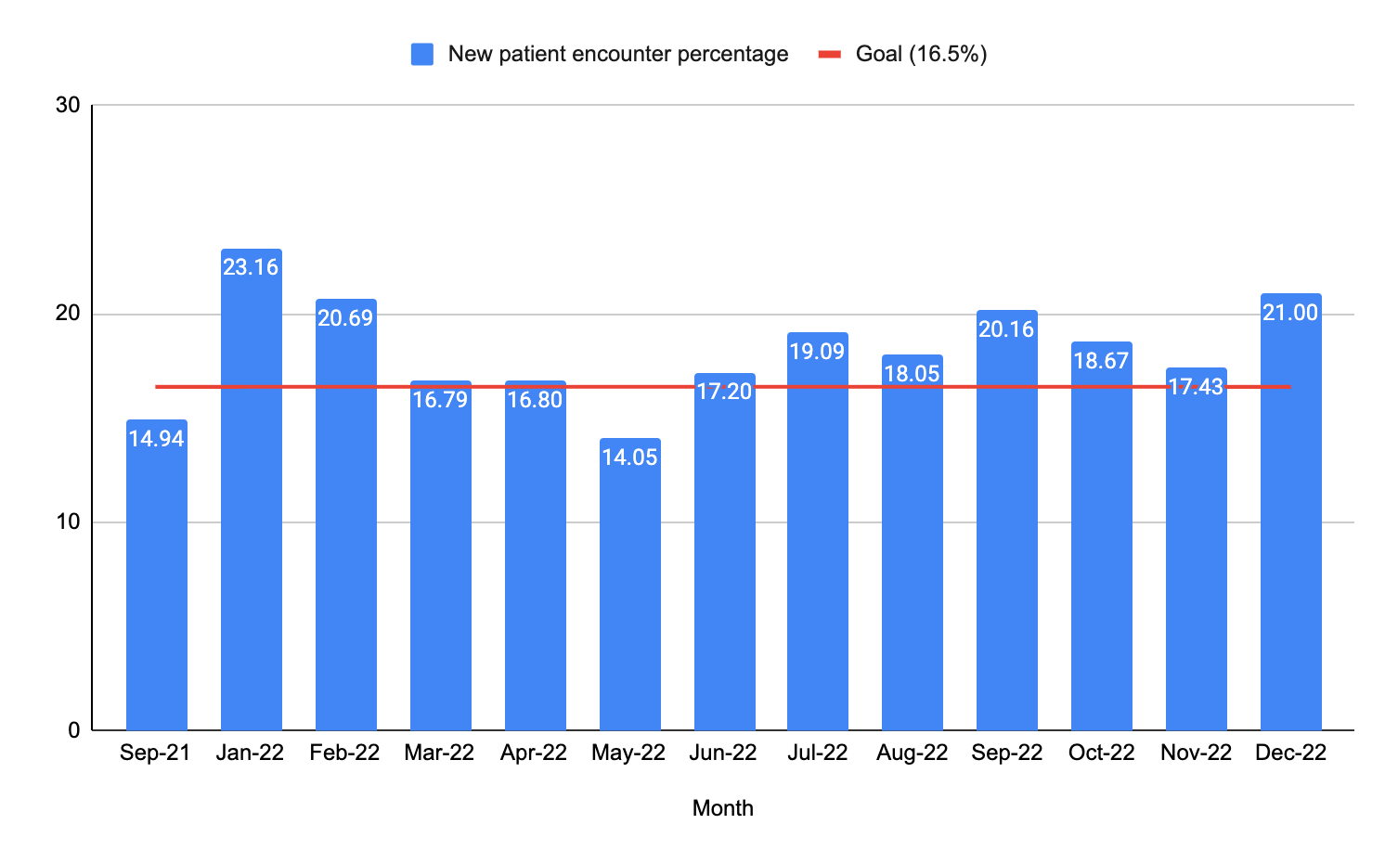

Northeastern Health System - Internal Medicine
Increasing patient encounters at the Residency Clinic
Buster Reddick D.O. PGY-2, Harsh Patel D.O. PGY-1, Priyanka Deshmukh M.D. PGY-2, Kate Allen D.O., Chelsea Smith D.O., Tex Gaskins D.O, Farhan Syed M.D.
INTRODUCTION
RESULTS
CONCLUSION
The Internal Medicine Residency Clinic has identified many gaps in care that are
related to low patient encounters in the clinic. We are trying to increase new patient encounters at the clinic to help increase the number of patients the residents are seeing. This will increase access to primary care in our rural community and help to provide learning opportunities for the Internal Medicine residents.
The goal of having 16.5% of patient encounters being new patient encounters was achieved for 6 straight months allowing us to close out the project. We learned that multiple approaches to advertising outpatient care should be utilized in an overall continued campaign for patient recruitment as focusing on a single patient demographic can eventually lead to diminishing returns
NEXT STEPS
OBJECTIVES
Next steps would be to continue forward with the pursuit of various different avenues of advertisement. Discussions have been had with administration to obtain temporary billboard access near the busiest intersection in Tahlequah.
Our plan for this project is to increase new patient encounters at the Internal Medicine Residency clinic by advertising new patient availability via Facebook and by distributing business cards to hospitalized patients on discharge. These methods should help to increase patient awareness of appointment availability so they can establish primary care at our clinic.
Goal: Our goal for this project is a 10% increase in the overall percentage of new encounters in the IM resident clinic each month when compared to the baseline percentage of new encounters from July 5th-Septemeber 30th of 2021. Baseline percentage of new encounters ended up being 15% in September 2021. Our goal was to increase this percentage by an additional 10%, or in otherwords, make our new percentage of new patient encounters total 16.5% each month.
RESOURCES
Resources: NHS advertisement department and clinical IT to assist with running patient
encounter data.
METHODS
A Facebook advertisement campaign was started in January, but 4 months into the project the numbers fell below our 16.5 percent goal. At this point Facebook advertisement was replaced by inpatient recruitment via business card distribution.
The change being tested was that handing out business cards after each discharge brought in a broader range of patients that then social media approach.
Data Summary
Graph represents new patient percentage going from January of 2022 to December 2022 when compared to the baseline in September. The red bar is our goal of 16.5% each month. This goal was achieved from June 2022 to December of 2022, a successive increase in new patients encounters for 7 straight months at our goal.
ACKNOWLEDGEMENTS
Assistance for this project was given by Kelly Marak D.O., Farhan Syed M.D., NHS Clinical IT.

