Slide 1

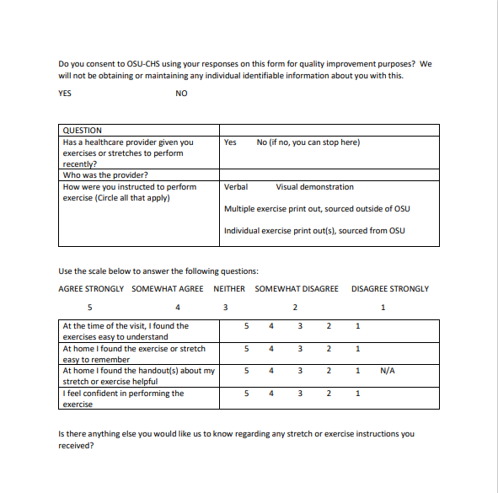
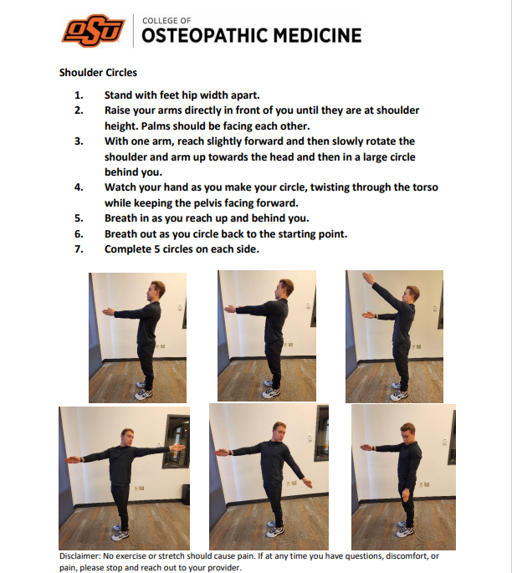
OSU-CHS/ ONMM and Family Medicine
Exercising Clarity
Cameron Henderson, DO PGY-4 ONMM; Mitchell Cruz, DO PGY-2 FM; Phillip Ridgeway, DO PGY-2 FM; Meg Ivanova, RN; Jennifer Wilson, DO ONMM Faculty Advisor; John Miller, DO FM Faculty Advisor
BACKGROUND
RESULTS
NEXT STEPS
Home exercise prescription is frequently implemented in conjunction with osteopathic treatment. Efficacy of this varies from study to study and is quite difficult to standardize and measure. One of the chronic difficulties within this is adherence, which is improved with written instruction. (Schneiders) From frequent clinical experience, we have had patients tell us they either forgot how to do an exercise or what exercise they were supposed to do. Our current structure for exercise prescription is not standardized, with multiple exercises on a page at times and greatly varying target audience in both writing style and illustrations. In standardizing this, we hope to provide comprehension and confidence to complete exercise to our patients. Providing simple instructions (Warde) and adding clear pictures of the exercises to increase use across varying levels of health literacy (Park) were key points to increase understanding of home exercise prescription for patients. Making the exercises a single page was done due to multiple patients stating feeling overwhelmed with multiple exercise pages that quashed motivation very rapidly, while also allowing for larger illustrations which are clearer.
Patient questionnaire focused on exercise understanding.
Survey data was collected over approximately 1 month in multiple clinics for this initial stage. Patient participation in survey was widely variable across the clinics, regardless of pre or post intervention, while handing out surveys. This did make it difficult to get a significant sample size for wider applicability of data, with an N of 13 (5 new instruction and 8 old), and likely led to some bias in participant selection.
In our limited initial findings, with no standardized instructions as previously implemented, patient understanding was highly variable regardless of modality (solely verbal to multimodal). This was anywhere from patients having somewhat agree and strongly agree across all answers to patients stating no recollection of what exercises they were to do for what purpose although they did recall being instructed, given multiple exercise handouts, and having demonstrations. Almost unanimously with the latter, it was a narrative answer rather than applied over Likert scale, which did not lend to data entry for the study. Patient comprehension outcomes did not trend based on length of time from exercise instruction to survey, provider giving instruction, or previous mode of instruction. No specific feedback was given, in addition.
With implementation of simple single exercise handouts, data was much more standardized and uniform. On all questions patients indicated strongly agree or agree for understanding, recall, and confidence of performing exercise. Patients were also much more able to give specific feedback regarding certain exercises and how they were working for them, up to a month out from initial instruction.
Further improvements to explore on the current implementation would include increased exercise handouts, standardization in plain language, and translation to other languages common in our clinics. Utilizing our target population to assist in the creation of text and visual aids may assist as well. (Park)
Data from the study was difficult to trend and interpret, so follow up on current PDSA cycle is preferable with further study. Directly administering survey would be preferable to both increase sample size and assist in standardization of responses to Likert scale. This may skew results with healthcare personnel directly questioning participants likely to artificially improve reported outcome.
REFERENCES
Park, J., & Zuniga, J. (2016). Effectiveness of using picture-based health education for people with low health literacy: An integrative review. Cogent Medicine, 3(1), 1264679. https://doi.org/10.1080/2331205x.2016.1264679
Schneiders, A. G., Zusman, M., & Singer, K. P. (1998). Exercise therapy compliance in acute low back pain patients. Manual Therapy, 3(3), 147–152. https://doi.org/10.1016/s1356-689x(98)80005-2
Warde F, Papadakos J, Papadakos T, Rodin D, Salhia M, Giuliani M. Plain language communication as a priority competency for medical professionals in a globalized world. Can Med Educ J. 2018 May 31;9(2):e52-e59. PMID: 30018684; PMCID: PMC6044302.
AIM STATEMENT
Example exercise sheet, in clear simple language with simple pictures.
Improvement in Self-Assessed Patient Comprehension of Home Exercise and Stretch
CONCLUSIONS
METHODS
In this initial stage of assessment, our aim of improving overall patient understanding of exercise prescription with a clear simple handout with pictures appears beneficial, although this is difficult to fully interpret secondary to limited and nonhomogeneous data. It may have added a significant component of standardization in patient understanding, although follow up study is needed to further confirm and quantify this. The aim of clarity for multiple levels of health literacy likely lent to any standardization. While other studies have shown some ties of comprehension and compliance, compliance was not assessed in this study.
An added benefit discovered in this study which was not foreseen was increased feedback from patients regarding their exercises at follow-up. This adds opportunity to improve instruction, to clarify any difficulties they are having at home, to modify home exercise plan for increased efficacy, and to recognize any opportunities for injury prevention.
A survey was administered to patients regarding understanding of previous exercise and stretch instructions which they have received from various sources. This is very nonuniform in previous implementation, with numerous different sources of varying quality and clarity. We implemented 10 more standardized individual exercise and stretch instructions, simplified with pictures showing the exercises on a single page, combined with verbal explanation and demonstration with the patients. The same survey was administered regarding understanding of the new instructions.
ACKNOWLEDGEMENTS
Dr. Mark Thai, DO for assisting with data collection and study design/implementation from the OMM Department.

