Slide 1

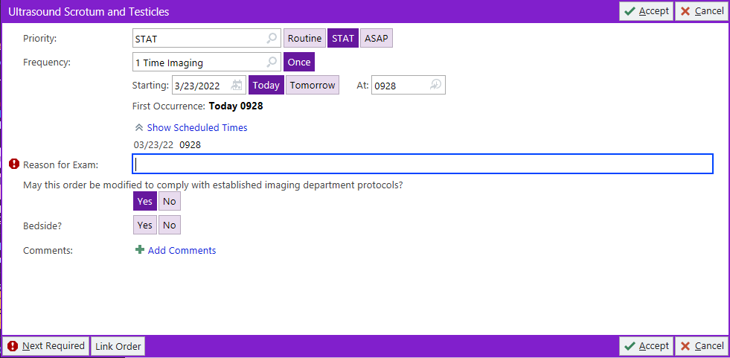
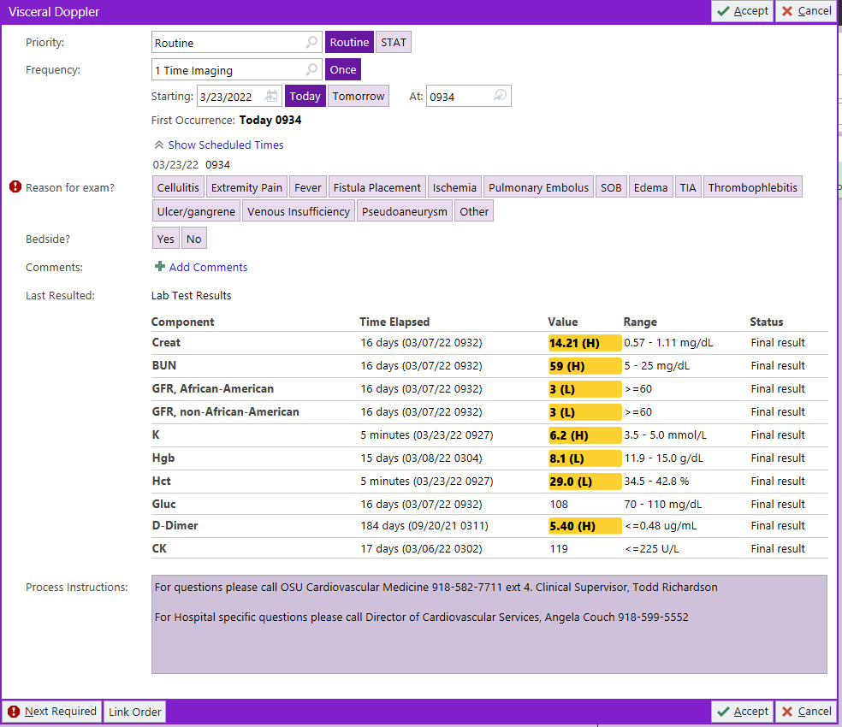

OSU Center for Health Sciences, Department of Emergency Medicine
Ultra-simplification of Ultrasound Scrotum Orders
Alex Hall, DO, PGY3; Faculty Advisors: Charles E. Harris, III, DO; Steven Gearhart, DO
INTRODUCTION
Methods (Cont.)
The order for performing ultrasound imaging of the scrotum and testicles has been problematic for our emergency department since we starting using Epic. This order is used to aid in diagnosis of any conditions in the scrotum or testicles, but it is mainly used in our department to rule out testicular torsion, a surgical emergency. Testicular torsion is a urologic emergency with testicular loss possible without detection within six hours. Ultrasound is the preferred diagnostic method for this condition with a sensitivity of 93% and specificity of 100% (Schick et al., 2022). In order to rule out this condition, visceral doppler is required in the study. For some reason, this order is completely separate from the ultrasound order, and the ultrasound department has to call us to have us modify our orders every time we order this study. Also, “rule out torsion,” is not even an option to select for reason of study when we do order the visceral doppler study.
CURRENT EPIC ORDERS
Next we will make a formal request to consolidate the orders through the “Epic request” link on the Oklahoma State University Medical Center Help Desk website. We will then discuss how these changes will improve day to day operation in the emergency department with the Epic technicians.
We will then inform the emergency department and ultrasound department staff of the order changes in Epic so that they are aware of the new process.
Ultrasound Order
Visceral Doppler: Required Additional Order
CONCLUSION
Left image: The current Epic order for ultrasound of the scrotum and testicles. This does not include the necessary order for visceral doppler, which we would rarely, if ever, have the need to exclude from this study.
Right image: The current Epic order for visceral doppler. It is not included in the ultrasound scrotum order as it should be, and it doesn’t include “rule out torsion” as an option for reason for exam, which is the main reason we typically order this study.
The separation of these orders as well as the communication issues that they have caused has created a longstanding issue that lead to inefficiency and increased the time to obtain time sensitive imaging. Combining the ultrasound scrotum and testicles order with the visceral doppler order as well as adding an option for “rule out torsion” on reason for exam will create a much smoother process to obtaining this imaging quickly. This will relieve current obstructions in the process, improve communications, and help patients get the imaging they need more quickly.
OBJECTIVES
Objectives are to consolidate the Epic orders of ultrasound scrotum and testicles with the order for visceral doppler. This will save time and effort for both the emergency department as well as the ultrasound department. It will also improve communication between the departments and lead to a more efficient process for obtaining timely imaging for potential emergent conditions.
PROPOSED EPIC ORDER CHANGES
REFERENCES
New Ultrasound Order
Schick MA, Sternard BT. Testicular Torsion. [Updated 2022 Jun 21]. In: StatPearls [Internet]. Treasure Island (FL): StatPearls Publishing; 2023 Jan-. Available from: https://www.ncbi.nlm.nih.gov/books/NBK448199/
METHODS
In order to make this change, we will take multiple steps. We will first communicate with the ultrasound department and obtain their support to make this change which will improve both departments.
The new order has been created to open a bundle that automatically includes the visceral Doppler option, and the proper indications will be included in the new order.
ACKNOWLEDGEMENTS
1. Kelly Murray is the greatest and most awesome Resident Research Director in all the land and without her I wouldn’t get to follow my dreams of being an EM physician.
2. Heidi Holmes, Director of Health Information Technology at Oklahoma State University Medical Center

