Slide 1

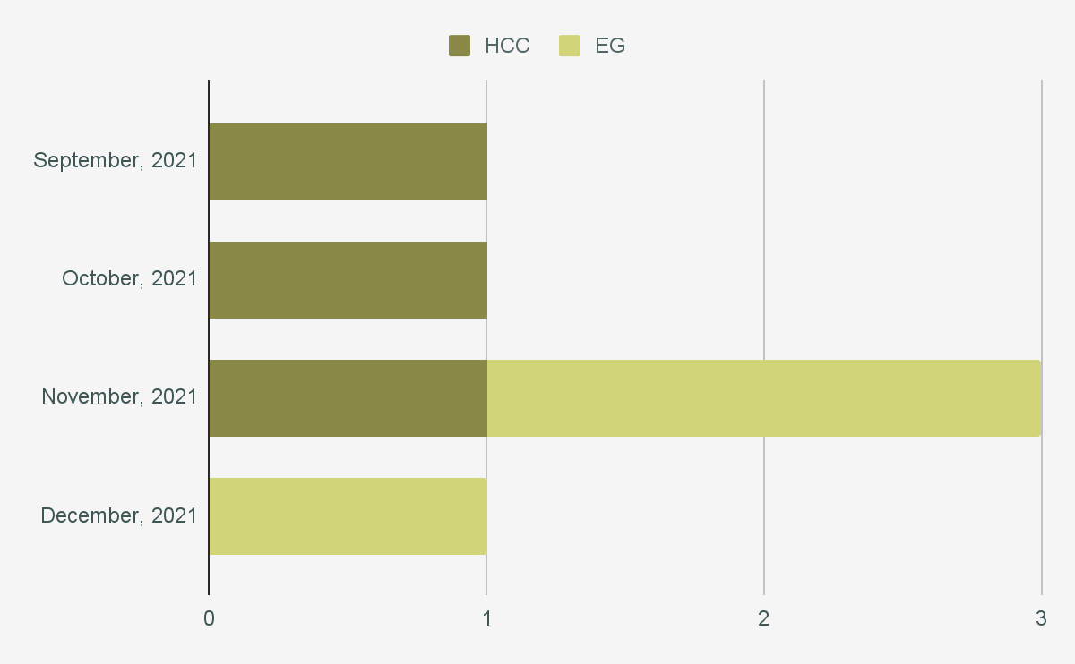
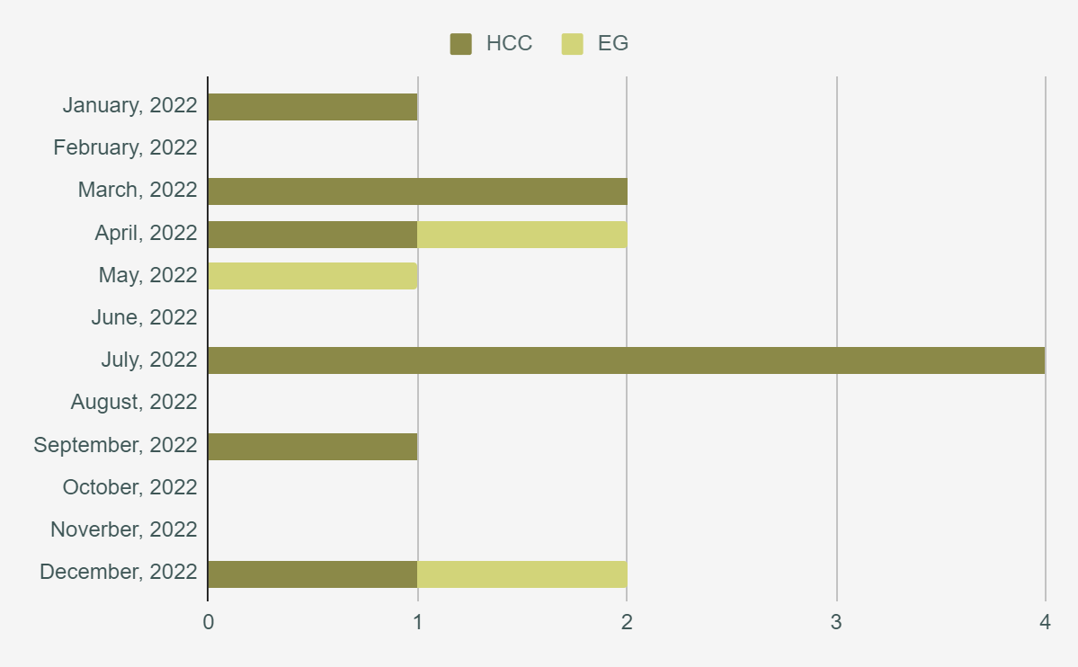


DEPARTMENT OF FAMILY MEDICINE
Implementation of HIV Preexposure Prophylaxis in a Primary Care Setting
Authors: Thomas Duffy, DO PGY-2, Mary-Kate Lowe, DO PGY-2, Zac Cockrell, DO, PGY-2, Marcus Capizzano DO, PGY-1
Faculty Advisors: Amanda Carey, DO
INTRODUCTION
RESULTS
CONCLUSION
Pre-exposure prophylaxis (PrEP) with tenofovir disoproxil fumarate and emtricitabine (TDF–FTC) is a safe and very effective method of preventing HIV infection in high-risk populations. TDF–FTC as PrEP is a once-daily pill that reduces the risk of HIV transmission by more than 90%.¹ As more data becomes available regarding PrEP, the recognized benefits of implementing PrEP in high-risk populations continues to accumulate. Not only does PrEP therapy decrease HIV transmission rates but it has also been found to improve surveillance for sexually transmitted infections and even boost access to primary care. Despite these indisputable benefits, PrEP is a considerably underutilized tool in the medical community. Lack of provider knowledge regarding the use of PrEP represents a substantial barrier to improving the use of PrEP in the communities at the highest risk.² The limited number of prescriptions overall that are provided to at-risk populations may be directly related to a lack of provider knowledge about PrEP and discomfort with prescribing PrEP.³ Ultimately primary care providers have limited knowledge about HIV PrEP and HIV testing, and report lack of provider training as the main barrier to PrEP implementation. Provider education is needed to ensure that our high-risk populations have access to comprehensive HIV prevention methods.
PrEP is essential for HIV prevention and is severely underutilized in high-risk populations. Our initial QI initiative identified awareness, knowledge, and experience as barriers to PrEP implementation in the OSU Family Medicine clinics. The data collected from September to December 2021 from the OSU Health Care Center clinic and OSU Eastgate Clinic showed that only 6 patients were currently being prescribed PrEP therapy. After gathering surveys from the providers, it was determined that the providers’ lack of knowledge of prescribing PrEP was one of the main barriers to implementation in this setting. After a traditional lecture regarding HIV prevention and initiating PrEP therapy was given, placed over a 12 month period. This accounts for an increase in total patients in our census on PrEP, but of 28% fewer prescriptions per month. Primary care providers’ lack of experience with PrEP is resulting in missed HIV prevention opportunities. As primary care physicians we develop strong and trusting with our patients, and therefore foster an environment that makes our patients feel comfortable discussing sexual health and other more sensitive risk behaviors.⁴ Because of this we have a unique opportunity to more quickly identify PrEP candidates and ultimately improve access to PrEP therapy. This follow-up project serves as a reminder for continued education in HIV prevention. The goal is to continue to address provider knowledge deficits and ultimately increase prescribing of PrEP by primary care providers. This project will continue to next year with a goal of initiation of PrEP therapy in 10% of eligible patients not already on PrEP by next year.
Figure 1: Initial In-Clinic PrEP Prescription
OBJECTIVES
Displayed are the two datasets collected in the course of our project. Figure 1 shows monthly instances of PrEP encounters across the two clinic sites, Health Care Center (HCC) and Eastgate (EG). These numbers were collected in the four months of data available prior to initiation of educational training on PrEP therapy. Figure 2 shows the monthly instances of unique PrEP patients presenting across the two clinic sites, Health Care Center (HCC) and Eastgate (EG) over the year of 2022.
This follow-up QI project focuses on identifying barriers to PrEP implementation in the OSU Family Medicine clinics with the goal of developing a system to overcome these barriers and improve access to PrEP in eligible patients.
REFERENCES
Drabo EF, Hay JW, Vardavas R, Wagner ZR, Sood N. A cost-effectiveness analysis of preexposure prophylaxis for the prevention of HIV among Los Angeles County men who have sex with men. Clin Infect Dis 2016;63:1495-1504.
R.H. Goldstein, C.G. Streed, S. Cahill. Being PrEPared-preexposure prophylaxis and HIV disparities. N Engl J Med, 379 (14) (2018), pp. 1293-1295
Sybil Hosek, Lisa Henry-Reid. (2020) PrEP and Adolescents: The Role of Providers in Ending the AIDS Epidemic. Pediatrics 145:1.
Gregg E, Linn C, Nace E, Gelberg L, Cowan B, & Fulcher JA (2020). Implementation of HIV preexposure prophylaxis in a homeless primary care setting at the Veterans Affairs. Journal of Primary Care & Community Health, 11, 2510132720908370.
METHODS
Initial prescription data was collected via inquiry to the medical records department. A request was placed for instances of orders placed for either Descovy or Truvada initially between 9/1/2021 and 12/31/2021 and as a follow-up between 1/1/2022 and 12/31/2023. Data was collected across two OSU/OMECO Family Medicine continuity clinics, the Health Care Center and Eastgate. The second set of data was following collected following an educational training on PrEP was given at the OSU/OMECO Resident Didactics. This educational training included a traditional lecture which can be found by using the adjacent QR code. Six learning objectives focused on Drug Names, Sexual Criteria, IV Drug Abuse Criteria, Baseline Labs, Follow-up
Frequency, and Contraindications.
ACKNOWLEDGEMENTS
OSU and OMECO Family Medicine Residency program
Figure 2: In-Clinic PrEP Prescription Post-training

