Slide 1
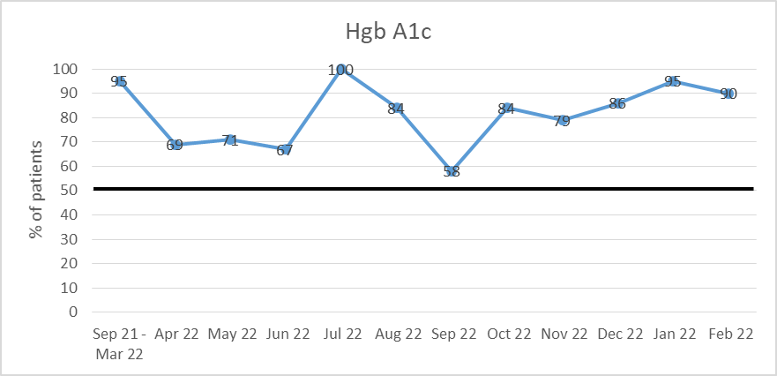
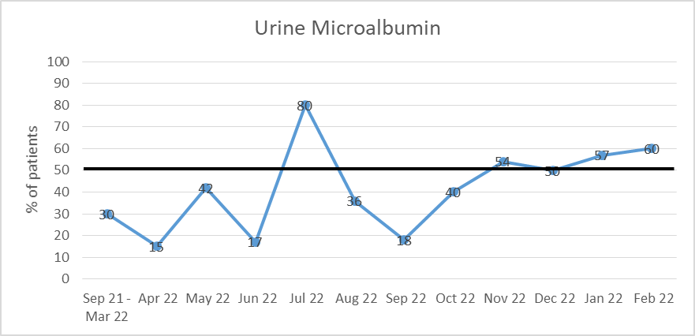
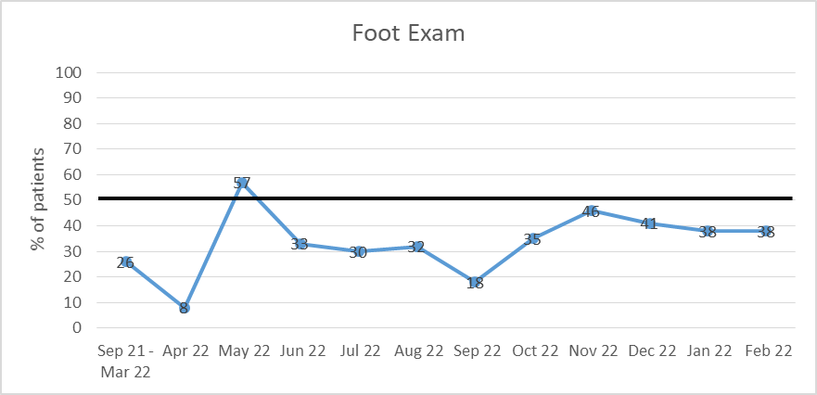
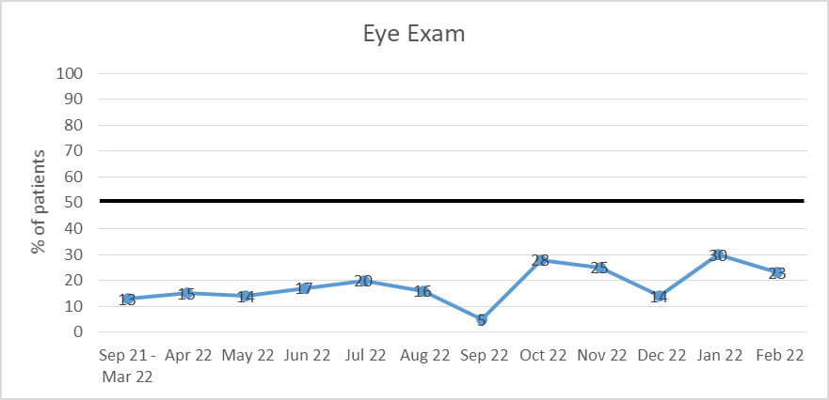
OMECO/Internal Medicine – Tahlequah
Improving Outpatient Diabetic Management Through EHR-based Quality Measure Tracking
Stephen Bastible, DO, PGY-2, Blair Brown, DO, PGY-2, Noor-Mah Khan, MD, PGY-1, Xuanchinh Tran, DO, PGY-3 Faculty Advisor: Kelly Marak, DO
INTRODUCTION
Type II Diabetes Mellitus is the 8th leading cause of death in Oklahoma.¹ The conditions associated with DM2 are especially detrimental in populations of those in certain indigenous communities and low income, rural populations within Oklahoma. End Organs like the eyes, vasculature, and kidneys are particularly vulnerable to damage from persistently uncontrolled serum glucose levels. Eye exams are important to screen for diabetic retinopathy. Randomized controlled trials demonstrate that in those with diabetic retinopathy, early treatment can reduce the risk of significant visual loss by 57%.² Likewise, urine microalbumin is known to be a predictor of diabetic nephropathy ³; early detection and treatment is important to prevent development or progression of chronic kidney disease. For each 1% elevation above threshold (7% for macrovascular and 6.5% for microvascular), the risk of an adverse event increase by 38% for macrovascular and 40% for microvascular.⁴ The Centers for Medicare and Medicaid Services have made annual eye exams, diabetic foot exams, and urine micro albumin screenings quality measures due to their important role in reducing morbidity associated with T2DM. Our IM Residency clinic, based in rural Oklahoma, could benefit by assuring the patients be offered and receive all required screenings.
OBJECTIVES
To increase identification of diabetic complications and prevent disease progression in the NHS IM resident clinic patient population by increasing rates of routine testing for diabetic foot exam, eye exam, and urine microalbumin to a minimum of 50% per national average of Internal Medicine clinics.
METHODS
Current ADA guidelines were presented to the NHS IM residents to educate and review evidence based data. Residents were instructed on the appropriate use of Cerner Health Maintenance feature to track A1c, urine microalbumin, eye exams, and diabetic foot exam completion dates. This presentation has been repeated annually. With the aid of reports generated from the Clinical IT department, patients with a diagnosis of DM were manually reviewed to determine the percent of patients each month who had appropriately documented HbA1c, urine microalbumin, monofilament foot exam, and diabetic eye exam using the Health Maintenance tab. A dot phrase was created and placed in the dictation room to help remind resident physicians to document in the Health Maintenance tab in addition to medical documentation. Pertinent data was collected from September 2021 to March 2022.
RESULTS
Compliance with HbA1c screening maintained above goal for 11 months.
For urine microalbumin screening, consistent improvement above our goal realized for the past 4 months.
For diabetic foot and eye exams, compliance has improved but has not reached goal.
CONCLUSIONS
This study is ongoing and will continue until we meet our goal for a total of 6 consecutive months. We have maintained our success for HbA1c and have met our goal for urine microalbumin for the last 4 months. Compliance with eye exam and foot exam has improved over the past 11 months but has not been significant enough to meet the national average. Accurate and trackable data is crucial in following patient outcomes. Use of the Health Maintenance tab to track diabetic screening exams has increased since the initiation of this project, however, with better user interface and regular physician/staff EMR training, monitoring can definitely be improved. Lack of documentation is likely multifactorial but may be due to non-optimal functionality of the health maintenance tab. The tab is not found in the more accessible Provider Workflow and hence, the recommended screenings must be manually added for each diabetic patient. The recommendations do not auto-populate for patients with an associated T2DM diagnosis. On the other hand, the use of the EHR-based Health Maintenance tab with recurring education has improved outpatient diabetic care by increasing documentation of the microvascular effects of T2DM. Multiple confounding factors, including a change of the Health Maintenance tab to Recommendations tab has played a role in sub-optimal use of the data. Due to these factors, there is room for progress. The lack of medical assistants to help with examinations has played a significant role in below par results. The IM clinic welcomed a new dedicated permanent attending this past fall. This added variability in T2DM diagnosis criteria. Resident Physicians may benefit from education regarding the 1) location and use of disposable monofilament packs in the clinic, 2) review of diabetic foot examination, and 3) locations for eye exam referrals. During our project, we were unable to recruit sufficient medical aides to help identify patients in need of screening and help streamline an efficient process for resident physician workflow. During the implementation of our interventions, we were unable to find an effective way to increase eye exam screening documentation. The eye exam requires patients to see an outside provider. Despite efforts to streamline referral to optometry clinics, there was only minimal improvement in data tracking for eye exams. With better understanding of the EMR hand in hand with physician education regarding EMR use and a collaborative workflow in the IM clinic, better tracking, documentation and streamlining is an achievable goal. We hope to continue to optimize the process and reach the national average goal as a result.
FUTURE RECOMMENDATIONS
Cooperative inter-departmental work with Clinical IT to have HbA1c, urine microalbumin, foot exam, and eye exam auto populate on the health maintenance tab for any patient with an established or new Diabetes Mellitus diagnosis.
More efficient and collaborative division of labour among IM clinic nursing staff and medical aides to notify resident physicians regarding diabetic patients without documented screening exams.
Continue to educate resident physicians regarding the appropriate use of the Recommendations tab (formerly known as Health Maintenance) and pertinent dot phrases.
RESULTS
REFERENCES
1. Oklahoma State Department of Health. 2023 Oklahoma Diabetes Prevention Report. Center for Chronic Disease Prevention. Published 2023. Accessed April 29, 2023. https://oklahoma.gov/content/dam/ok/en/health/health2/aem-documents/health-promotion/center-for-chronic-disease-prevention---health-promotion/2023%20Oklahoma%20Diabetes%20Prevention%20Report.pdf
2. Ting DS, Cheung GC, Wong TY. Diabetic retinopathy: global prevalence, major risk factors, screening practices and public health challenges: a review. Clin Exp Ophthalmol. 2016;44(4):260-277. doi:10.1111/ceo.12696
3. Rowe DJ, Dawnay A, Watts GF. Microalbuminuria in diabetes mellitus: review and recommendations for the measurement of albumin in urine. Ann Clin Biochem. 1990;27 ( Pt 4):297-312. doi:10.1177/000456329002700404
4. Zoungas S, Chalmers J, Ninomiya T, et al. Association of HbA1c levels with vascular complications and death in patients with type 2 diabetes: evidence of glycaemic thresholds. Diabetologia. 2012;55(3):636-643. doi:10.1007/s00125-011-2404-1

