Slide 1
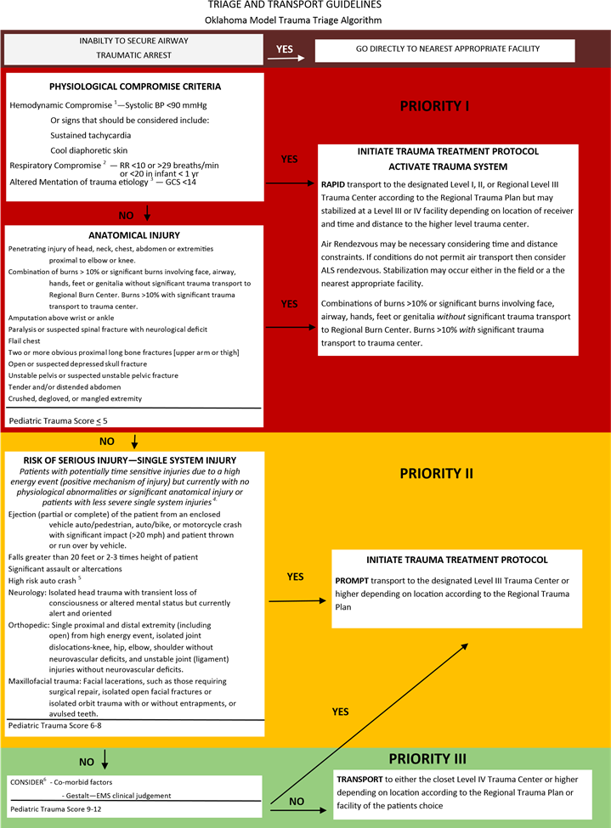
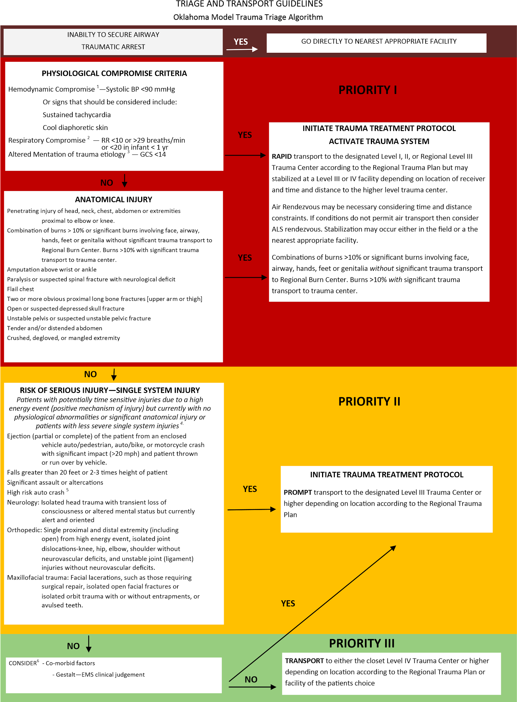
Accuracy of Prehospital Trauma Scoring by EMS in a Rural Community Hospital Setting: A Retrospective Analysis
Ethan Jernigan D.O. (PGY3), Colin Bumann D.O. (PGY3), April Kim D.O. (PGY3), Jordan Price D.O. (PGY3), Kennan Richards D.O. (PGY3), Shelby Willis D.O. (PGY3), David Behm, D.O (Faculty Advisor)
Oklahoma State University-Comanche County Memorial Hospital, Emergency Medicine Residency
Objective
Methods
EMS Trauma Scores compared to OPTTG scoring
EMS Trauma Score | OPTTG Trauma Score
 |  | 1 | 2 | 3
 | 1 | 126 | 25 | 48
 | 2 | 62 | 216 | 41
 | 3 | 138 | 347 | 1177
 | Percent of Agreement | 38.7% | 36.7% | 93%
The purpose of this study is to analyze the accuracy of prehospital trauma scoring by EMS providers based on Oklahoma’s Prehospital Triage and Transport Guidelines (OPTTG).
Retrospective chart review was performed to determine trauma priority scores based on OPTTG (as seen below) when reviewing emergency department records compared to trauma priority scores documented by prehospital EMS. Preliminary data was collected between January 1st, 2017 and December 31, 2019. Methodology and data extraction points such as time of day, level of medic, gender, EMS agency, mechanism of injury were predetermined. Chart review and data entry were performed by two physicians in an attempt to further decrease bias and increase validity.⁵ Data was analyzed for statistical relationship using Spearman Correlation. Correction for chance in data points was addressed with Kappa scoring.
Of the 547 patients that were undertriaged, failure to account for age, anticoagulation use, altered mental status and hemodynamic compromise were the most commonly missed elements by EMS
Abstract
The ultimate goal of trauma systems is to match the needs of the injured patient to the closest hospital with the capability of providing definitive care in the most appropriate timeframe. The purpose of this study is to analyze the accuracy of prehospital trauma scoring by EMS providers based on OPTTG in order to identify inaccuracies and improve patient care. Our hypothesis is that at some rate EMS inaccurately triage trauma patients when compared to state guidelines.
A retrospective chart review compared Comanche County Memorial Hospital (CCMH) EMS run reports to OPTTG. Data was extracted from EMS reports January 1, 2017 through December 31, 2019 to determine priority of trauma triage. Two physicians performed chart review and data entry to decrease uncertainty and bias.⁴ Data was analyzed using Spearman correlation. Kappa scoring was used to decrease chance and increase validity.
Preliminary data review consisted of 2,180 trauma charts that included both a trauma score reported by EMS and a trauma score calculated after review of emergency department records. The most common inaccuracy was undertriage of priority 1 and 2 trauma patients. Failure to recognize comorbidities of age, concurrent anticoagulation use, altered mental status and hemodynamic compromise were the most common causes of inaccuracy.
Overall, 25.1% of patients were undertriaged, which is greater than the acceptable rate (5%) as published by the American College of Surgeons Committee on Trauma (ACSCOT).¹ We believe this can be improved with further education of EMS providers to avoid undertriage of trauma, particularly priority 1 and 2 trauma patients.
Conclusions
The greatest agreement between EMS and OPTTG trauma scoring occurred among priority 3 with 93% agreement.
The greatest inaccuracy in EMS trauma scoring occurred when there was a failure to recognize priority 2 resulting in only 36.7% accuracy. Most commonly overlooked elements included comorbidities of age, anticoagulation use, and transient altered mental status.
Only 38.7% of the time did EMS correctly recognize a priority 1 patient, presumably the most critical of all patients
Overall, 25.1% of the patients were undertriaged and 5.2% of the patients were overtriaged, both of which do not meet standards for trauma triage by ACSCOT.¹
Based on our data, further education may be needed for EMS providers to avoid inaccurate priority scoring of trauma patients.
Further studies may be needed to identify inaccuracies in other geographic locations
References
American College of Surgeons Committee on Trauma. Resources for optimal care of the injured patient, Chapter 3; 2014; 23-9.
Center for Disease Control Publications, 2004-2006.
Garwe T, Stewart K, Stoner JA, et al. Out-of-hospital and Inter-hospital Under-triage to Designated Tertiary Trauma Centers among Injured Older Adults: A 10-year Statewide Geospatial-Adjusted Analysis. Prehospital Emergency Care. 2017;21(6):734-743. doi:10.1080/10903127.2017.1332123.
James MK, Clarke LA, Simpson RM, et al. Accuracy of pre-hospital trauma notification calls. The American Journal of Emergency Medicine. 2018;37(4):620-626. doi:10.1016/j.ajem.2018.06.058.
Kaji AH, Schriger D, Green S. Looking Through the Retrospectoscope: Reducing Bias in Emergency Medicine Chart Review Studies. Annals of Emergency Medicine. 2014;64(3):292-298. doi:10.1016/j.annemergmed.2014.03.025.
Kerby JD, Maclennan PA, Burton JN, McGwin G, Rue LW. Agreement Between Prehospital and Emergency Department Glasgow Coma Scores. The Journal of Trauma: Injury, Infection, and Critical Care. 2007;63(5):1026-1031. doi:10.1097/ta.0b013e318157d9e8.
Nishijima DK, Gaona SD, Waechter T, et al. Out-of-Hospital Triage of Older Adults With Head Injury: A Retrospective Study of the Effect of Adding “Anticoagulation or Antiplatelet Medication Use” as a Criterion. Annals of Emergency Medicine. 2017;70(2):127-138. doi:10.1016/j.annemergmed.2016.12.018.
Peng J, Xiang H. Trauma undertriage and overtriage rates: are we using the wrong formulas? The American Journal of Emergency Medicine. 2016;34(11):2191-2192. doi:10.1016/j.ajem.2016.08.061.
Background
Pediatric Oklahoma Priority Triage and Transport Guidelines
Adult Oklahoma Priority Triage and Transport Guidelines
Unintentional injuries remain the leading cause of death among children and adults ages 1-44 and cost an estimated $177 billion per year in the United States.² The ultimate goal of trauma systems is to match the needs of the injured patient to the closest hospital with the capability to provide definitive care, in the most appropriate timeframe. More specifically, trauma triage priority scoring is a critical component for deciding transport destination.
Oklahoma is divided into eight trauma regions. Comanche County Memorial Hospital is located in the southwestern part of the state. It is located in trauma region 3, serving a current population of approximately 400,000. There are more than a dozen EMS services delivering more than 100 trauma patients per month to Comanche County Memorial Hospital.
ACSCOT has published acceptable rates for overtriage and undertriage of 25-35% and <5% respectively.¹ Our project sought to compare our rates of overtriage and undertriage with ACSCOT standards.
Results
Our preliminary data consisted of 2,180 trauma patient charts. When the study is complete, we anticipate n=3,600.
The most common mechanisms of injury were less than “great fall” (56%) and MVC (17%) based on updated data.
The overall percent agreement for priority 3 trauma 93%, priority 2 trauma was 36.7% and priority 1 trauma was 38.7%.
Of the 547 total patients that were undertriaged, failure to account for age, anticoagulation use, altered mental status and hemodynamic compromise were the most commonly missed elements by EMS.
The highest level of disagreement was due to undertriage of priority 2 traumas.
Acknowledgement
Thank you to the Emergency Systems of the Oklahoma Department of Health for their support and collaboration.

