Slide 1

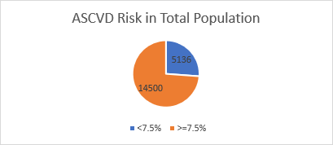
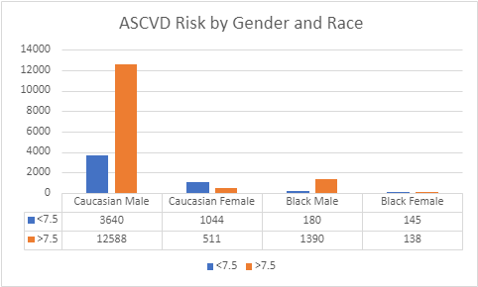
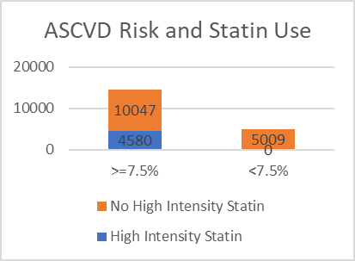
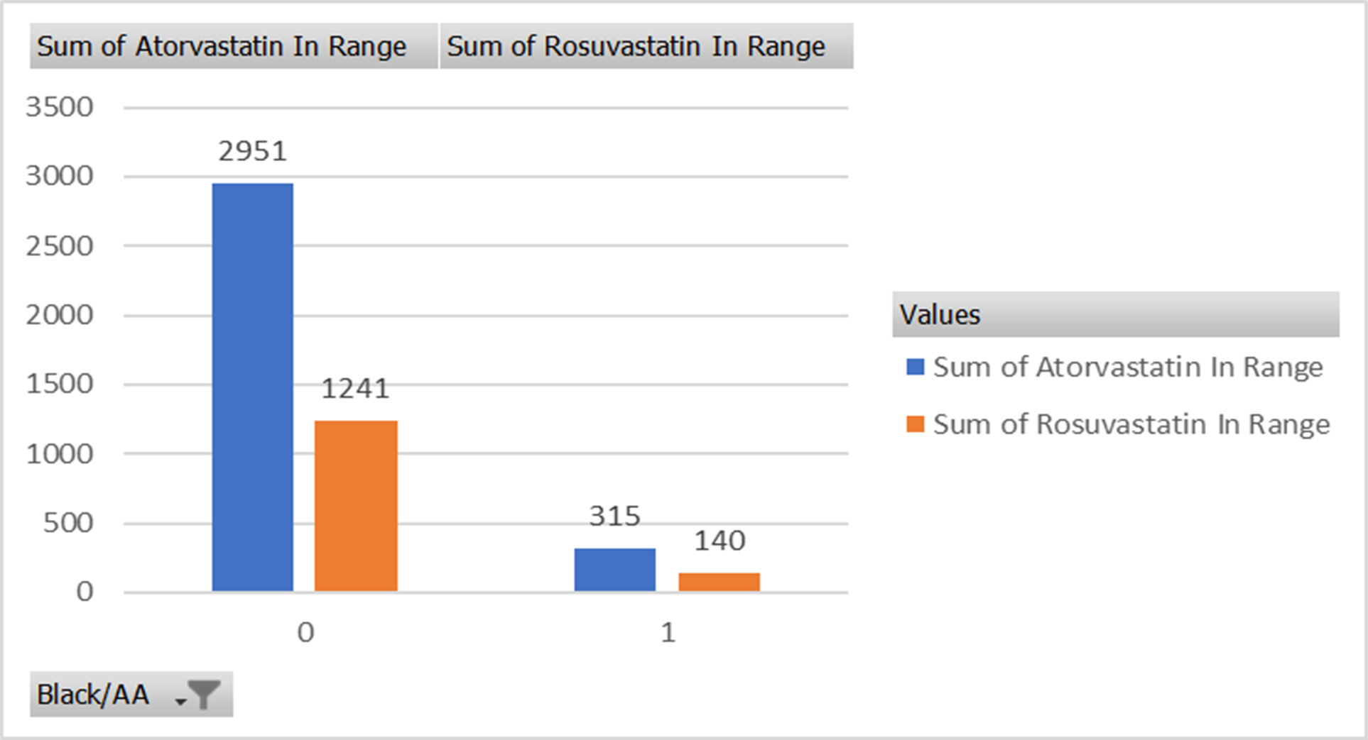

Oklahoma State University Medical Center Internal Medicine
ASCVD Risk and Statin Prescribing Practices among VA Physicians:
A Primer On Improving Clinical Care
Jonathan Gaikwad D.O., River Smith Ph.D., Chao Li Ph.D
INTRODUCTION
STATINS & ASCVD
RESULTS
Cardiovascular disease is currently the leading cause of death in the United States of America. Though most people think of cardiovascular disease as just affecting the heart, cardiovascular disease is somewhat of an umbrella term that can refer to a number of conditions that affect both coronary as well as peripheral vasculature. Coronary artery disease is the most common cause of heart disease in the United States. Coronary artery disease is a result of plaque buildup within the arteries surrounding and supplying the heart muscle. The main component of these plaques is cholesterol which can rupture and cause heart attacks.
There are many factors that put a particular patient at an increased risk for coronary artery disease, more specifically atherosclerotic coronary artery disease. Such factors include but are not limited to age, weight, hypertension, hyperlipidemia, diabetes mellitus, and various lifestyle factors such as smoking and sedentary lifestyle.
The purpose of this quality improvement project is to evaluate the ASCVD risk and statin use in this population with the intention of providing data driven feedback to providers to improve overall implementation of high intensity statins to reduce morbidity and mortality overtime.
Statins which are class of medication that can help reduce cholesterol and thereby reduce the atherosclerotic burden have been shown to reduce cardiovascular morbidity mortality in patients with an atherosclerotic cardiovascular disease score of above 7.5%. . Statins lower the low-density lipoprotein cholesterol, stabilize any current atherosclerotic plaques, and they have also been shown to have an anti-inflammatory property as well. The ASCVD risk algorithm is a calculator that is used to determine the 10 your risk of heart disease or stroke and provides recommendations based on many factors if high intensity statin (Atorvastatin or Rosuvastatin) use is recommended.
The ASCVD score identifies patients who would benefit from statin therapy. The risk score considered the patients age specifically considering those between the ages of 45-75, presence of diabetes mellitus, sex, smoking status, total cholesterol, HDL cholesterol, systolic blood pressure, treatment for hypertension, and race.
A total of 19,636 unique Veterans were identified from VHA health records who had received treatment in the past year.
9.3% of the total sample were female. 9.4% were identified as African American.
Nearly 74% of the population in study had an ASCVD score >7.5%
Of those with ASCVD scores above 7.5% only 31.3% were on a high intensity statin.
There does not seen to be a discrepancy in statin prescribing practices among different races.
There were no veterans with an ASCVD under 7.5% inappropriately placed on a high intensity statin.
AIM 1: How many Veterans in the sample had an ASCVD score of 7.5 or higher?
N= 14,500 (73.8%)
AIMS 3: How do statin prescribing practices differ
based on race/ethnicity?
24.5% of AA in the sample were prescribed a high intensity statin.
23.% of Caucasian/Others in the sample were prescribed high intensity statins.
CONCLUSION
It is difficult to say how the population in this specific population compares to the general American population in regard to ASCVD as data is limited.
While a significant percentage of the population with high ASCVD risk are being targeted for high intensity statins at the VA, there is some work to be done.
Next steps
Present these findings back to the primary care physicians to track statin prescribing trends over time.
Limitations:
Retrospective look at EHR data, cross sectional in nature
No inferential statistics used, will be important to look for statistical significance in the future.
Would be helpful to look across more racial groups
Limited antihypertensives utilized
OBJECTIVES
Aim 2: How many Veterans with a risk score of 7.5% or higher were on a high intensity statin? N= 4580 (31.3%)
1. Identify unique veterans with an ASCVD score 7.5% within the past year
2. Identify which veterans are on appropriate statin therapy
3. Identify if there are healthcare disparities in statin prescription based on ethnicity
REFERENCES
https://www.heart.org/en/health-topics/consumer-healthcare/what-is-cardiovascular-disease
https://www.cdc.gov/heartdisease/coronary_ad.htm#:~:text=Coronary%20artery%20disease%20is%20caused,This%20process%20is%20called%20atherosclerosis.
https://www.mayoclinic.org/diseases-conditions/arteriosclerosis-atherosclerosis/symptoms-causes/syc-20350569
https://www.ncbi.nlm.nih.gov/pmc/articles/PMC3582048/
https://www.ncbi.nlm.nih.gov/pmc/articles/PMC5126440/#:~:text=Statin%20therapy%20has%20been%20shown,levels%20(5%2D10%25).
https://www.uptodate.com/contents/calculator-cardiovascular-risk-assessment-in-adults-10-year-acc-aha-2013-conventional-and-si-units?topicRef=1546&source=related_link
https://www.ahajournals.org/doi/epub/10.1161/01.cir.0000437741.48606.98
https://www.va.gov/QUALITYOFCARE/initiatives/compare/Statin_Therapy_for_cardiovascular_disease.asp
https://www.healthquality.va.gov/guidelines/CD/lipids/DyslipidemiaFAQForProviderFINAL28Dec2020.pdf
METHODS
Data was extrapolated from the Eastern Oklahoma VA Healthcare system based on patients with diagnosis and demographic characteristics consistent with the ASCVD risk algorithm.
Once this patient data was collected individual ASCVD scores were calculated for each patient using the ACC/AHA 2013 ASCVD risk algorithm.
Patient data required for ASCVD calculation include age (ASCVD risk only considers those between the ages of 45 and 75), presence of diabetes mellitus, sex, smoker status, total cholesterol, HDL cholesterol, systolic blood pressure, treatment for hypertension, and race (particularly whether African American or other).
ACKNOWLEDGEMENTS
This study was part of a QI project using VA operations data. The conclusions are based on the opinions of the author and not the VA.

