Slide 1


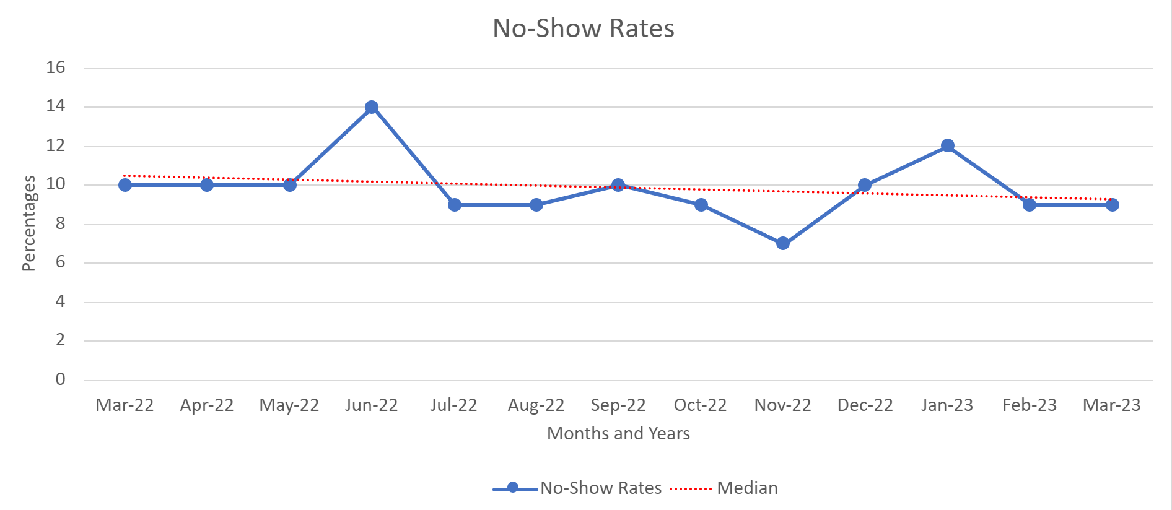
Reducing No-Show Rates and Improving Continuity of Care by Prescheduling Appointments
for Mental Health Patients
Henry Gutierrez, D.O., PGY2
Faculty Mentor: Eric Gillette, D.O.
Choctaw Nation Family Medicine Residency
BACKGROUND
RESULTS
NEXT STEPS
No-show appointments are a common occurrence within all health care systems.¹ They negatively impact continuity of care as well as overall health outcomes.² Unfortunately, no-show appointments are more common among patients being treated for mental health conditions.^{3,5} A 2018 systematic study¹ showed the median no-show rate for psychiatric/mental health was about 22% with rates being as high as nearly 60%. In the primary care setting, general rates for no-show were about 17% with a maximum of nearly 50%. Studies demonstrate that the scheduling process plays a role in mitigating no-shows.^{4,6} A presumed reason for no-shows within our mental health patient population at the Family Medicine Resident Clinic and Choctaw Nation in Talihina, OK was that we were unable to schedule follow-up appointments for the patient before they left the clinic (preschedule). This is because we did not have the schedule created far enough in advance to unlock appointments in the Electronic Health Record (EHR). Attempting to contact the patient after they had already left the clinic was unreliable and limited our ability to utilize automized phone-call and email reminders.
Average No-Show Rate Percentage by Month in Resident Clinic
While there was a nominal reduction in no-show rates from 10.3% to 9.4%, and while we did briefly accomplish our aim of a 30% no-show reduction in the month of November, continued analysis is still warranted to ascertain the concrete efficacy of prescheduling mental health appointments to reduce no-show rates. After identifying key variables that impacted our outcomes, we plan to construct a project design that will account for these variables by communicating more purposefully with our clinical staff about the goals and design of our project. Additionally, we may need to consider expanding our study to a full calendar year to eliminate the biases that holidays and weather create within a 6-month period. With new staff and a new Chief Resident in charge of our scheduling process starting July 2023, we hope to have a design ready for proper implementation with the continued aim of reducing no-show rates and improving the care we provide to our patients.
Project Implementation
REFERENCES
AIM STATEMENT
Dantas LF, Fleck JL, Cyrino Oliveira FL, Hamacher S. No-shows in appointment scheduling – a systematic literature review. Health Policy. 2018;122(4):412-421. doi:10.1016/j.healthpol.2018.02.002
Marbouh D, Khaleel I, Al Shanqiti K, Al Tamimi M, Simsekler MCE, Ellahham S, Alibazoglu D, Alibazoglu H. Evaluating the Impact of Patient No-Shows on Service Quality. Risk Manag Healthc Policy. 2020 Jun 4;13:509-517. doi: 10.2147/RMHP.S232114. PMID: 32581613; PMCID: PMC7280239.
Van Dieren, Q., Rijckmans, M. J. N., Mathijssen, J. J. P., Lobbestael, J., & Arntz, A. R. (2013). Reducing no-show behavior at a community mental health center. Journal of Community Psychology, 41(7), 844–850. 10.1002/jcop.21577.
Glowacka KJ, Henry RM, May JH. A hybrid data mining/simulation approach for modelling outpatient no-shows in clinic scheduling. J Oper Res Soc. 2009;60(8):1056–1068. doi: 10.1057/jors.2008.177
Barron WM. Failed appointments. Who misses them, why they are missed, and what can be done. Prim Care. 1980 Dec;7(4):563-74. PMID: 7010402.
Saine PJ, Baker SM. What is the best way to schedule patient follow-up appointments? Jt Comm J Qual Saf. 2003 Jun;29(6):309-15. doi: 10.1016/s1549-3741(03)29035-3. PMID: 14564749.
Within 6 months of project implementation, our aim was to decrease the no-show rate for patients being seen for mental health conditions at the Choctaw Nation Family Medicine Resident Clinic by 30%.
The average baseline no-show rate in our clinic 6 months prior to project implementation was 10.3%
Project implementation occurred September 2022
We achieved a clinic record 7% no-show rate in November 2022
The average no-show rate 6 months after project implementation was found to be 9.4%
While there was a minimal decrease in no-show rates after project implementation, we did not accomplish our aim of a 30% reduction and the results were statistically insignificant with a p-value >0.05%
METHODS
To allow for effective prescheduling of mental health follow-up appointments, we needed to ensure that the clinic schedule was created and unlocked in the EHR at least 3 months in advance to allow adequate time for follow-up visits.
Starting in September 2022 (project implementation date), the Chief Resident ensured that the clinic schedule was complete and given to the unit manager at least 3 months in advance so that the schedule could be unlocked.
We then started prescheduling follow-up appointments for our mental health patients before they left the clinic the day of their current visit.
We compared the no-show rates of the 6 months prior to project implementation (no prescheduling) to the no-show rates of the 6 months after project implementations (with prescheduling).
CONCLUSIONS
Based on the data we obtained we did not find there to be a significant reduction in no-show rates by prescheduling appointments for mental health patients. However, there were many variables that could explain the unexpected outcomes and there were flaws with the project design and execution that we identified late in the process. Three important considerations were:
Even though we ensured the clinic schedule was created and given to the unit manager at least 3 months in advance, we learned that the schedule was not always unlocked in the EHR, thus disallowing regular prescheduling for mental health patients. Often the schedule was only unlocked in the EHR 4-6 weeks in advance. This occurred late in project implementation.
Early in project implementation, the schedule was unlocked 3 months in advance, which could explain why we initially saw a decline in no-show rates in October and November.
Despite this slight decline and reaching a 7% no-show rate in November 2022, we quickly saw increases in no-show rates to 10% in December and 12% in January. We noted that in December patients were more likely to no-show appointments around the Christmas holiday; and in January there was significant weather involving snow and severe ice for several weeks that prevented patients from accessing the clinic and presenting to their scheduled appointments.

