Slide 1
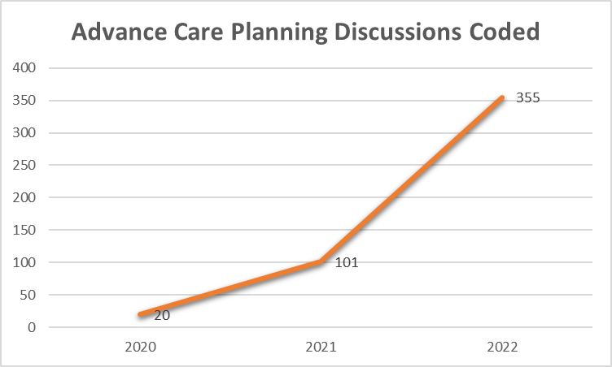
Increasing Advance Care Planning: A Follow-Up on Previous Quality Improvement Measures
Patrick McIntosh, D.O., PGY-2, Daniel Stacy, D.O., PGY-2, Henry Gutierrez, D.O., PGY2
Faculty Mentors: Ashton B. Clayborn, D.O. and Eric Gillette, D.O.
Choctaw Nation Family Medicine Residency
Previous Access Icon Initiative
CONCLUSIONS
Prior to implementation of the access icon, users had to search through a list of scanned documents to determine if an AD was present
Since the project, the icon illuminates red if an AD is scanned
When clicked, the icon displays the date (within 1-2 days) the document was scanned, allowing the user to quickly search the scanned document list
Lack of illumination (grey color) of the icon may also serve as a reminder to complete advance care planning
Efforts to increase the number of ACP discussions held were successful.
There was a nearly 18-fold increase in the number of ACP discussions documented and coded over the three-year period.
Limitations of the project include difficulty in extracting data from the electronic health record necessitating the query for the code 99497 (indicating documented ACP occurred); however, this also reflects dependence upon physician coding and documentation.
INTRODUCTION
We previously reported on mechanisms to address barriers to advance care planning (ACP) and access to advance directives (AD) within our health system.
Over the past three years, two quality improvement projects were completed with aims of increasing discussions on ACP between resident physicians and their patients and to improve access to ADs in our electronic health record system. Prior to these projects, we found it cumbersome to determine if a patient had a scanned directive document on file and to extract the AD for use in end-of-life scenarios that required rapid retrieval. The data presented here reflects three years of follow-up since the quality improvement initiatives began.
OBJECTIVES
The previous quality improvement projects were undertaken with the goal of increasing ACP discussions and improving ease-of-use of our electronic health record to quickly determine if a patient has an advance directive on file and hasten retrieval if the document existed. In addition, we hoped that the access icon created for this purpose will serve as a reminder for physicians to increase documentation of patients’ wishes by encouraging advance care planning. Initial data indicated success; and this data reflects 3 years of follow up.
Follow Up Data
REFERENCES
1. Silveira MJ, Kim SY, Langa KM. Advance directives and outcomes of surrogate decision making before death. N Engl J Med 2010; 362:1211.​
2. Simon J, Porterfield P, Bouchal SR, Heyland D. ‘Not yet’ and ‘Just ask’: barriers and facilitators to advance care planning—a qualitative descriptive study of the perspectives of seriously ill, older patients and their families. BMJ Support Palliat Care. 2015 Mar;5(1):54-62. doi: 10.1136/bmjspcare-2013-000487. Epub 2013 Nov 19.
3. Hayek S, Nieva R, Corrigan F, Zhou A, Mudaliar U, Mays D, Massoomi M, Ilksoy N. End-of-life care planning: improving documentation of advance directives in the outpatient clinic using electronic medical records. J Palliat Med. 2014 Dec;17(12):1348-52. doi: 10.1089/jpm.2013.0684. PMID: 24988497.
4. Payne TH. The electronic health record as a catalyst for quality improvement in patient care. Heart. 2016 Nov 15;102(22):1782-1787. doi: 10.1136/heartjnl-2015-308724. Epub 2016 Aug 8. PMID: 27504000.
METHODS
Initial quality improvement efforts included use of an educational video as a prompt for ACP discussions between physicians and their patients.
The multi-dimensional project included a policy change to ensure that ADs were honored in all clinical settings within our health system.
Next followed conceptualizing and programming an access icon in our electronic health record that secondarily served as a reminder to physicians to assist in ACP and composition of ADs when such documentation was not scanned into the patient’s chart.
Follow up data was collected on the number ACP discussions held by running a query for the code 99497 for each fiscal year in the electronic health record system.

