Slide 1
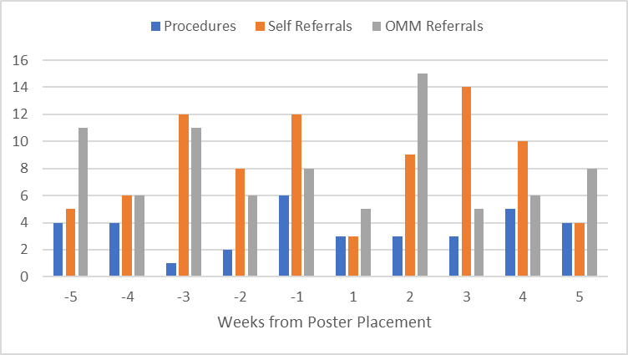
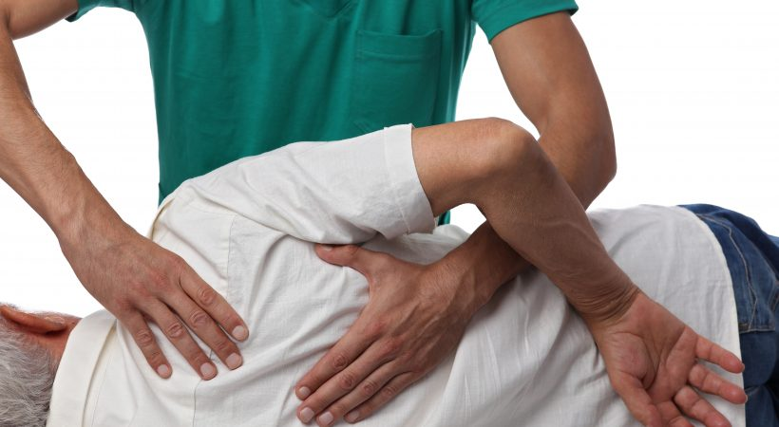
OSU/OMECO Family Medicine
Encouraging Patient Interest in OMM
Mitchel Cruz D.O. PGY-2, Caleb C. Jones, D.O. PGY-2, Mary Kate Lowe, D.O. PGY-2, Philip Ridgway D.O. PGY-2, John Miller D.O (Faculty)
INTRODUCTION
RESULTS
CONCLUSION
Lack of awareness for OMM decreases understanding for possible treatment options for common clinic pathologies. Furthermore, patients may be aware of OMM, but do not have a full understanding of the therapeutic potential for common clinic complaints. Based on experience, few patients know of OMM and even fewer have been treated with OMT. Increasing awareness of the therapeutic potential and understanding of OMM can improve patient satisfaction, quality of life, and prevent unnecessary referrals to specialty. This can also decrease use of pain medication.
Several forms of passive patient education modalities were utilized. The data showed that this did not lead to a statistically significant increase in OMM utilization. Obstacles and limitations in this study include sample size, time of study, patient and provider participation. The data also showed that only approximately 40% of OMM referrals within the OSU Family Medicine clinics lead to an actual OMM procedure being performed. The exact cause of this is something that should be investigated in a future project.
FUTURE GOALS
OBJECTIVES
This is part of a bigger project to increase exposure, awareness, and application of OMM/OMT at OSU Family Medicine clinics. In response to the data, we need to become more active in our approach to encouraging interest in OMM. This could be done by encouraging physicians to use OMM/OMT in every applicable situation as well as give handouts about OMM/OMT after these visits.
The goal of this project is to increase OMM utilization by providing educational materials through multiple media modalities.
METHODS
 | OMM Procedures | OMM Self-Referrals | OMM Clinic Referrals
Pre-Intervention Average | 3.4 | 8.6 | 8.4
Post-Intervention Average | 3.6 | 8.0 | 7.8
P-values | 0.42 | 0.39 | 0.42
Educational materials for patients were provided in the form of pamphlets, posters, and slides on waiting room TVs. Metadata from the EMR was collected to measure OMM referrals and in-office treatments before and after the educational materials were utilized.
ACKNOWLEDGEMENTS
Special thanks to OSU HCC and Eastgate clinics for allowing us to distribute information within the clinics.
Special thanks to Dr. Miller, Mrs. Candice, Biby, and Dr Cotton in helping our team complete this project.
*This data is based on a weekly average over 5 weeks
www.passionatepeople.invacare.eu.com/chiropractor-osteopath-see
*IRB exempt*​

Slide 2
 | Start date | End Date | Week number | Procedures | Self Referals | OMM Referals
 | 2/6/2023 | 2/12/2023 | -5 | 4 | 5 | 11
 | 2/13/2023 | 2/19/2023 | -4 | 4 | 6 | 6
 | 2/20/2023 | 2/26/2023 | -3 | 1 | 12 | 11
 | 2/27/2023 | 3/5/2023 | -2 | 2 | 8 | 6
 | 3/6/2023 | 3/12/2023 | -1 | 6 | 12 | 8
 | 3/13/2023 | 3/19/2023 | 1 | 3 | 3 | 5
 | 3/20/2023 | 3/26/2023 | 2 | 3 | 9 | 15
 | 3/27/2023 | 4/2/2023 | 3 | 3 | 14 | 5
 | 4/3/2023 | 4/9/2023 | 4 | 5 | 10 | 6
 | 4/10/2023 | 4/16/2023 | 5 | 4 | 4 | 8
 | Average pre-posters |  |  | 3.4 | 8.6 | 8.4
 | Average post-posters |  |  | 3.6 | 8 | 7.8
 | P value (1 tail) |  |  | 0.4233216 | 0.39162938 | 0.418970094
 | P value (2 tail) |  |  | 0.8466432 | 0.78325875 | 0.837940187
 | Procedures | Self Referals | OMM Referals
Average pre-posters | 3.4 | 8.6 | 8.4
Average post-posters | 3.6 | 8 | 7.8
P value | 0.42 | 0.39 | 0.42

