Slide 1

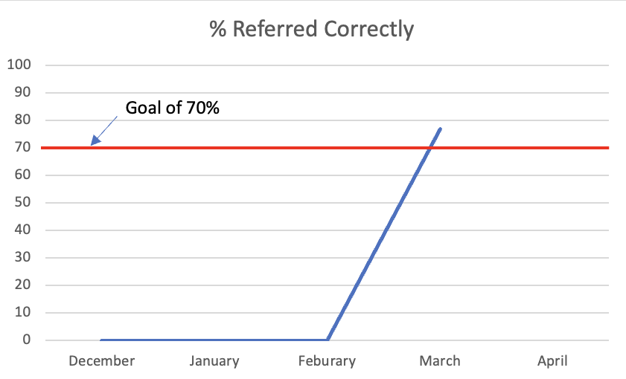
OMECO/Internal Medicine - Tahlequah
Improving Methamphetamine Addiction Resource Center Referral Rates in Rural Oklahoma
Mark Bannon DO PGY2, Paige Sanders DO PGY2, Bryan Butel DO PGY2, Eric Dahlquist DO PGY1, Katherine Mosteller DO
AIM STATEMENT
RESULTS
CONCLUSION
The aim of our project is to refer at least 70% of hospitalized patients with a positive UDS for both amphetamines and methamphetamine to addiction resource center upon discharge from the hospital .
The goal of improving health outcomes in the community may be addressed in part by improving referrals to appropriate resources. This is particularly true in populations that face barriers to receiving aid such as patients who suffer from methamphetamine use disorder.
The purpose of the project was to track and promote the number of referrals over time in order to meet and sustain a preset goal of 70%.
Difficulties in achieving our goal in earlier months were overcome with frequent reeducation and building modules into the EMR. More data is required to determine whether referral rate will be maintained above the goal of 70%.
BACKGROUND
Methamphetamine Use Disorder is a debilitating condition that can lead to consequences for those suffering from it in all aspects of their lives. According to RAND, a nonprofit research institution focusing on public health and policy, the estimated economic burden/cost of methamphetamine use in the US in 2005 was $23.4 billion. RAND estimates that healthcare and intangibles/premature death account for 73% of this annual cost[1]. While there are many barriers to patients seeking treatment, one that is common in rural area is that individuals lack the knowledge of, or access to, the local resource centers. By increasing our hospitals percentage of referrals to ARC for these patients we hope to give them a better opportunity to recover.
Future Recommendations
Fig 1. Hospital Addiction Resource Referrals per Month
1. Track data on established patient follow up visits to Addiction Resource Center per month
2. Expand study to include Tahlequah ER patient population and NHS Sequoyah Hospital
3.Compare referral rate to hospital readmission rate for patients with methamphetamine use disorder
METHODS
An educational module was given to IM physicians on how to refer inpatients with methamphetamine addiction to the local resource center in December 2022. Inclusion criteria includes NHS Tahlequah hospital patients with a positive UDS for methamphetamines and amphetamines to prevent false positives. Exclusion criteria are NHS Sequoyah Hospital or NHS Tahlequah ER patients who were not admitted. A successful referral occurs when both the patient is provided with addiction center contact details upon discharge in the discharge summary and a separate referral is sent containing patient’s contact information to the ARC. Failure to complete both steps resulted in a failed referral.
Month | UDS + Patients | #ARC Info in DC Sum. | #Order to Refer Pl. | Incorrectly referred | %Referred Correctly
December | 1 | 1 | 0 | 1 | 0
January | 12 | 7 | 0 | 12 | 0
February | 6 | 0 | 1 | 6 | 0
March | 13 | 11 | 10 | 3 | 76.92
REFERENCES
https://www.rand.org/pubs/monographs/MG829.html
Fig 2. Addiction Resource Center Referral for Methamphetamine Use per Month
ACKNOWLEDGEMENTS
Thank you, NHS Tahlequah, for funding and supporting the project.

