Slide 1

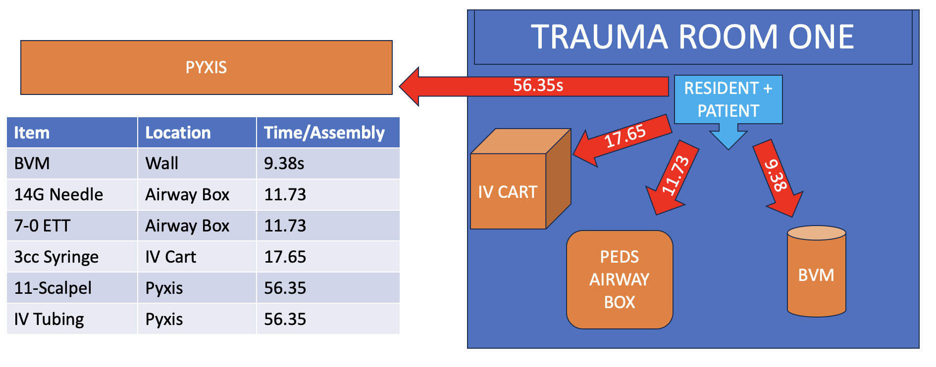
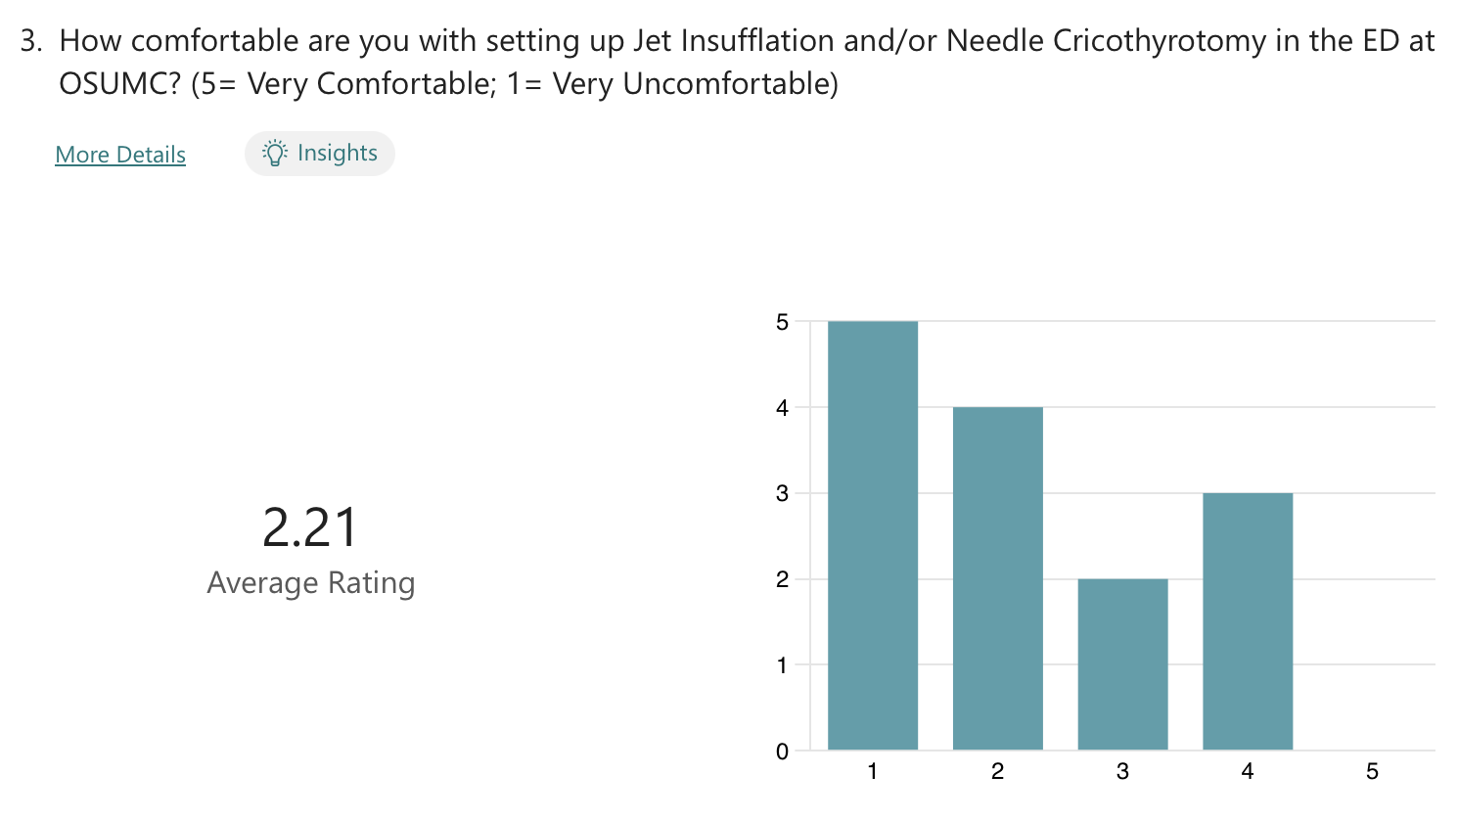
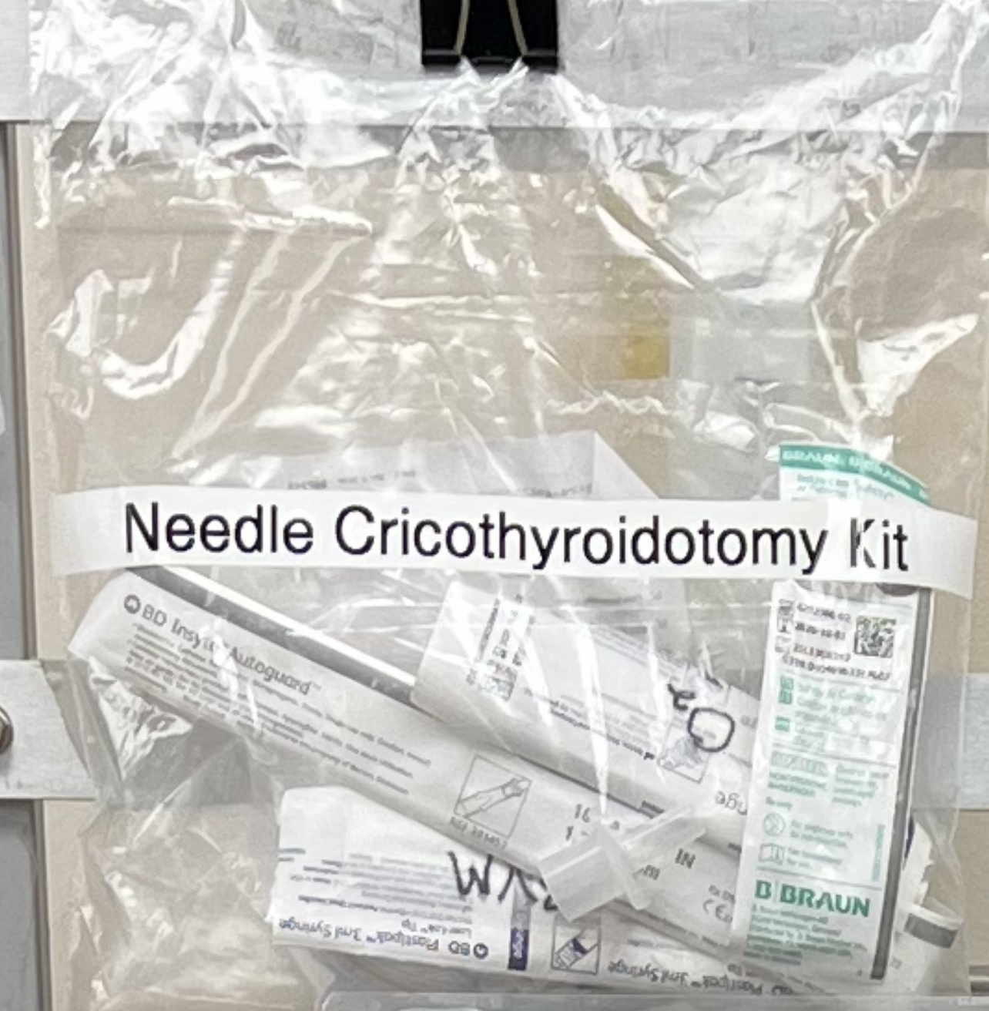
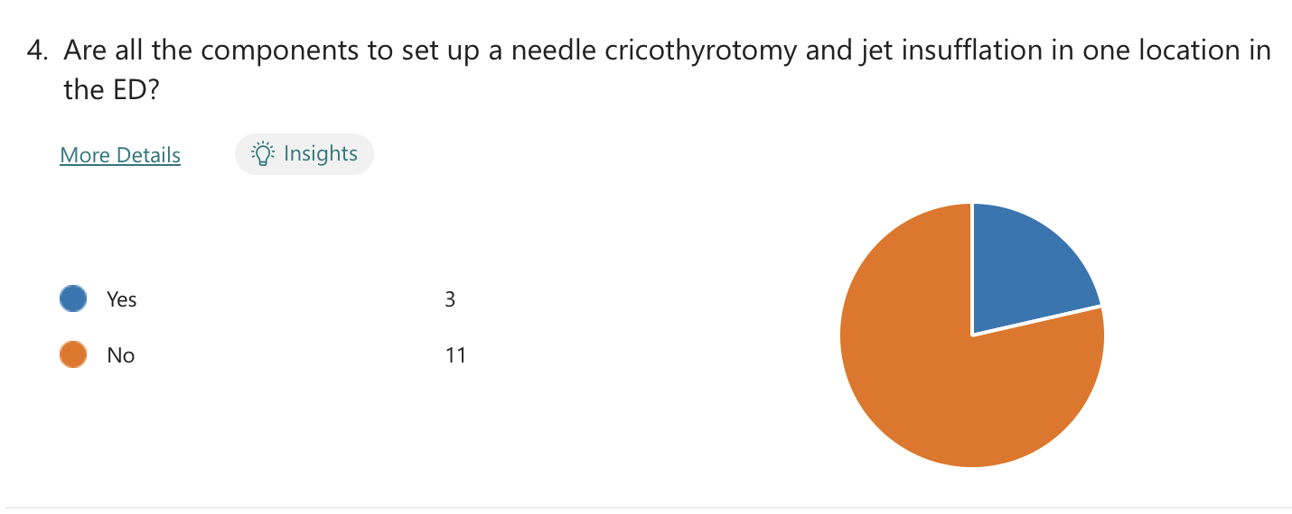
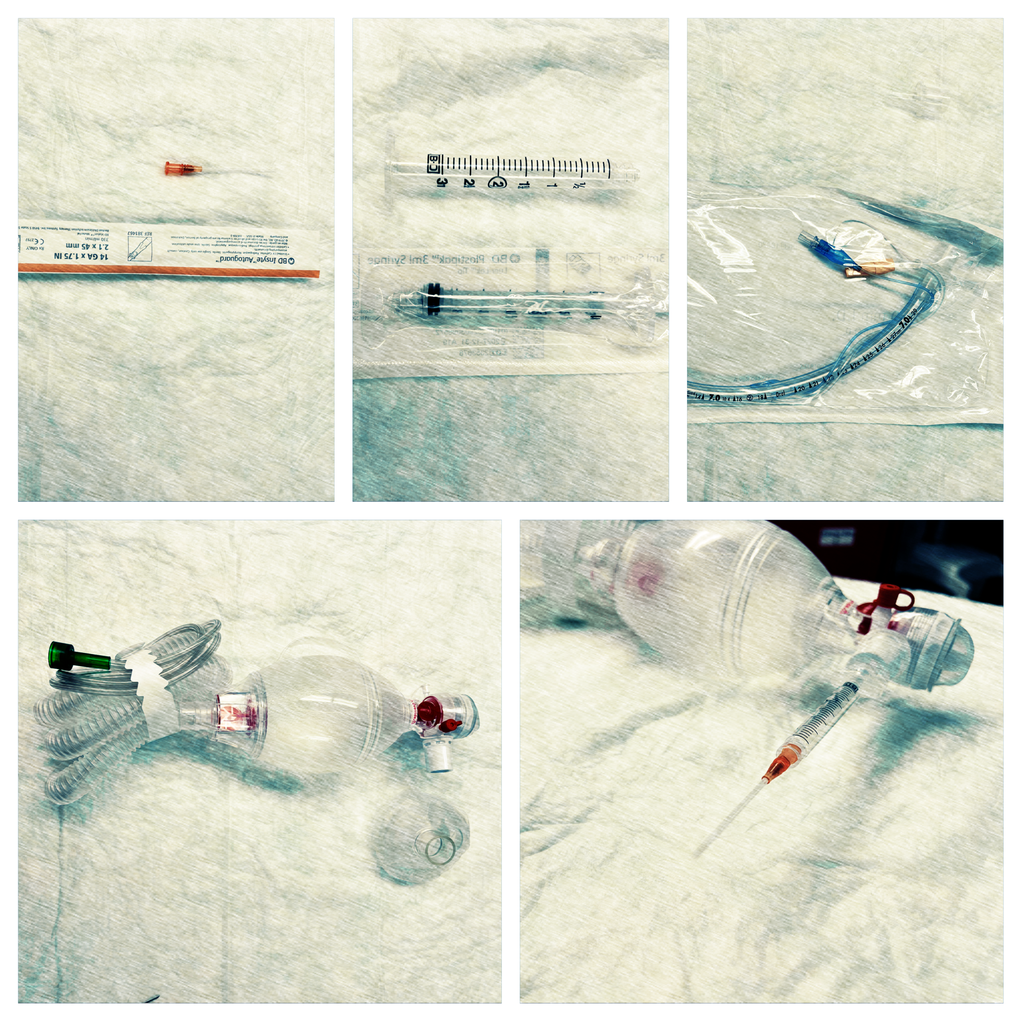
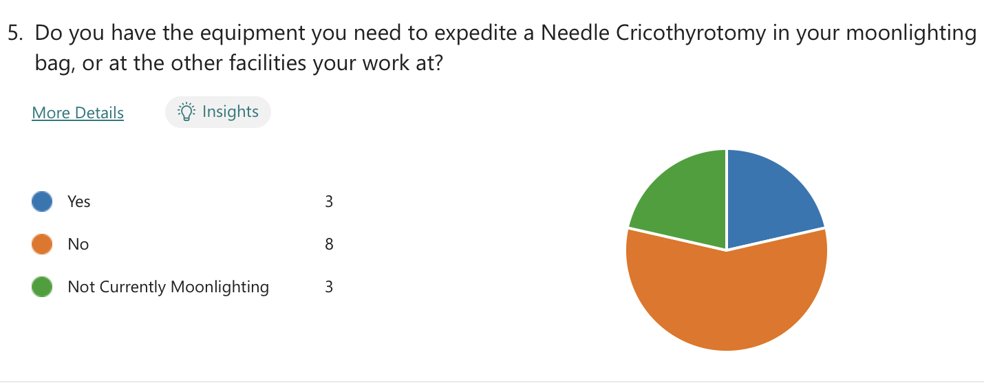
OSUMC/EMERGENCY DEPARTMENT
A Temporizing & Time-Saving Airway Tool
Residents: Christopher McNeil DO (PGY2), Daelor Osen DO (PGY2), Ryan Acker DO (PGY1)
Faculty Advisors: David Gearhart DO, Cathryn Crittenden-Byers MD
Oklahoma State University Medical Center, Department of Emergency Medicine¹ ;Oklahoma State University Center for Health Sciences, Department of Emergency Medicine² ; Saint Francis Health System, Department of Pediatric Emergency Medicine³
INTRODUCTION
RESULTS
CONCLUSION
Not breathing for two minutes and 38 seconds is the amount of time a previously healthy child has before severe metabolic derangements occur. The time is cut in half if the patient is an infant and further complicated when neither oxygenation or ventilation is working. Children less than 8 with this problem require a needle cricothyrotomy to exchange oxygen and carbon dioxide.
From 2017 to 2022, there have been 348 severe pediatric respiratory diagnoses made with over 84% of the patients receiving having documented intubation orders and less than 1% having a cricothyrotomy. No needle cricothyrotomies were recorded because there is no way to document them in the ER, and the time to acquire the supplies and assemble the required devices in the ER takes almost 3 minutes.
Time can be saved and allocated towards temporizing measures in emergent pediatric airway cases when critical steps are outlined and measured by their productivity towards life sustaining interventions. There are multiple wasted steps that can count against the time before a pediatric patient desaturates used to perform a needle cricothrotomy in the ED.
The prevalence of the procedure can now be better studied with the creation of a “temporizing” procedure note for a needle cric, and resident proficiency to perform the procedure at any hospital can be measured and improved. Confidence and patient safety can also be fortified with a NCK provided to offer familiarization with the components, access to the tools for moonlighting, and the convenience of a pre-assembled kit with directions and an inventory booklet to restock equipment for the next case.
FIGURE A
METHODS
A Needle Cricothyrotomy Kit (NCK) can be assembled in two ways defined by the final attachment/source of Oxygen. Components listed in Figure A by time and location:
The time to find and assemble the kit was performed in 3 successive waves.
Wave 1: First Time Finding Tools
Wave 2: Known Location & Improved Assembly
Wave 3: Preassembled NCK
A pre-assembled NCK stored by the Pediatric Airway Box saves 2min and 40 sec of unproductive time in securing an airway.
REFERENCES
FIGURE B
Else, S. D. N., & Kovatsis, P. G. (2019). A Narrative Review of Oxygenation During Pediatric Intubation and Airway Procedures. Anesthesia & Analgesia, 1. https://doi.org/10.1213/ane.0000000000004403
McKenna, P., Desai, N. M., & Morley, E. J. (2020). Cricothyrotomy (Cricothyroidotomy). PubMed; StatPearls Publishing. https://www.ncbi.nlm.nih.gov/books/NBK537350/
‌
Pek, J. H., Tan, H. C., Shen, G., & Ong, Y.-K. G. (2020). Apneic Oxygenation for Emergency Intubations in the Pediatric Emergency Department—A Quality Improvement Initiative. Pediatric Quality and Safety, 5(2), e255. https://doi.org/10.1097/pq9.0000000000000255
‌
FIGURE E
FIGURE C
Trial | Description | Time
Wave 1 | First Attempt | 2:51
Wave 2 | Known location & Assembly | 1:30
Wave 3 | Pre-assembled | 11.6s
ACKNOWLEDGEMENTS
TABLE A
FIGURE D
FIGURE F
Thank you Kelly Murray for your mentorship, Heidi Holmes for EMR data mining, and Angela Cordova for the technical assistance.

