Slide 1
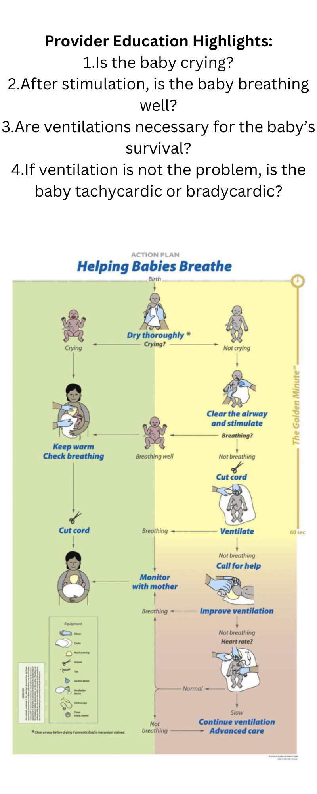
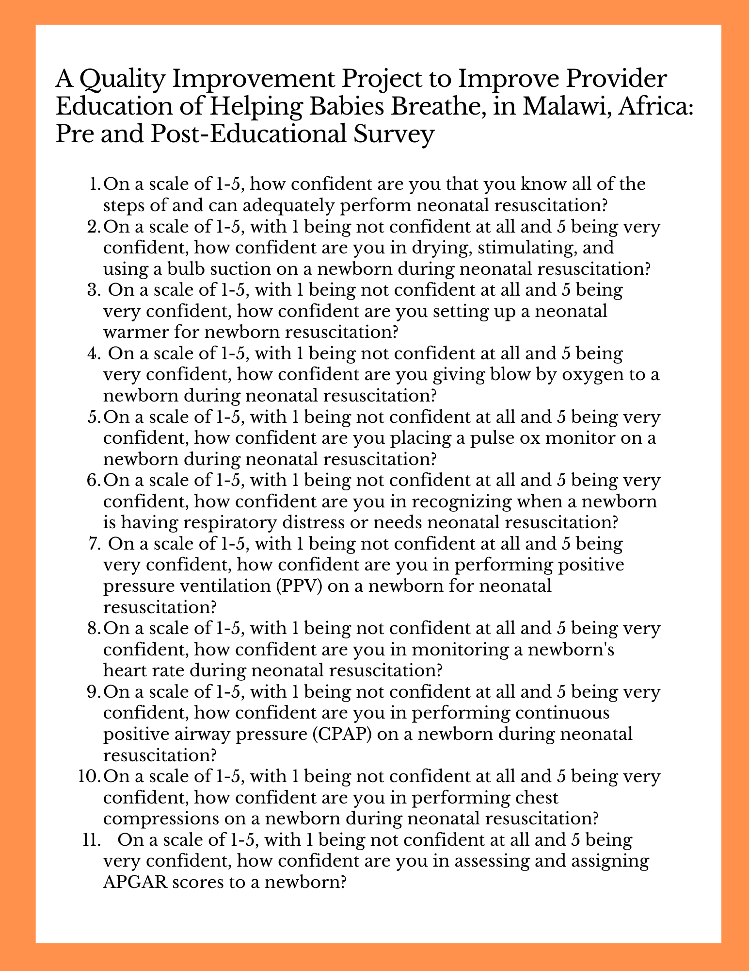
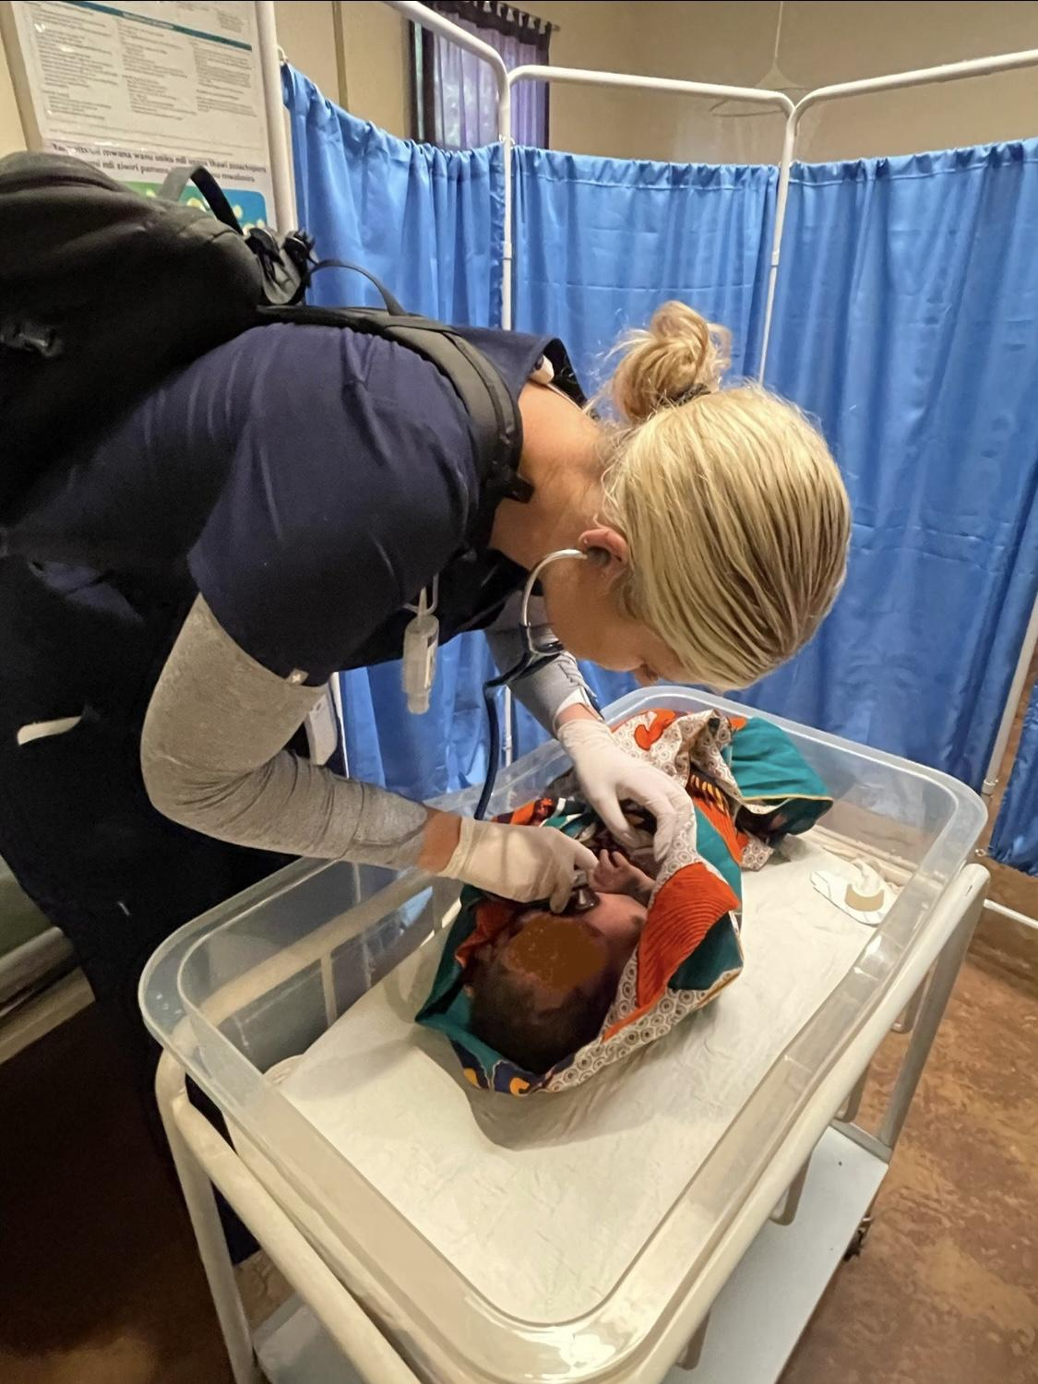
OSU Center for Health Sciences in Tulsa and Cherokee Nation
A Quality Improvement Project for Provider Education of Helping Babies Breathe in Malawi, Africa
Emily Kymes, MBA¹, Marjorie Rooney², Caitlin Ball, Sarah Nelson, Karley Koch D.O., Sarah Hall D.O.
INTRODUCTION
RESULTS
CONCLUSION
Neonatal mortality rates are highest in developing countries, primarily due to a lack of healthcare.¹ This was witnessed first-hand during a global health trip to Malawi, Africa in 2023. One such way to reduce neonatal mortality rates is the teaching and implementation of quality neonatal resuscitation in healthcare facilities. In response to high worldwide neonatal mortality rates, the American Academy of Pediatrics (AAP) created the Neonatal Resuscitation Program (NRP). Subsequently, the Helping Babies Breathe (HBB) curriculum, a subset of NRP, has been shown to reduce neonatal mortality rates in developing countries where resources are further limited. The goal of this project is to provide HBB training resources and education to hospital staff members at Child Legacy International (CLI).
Thorough implementation of HBB is proven to reduce the mortality rates of neonates. Based on firsthand experience from working at CLI in Malawi, Africa, the staff members knowledge of NRP was lacking. It is expected that with proper training and resources, the knowledge and understanding of when and how to use HBB on neonates will improve with this quality improvement project. And with improved knowledge and implementation of HBB, neonatal mortality rates should also decrease as has been shown worldwide by the AAP. Results and conclusions from this project are currently pending.
OBJECTIVES
The overall goal of this project is to improve provider education and knowledge in times of neonatal crisis by gaining confidence and competency in the tenets of Helping Babies Breathe. While HBB has been implemented in Malawi², it was not known to the providers at Child Legacy International (CLI) Hospital where OSU-COM students and doctors visited. Thus, training providers in the curriculum may improve overall birth outcomes at CLI Hospital.
METHODS
REFERENCES OR ACKNOWLEDGEMENTS
Preliminary surveys were sent to the lead physician at CLI Hospital to distribute among colleagues, staff, and other members of the care team to ascertain their knowledge and level of comfort in providing life saving measures on newborns. Those survey results were analyzed, and a presentation video detailing the “How-to” of HBB was sent to CLI. Researchers were available to answer questions or help the team problem-solve any specific issues that arose. Additional handouts, informational brochures, training video and PowerPoint presentations were also provided to the staff. After 3 months time, a post-survey will be completed to determine whether overall improvements in education and understanding of HBB were made. Results will be analyzed to determine changes in competency.
¹Vivek V. Shukla, Waldemar A. Carlo, Susan Niermeyer, Ruth Guinsburg. Neonatal resuscitation from a global perspective, Seminars in Perinatology Volume 46, Issue 6, 2022. https://doi.org/10.1016/j.semperi.2022.151630.
https://www.sciencedirect.com/science/article/pii/S014600052200060X
²UNICEF, WHO, United Nations, & World Bank Group. (2023, May 22). Malawi (MWI) - demographics, Health & Infant Mortality. UNICEF Data. https://data.unicef.org/country/mwi/
³ Kamath-Rayne, B., Berkelhamer, S., KC, A. et al. Neonatal resuscitation in global health settings: an examination of the past to prepare for the future. Pediatr Res 82, 194–200 (2017). https://doi.org/10.1038/pr.2017.48
⁴ American Academy of Pediatrics. (2016). Helping Babies Breathe (2nd Edition). https://www.aap.org/globalassets/international-resources/HBB_2nd_English_Africa_ProviderGuide_Approved.pdf
Figure 1. Provider Handout for CLI using HBB Checklist by AAP⁴
Figure 2: Newborn Physical Exam and Assessment in Malawi, Africa

