Slide 1
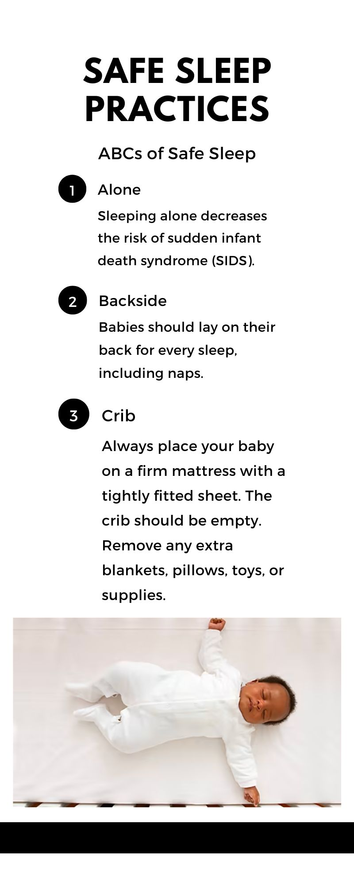
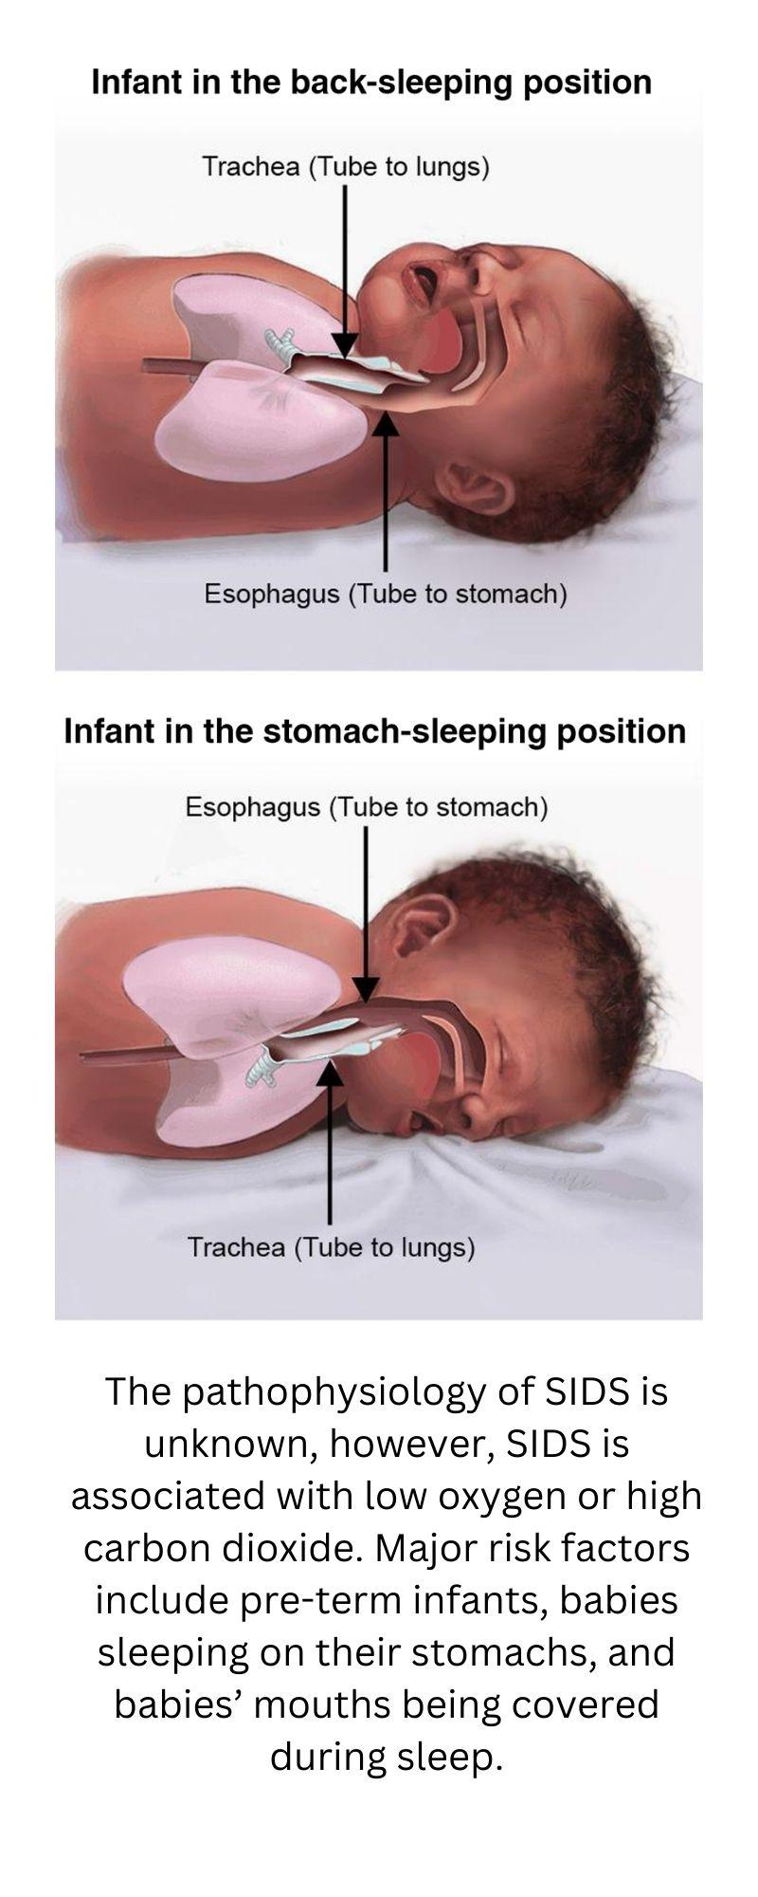
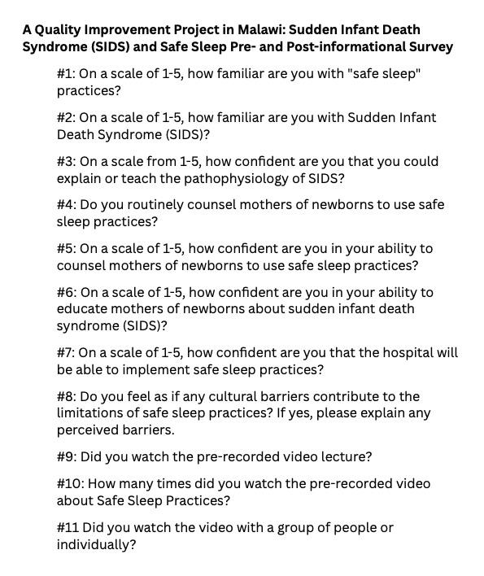
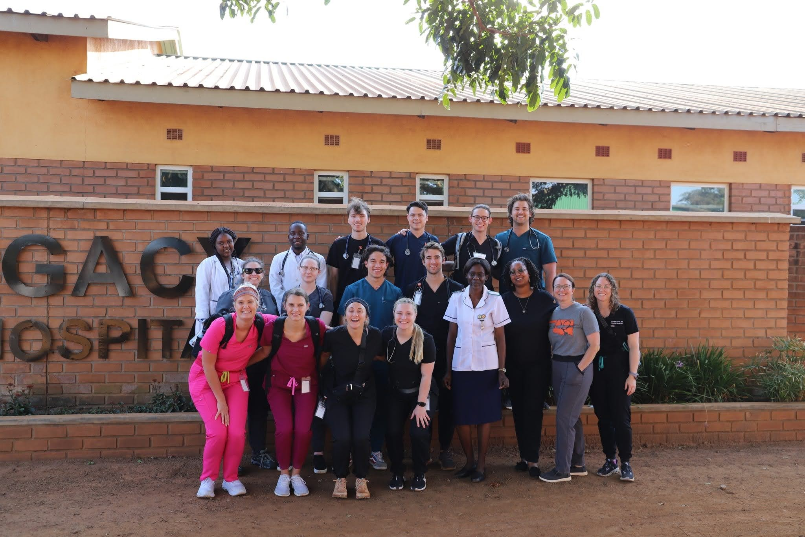
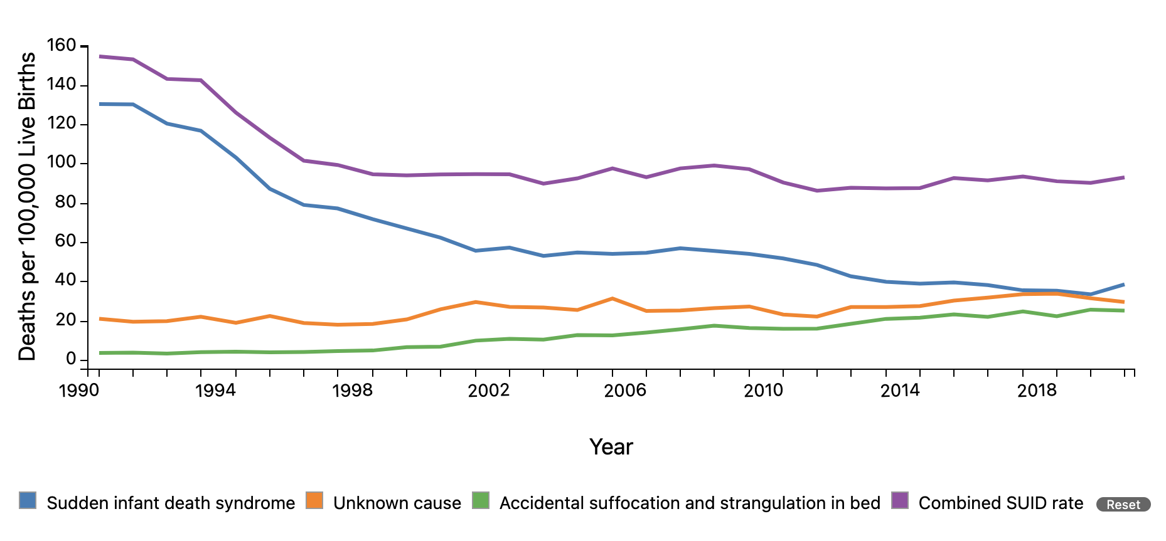
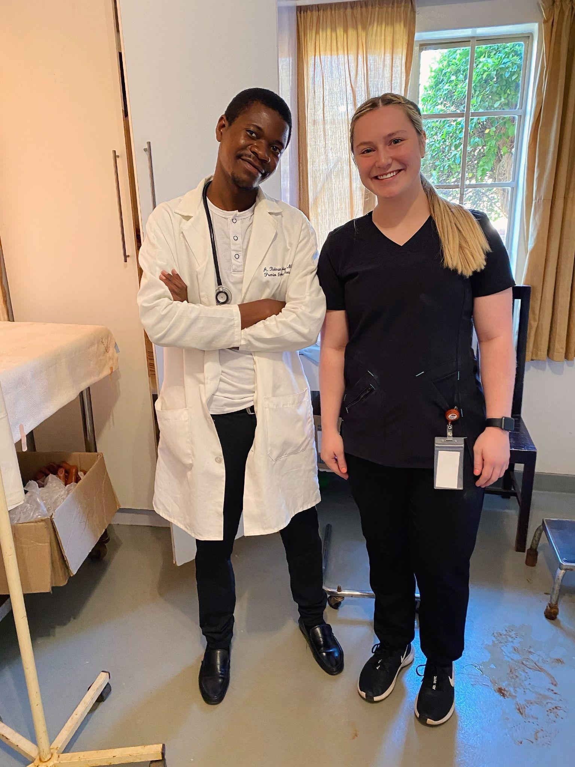
OSU Center for Health Sciences in Tulsa and Cherokee Nation
Improving Provider Education of Sudden Infant Death Syndrome in Malawi, Africa
Caitlin Ball, B.S., Sarah Nelson, B.S., Emily Kymes, B.S., MBA, Marjorie Rooney, B.S., Karley Koch D.O., Sarah Hall D.O.
INTRODUCTION
RESULTS
Sudden infant death syndrome (SIDS) is the unexpected and unexplained death of a seemingly healthy infant.¹⁰ Significant risk factors for SIDS include sleeping position and sleeping environment. In well-developed countries, SIDS is a widely understood and preventable cause of infant mortality. In Malawi, Africa however, little is known about SIDS.⁹
The goal of the Safe To Sleep Campaign is to educate parents and caregivers about ways to protect infants while sleeping.⁴ The American Academy of Pediatrics frequently updates Safe Sleep Recommendations and provides several resources for the “Safe Sleep Campaign Tool Kit”.¹ This project aims to improve education about SIDS and how to prevent it at Child Legacy International Hospital in Malawi, Africa.
To assist in education regarding SIDS, the staff will be provided with a pre-recorded lecture about the risk factors, pathophysiology, and preventative measure of SIDS. In addition, handouts and information brochures will be given to the staff for distribution to mothers of infants.
CONCLUSION
The cause of SIDS is largely unknown, however, the incidence of SIDS has been declining over time in the United States, and other developed countries (Figure 2). This decline is attributed to an education campaign informing parents and caregivers about the risk factors associated with an increased risk of sudden infant death.² It is expected that there will be less incidence of SIDS in Malawi, Africa once the quality improvement project has concluded.
OBJECTIVES
The goal of this quality improvement project is to educate the staff of Child Legacy International (CLI) Hospital in Malawi, Africa about SIDS and ways to prevent it. We also aim to give the staff the tools and resources to educate their patients during the pre- and post-natal visits and while in labor and delivery in order to reduce the risk of infant mortality.
METHODS
REFERENCES OR ACKNOWLEDGEMENTS
An initial cross-sectional survey (Figure 1) will be conducted with hospital/clinic staff at CLI Hospital to assess their baseline knowledge and understanding of SIDS and whether education about SIDS is being provided to new mothers of infants. Next, a video lecture about SIDS and SIDS prevention will be delivered to the staff at intervals of once monthly for 3 months. Additional resources such as posters and informational brochures will be given to staff to implement into their prenatal and postpartum education and to give to new mothers after delivery. After the project has been completed, the same cross-sectional survey will be conducted for hospital/clinic staff to compare their pre- and post-implementation knowledge on SIDS and SIDS prevention. This will determine whether or not video lectures and educational material improved their knowledge or not.
Figure 1. Survey provided to the staff of Child Legacy International (CLI) hospital in Malawi, Africa.
“American Academy of Pediatrics Updates Safe Sleep Recommendations: Back Is Best.” n.d. Accessed January 26, 2024. https://www.aap.org/en/news-room/news-releases/aap/2022/american-academy-of-pediatrics-updates-safe-sleep-recommendations-back-is-best/.
Carroll, J. L., and E. S. Siska. 1998. “SIDS: Counseling Parents to Reduce the Risk.” American Family Physician 57 (7): 1566–72.
“Data and Statistics.” 2023. March 10, 2023. https://www.cdc.gov/sids/data.htm.
Flickr, Follow us on. n.d. “About Safe Sleep for Babies.” Https://safetosleep.nichd.nih.gov/. Accessed January 26, 2024a. https://safetosleep.nichd.nih.gov/about.
———. n.d. “Order, Print, and Download Materials.” Https://safetosleep.nichd.nih.gov/. Accessed January 26, 2024b. https://safetosleep.nichd.nih.gov/resources/order.
Kim, Hoon, and Anthony L. Pearson-Shaver. 2023. Sudden Infant Death Syndrome. StatPearls Publishing.
Moon, Rachel Y., Rebecca F. Carlin, Ivan Hand, and TASK FORCE ON SUDDEN INFANT DEATH SYNDROME AND THE COMMITTEE ON FETUS AND NEWBORN. 2022. “Sleep-Related Infant Deaths: Updated 2022 Recommendations for Reducing Infant Deaths
Osei-Poku, Godwin Kofi. 2022. “Assessing the Burden and Risk Factors of Sudden Infant Death Syndrome (SIDS) and Other Sleep Related Infant Deaths in Africa: A Case Study of Zambia.” https://open.bu.edu/handle/2144/43688.
Priyadarshi, Mayank, Bharathi Balachander, and Mari J. Sankar. 2022. “Effect of Sleep Position in Term Healthy Newborns on Sudden Infant Death Syndrome and Other Infant Outcomes: A Systematic Review.” Journal of Global Health 12 (July): 12001.
“Sudden Infant Death Syndrome (SIDS).” 2023. Mayo Clinic. July 19, 2023. https://www.mayoclinic.org/diseases-conditions/sudden-infant-death-syndrome/symptoms-causes/syc-20352800.
Figure 2. The Sudden Unexpected Infant Death (SUID) rate, includes sudden infant death syndrome (SIDS), unknown cause, and other sleep-related death such as accidental suffocation and strangulation in bed.³ The trends of SUID shown here reveal that the SUID rate has declined in the United States from 1990 to 2020. A visible decline was noticeable following the release of Safe Sleep Recommendations by the American Association of Pediatrics (AAP) in 1992 and the initiation of the Back To Sleep (now Safe To Sleep) campaign in 1994, among others.³

