Slide 1

OSUMC Customer Service and Emergency Management

Slide 2
AIDET
A simple framework to ensure effective communication
Reduces anxiety
Creates safe environment
Increases compliance/better outcomes
Provides consistency
Builds loyalty – We want to be their preferred choice.
When Used
Effectively

Slide 3
Acknowledge
Knock
Smile
Make the customer feel welcome
Acknowledge others in the room or area
Make eye contact
Be authentic/genuine
Sit down
Notes:
Acknowledge is the first step of AIDET
When your customer is the patient it is important to knock on their door and be invited in.
With anyone be sure to smile and make eye contact.
Always be authentic and genuine, and sit at the patients level whenever possible

Slide 4
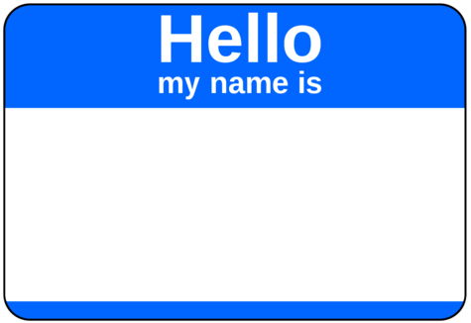
Introduce
State your name
State what department, skillset, expertise, or certification you have
Manage up!
  Yourself
  Co-workers
  Departments
Notes:
It is very important to always introduce yourself.
Including details will help ensure the customer understands your role.
We also encourage you to manage up, which is basically bragging about yourself or others on the team.
Highlighting your strengths or interests will help the patient feel confident in your abilities.

Slide 5

Duration
Explain how long:
  The test or procedure will take
  The activity will take
  Until results are received
When to expect an update
Be Specific
Check back/update
Notes:
People are generally very focused on time
It helps relieve their stress if you provide accurate information about how long things take or when an event will happen
It is important to provide updates if timelines change at any point.

Slide 6
Explain
Why
What to expect
Educate
Explain without jargon
Use key words and phrases
Listen & Answer Questions
  What questions may I answer for you?
  Actively listen - don’t interrupt
Confirm understanding
Notes:
It is of help to the patient and their family when you provide details to explain the purpose of your visit, or tests and procedures.
It is also critical to allow time for questions and feedback, and to ensure they understand the information you present.

Slide 7
Thank
Ask if there is anything else you can do for them
  “I have the time”
Thank customer for their time
Thank them for allowing us to care for them
REMEMBER: They have a choice “Thank you for choosing OSU Medical Center”
Notes:
Always take time to thank your customers when you are finished with your visit, this will make them feel valued and appreciated.

Slide 8
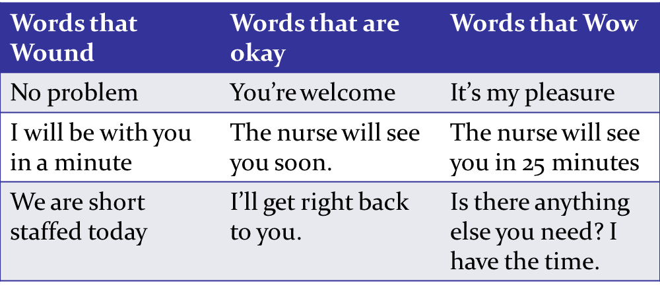
Keywords

Slide 9



Don’t forget body language speaks
Notes:
How you approach people is a key part of making our customers feel comfortable and confident in your care.

Slide 10
Emergency Management
OSUMC has policies and plans in place for emergencies, such as those listed below. We conduct drills to ensure continuous readiness.
Fire Alarm
Security Alert
  Active Shooter
  Disruptive Behavior
  Lockdown
  Hostage Situation
Evacuation
Internal Disruption
Community Emergency Response
Missing Infant/Child
Patient Elopement
Severe Weather/Tornado Alert
Bomb Threat
Communication Failure
Bloodborne Pathogen/Infectious Material Exposure
Hazardous Material Spill/Exposure
Medical Emergency – Code Blue/Rapid Response/MTP
Employee Injury
Utility System Failure
Notes:
OSUMC has many policies and plans in place for emergencies, such as those listed on this slide.
We conduct frequent drills to ensure we are continuously ready.
Everyone has a role to play during an emergency.

Slide 11
Emergency Management
Each unit in the hospital has an Emergency Quick Reference Guide which outlines what to do in each scenario. The Guide is also available on Ozone.
When an emergency is announced, everyone, including students, should participate in the response. Ask your leaders or others on the unit what you should do to assist or where you can find the Emergency Quick Reference Guide.

Slide 12
Emergency Management
Fire Response
R – Rescue:
  Rescue anyone in immediate danger of the fire including patients, staff and visitors
A – Alarm:
  Activate the fire alarm pull station & call 5000, give your name and location of the fire
C – Contain:
  Contain fire by closing all doors in the area
E – Extinguish/Evacuate:
  Extinguish small fires using PASS. If fire cannot be extinguished, evacuate the area and close the door. Evacuate horizontally, to the next smoke compartment, unless a vertical evacuation is authorized by the Fire Marshal, Incident Commander, Safety Officer, or Engineer
Notes:
A fire or smoke event is one of the most likely emergencies to occur in the hospital.
Memorize the steps of RACE to ensure you are ready to respond.
Read the steps

Slide 13
Emergency Management
Fire Response
P – Pull: Pull the pin to release the latch
A – Aim: Aim the extinguisher at the base of the fire
S – Squeeze: Squeeze the handle of the fire extinguisher
S – Sweep: Sweep from side to side at the base of the flame
Notes:
Use the PASS acronym to help you remember how to operate a fire extinguisher

Slide 14
Emergency Management
Fire Response
Fire extinguishers are available in hallways and in or near all stairwells.
Fire alarm pull stations are located by all stairwells and ground floor exits.
Notes:
Thank you for your time today and I am glad you’ve chosen OSU Medical Center for your training, if you have any questions please ask to speak with the Safety Officer.

