Slide 1

National Health Service Corps
“OK Health Corps”
(NHSC State Loan Repayment Program)
Office of Primary Care
Jana Castleberry, Director

Slide 2

Our Work
The Bureau of Health Workforce (BHW) improves the health of people who need it most. We strengthen the health workforce and connect skilled health care providers to communities in need.
What are your aims?
ACCESS: Make it easier for people to access health care.
SUPPLY: Balance the supply of health workers with the demand for care.
DISTRIBUTION: Improve distribution of the health workforce.
QUALITY: Improve the quality of the health workforce and the care they provide.
What programs do you offer?
We offer scholarship, loan, and loan repayment programs to individuals and award grants to organizations
Our programs advance health equity by ensuring that all communities have access to high-quality and culturally competent medical care.
Our healthcare clinician programs help connect skilled healthcare providers to communities in need.

Slide 3
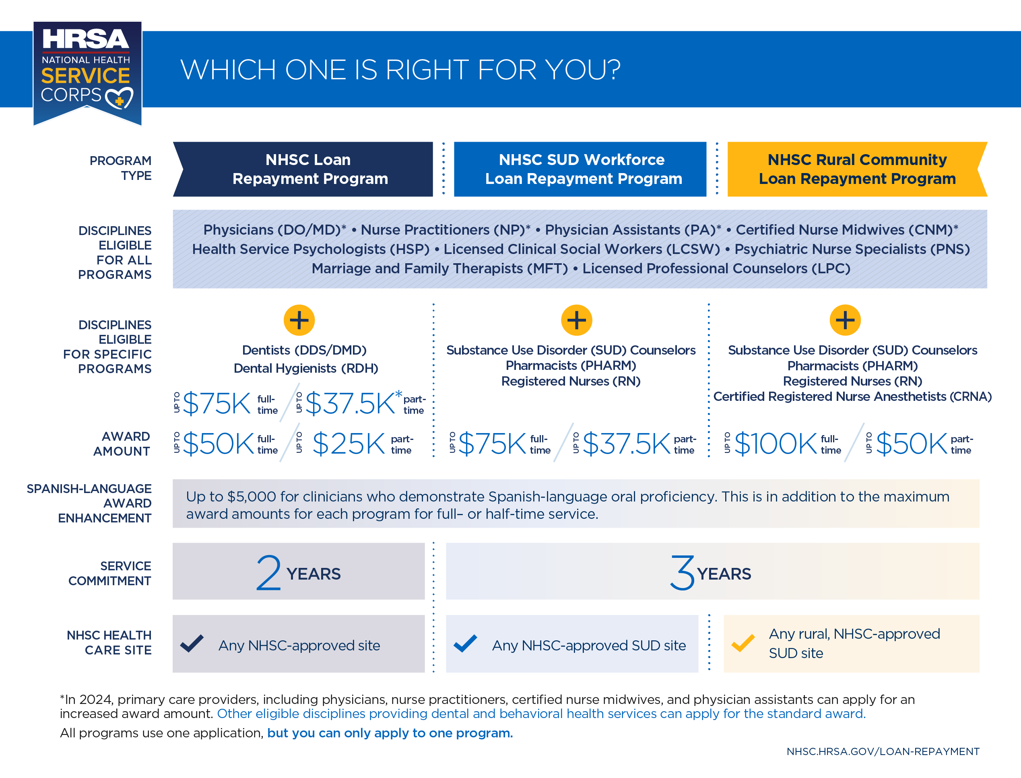

Slide 4

Approved Site Types
Auto-Approved
Federally-Qualified Health Centers (FQHCs);
FQHC Look-Alikes (LALs);
Indian Health Service (IHS) Facilities;
Tribally-Operated 638 Health Programs;
Urban Indian Health Programs;
Federal Prisons; and
Immigration and Customs Enforcement (ICE) Health Service Corps
Other Eligible Site Types
Submit applications and recertifications during open cycles
State Prisons;
Rural Health Clinics (RHCs);
Critical Access Hospitals (CAHs);
Community Mental Health Centers (CMHCs);
State or Local Health Departments;
Community Outpatient Facilities;
Private Practices;
School-Based Clinics;
Mobile Units;
Free Clinics; and
Substance Use Disorder (SUD) Treatment Facilities

Slide 5
Questions?
Jana Castleberry, JanaC@health.ok.gov
Melanie Reese, MSW Melanie.Reese@health.ok.gov
​

