Slide 1
Physician Advocacy and its Impact on Health Policy
Sean Neal
Vice President, Advocacy & Political Affairs
American Osteopathic Association

Slide 2
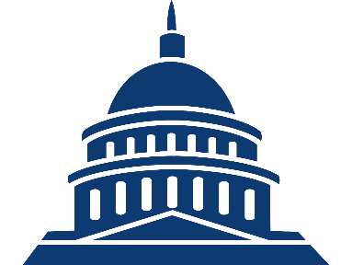


How Does Advocacy Work?
Show support
Ask for change
Tell stories
Share ideas
Provide info
Congress and the White House create laws and regulations to govern citizens
Citizens influence governing behavior by participating in advocacy efforts

Slide 3




Primary Levels of Government
Federal
Federal legislators
Regulatory bodies
State
State legislators
Regulatory bodies
Local
City councils
School boards

Slide 4

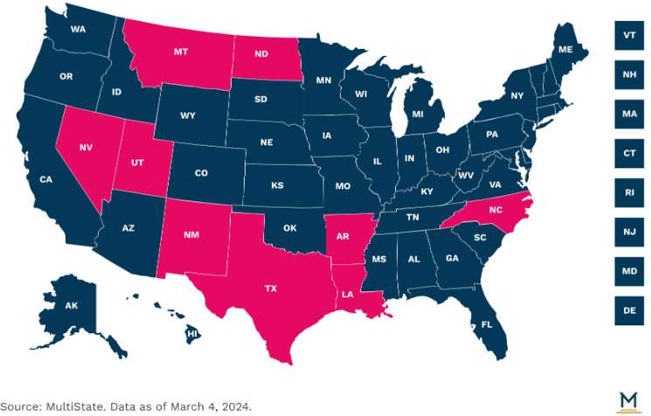
State Advocacy by the Numbers
In 2024, 46 states hold regular legislative sessions.
  41 states are currently convened
So far, we’ve partnered with affiliates on:
  18 letters
  10 grassroots alerts
Issues include:
  Opposing scope of practice expansions for psychologists and APRNs
  Opposing the creation of new, unproven physician licensure pathways
  Supporting medical truth in advertising
  Supporting osteopathic distinctiveness through self-regulation

Slide 5


West Virginia Senate Bill 714 – Eliminates Osteopathic Board
SB 714 eliminates the osteopathic medical board and transfers regulation of DOs to the allopathic medical board.
  No financial benefit to the state; WVBOM is entirely self-sustaining.
  WVOMA, AOA, ACOFP/ACOFP – WV and ACOS opposed
    Sent 4 letters and grassroots alerts
    Multiple meetings with bill sponsor, Sen. Tom Takubo, DO
    WVOMA hired a lobbying firm to assist
Revised bill:
  Transfers DO regulation to WV Board of Medicine
  Allocates 5 board seats to DOs and 5 to MDs
  Updates osteopathic terminology and makes other technical corrections

Slide 6
Constituent Visits are Most Influential
INFLUENCE OF ADVOCACY STRATEGIES DIRECTED AT A MEMBER’S WASHINGTON OFFICE
■ A lot of positive influence ■ Some positive influence

Slide 7
Success in the Advocacy Space can Take Time
BILLS AND RESOLUTIONS BY STATUS
■ 116th Congress ■ 117th Congress ■ 118th Congress
Historically, only about 5%-6% of bills make it to the House or Senate floor for a vote

Slide 8
Structure of a Congressional Office
Sample organizational structure of a congressional office
Member of Congress
Chief of Staff
Policy Staff*
Communications Staff*
Office Staff
District Staff
Legislative Director
Communications Director
Personal Assistant/ Scheduler
District Director
Legislative Assistant/Aide
Press Secretary/Assistant
Staff Assistant
District Caseworkers
Legislative Correspondent
Members of Congress have busy schedules – staffers often have more time to devote to Hill meetings and are more capable of affecting any takeaway
*Some offices may have “Senior Counsel/Counsel” roles among Policy staff, others may include a “Social Media Director” or “New Media Director” among Communications staff.

Slide 9

House of Representatives
Senate
Introduction
A representative or senator introduces a bill by filing it with the House/Senate clerk
Committee consideration
Bills are referred to committees for debate, analysis, and amendments
Simple majorities are needed to pass committees in both the House and Senate
Bills are often sent to subcommittees for extra analysis, especially on niche issues
Floor debate
House
Bill is debated and amended
Simple majority needed to pass
Senate
Bill is debated and amended
3/5 majority needed to end debate
Simple majority needed to pass
Final votes/
conference
committee
If both chambers pass an identical bill, it is sent directly to the president
If they pass different bills, a conference committee is formed of representatives and senators who try and find a compromise
Bills that pass conference committee must then pass both the House and Senate
President’s
signature
or veto
A bill becomes law after a president signs it or after 10 days if they take no action
The president can reject a bill with a veto
Congress can override the veto by with a 2/3 majority vote in each chamber

Slide 10







Bills Face Numerous Obstacles to Passage in Congress
Bill is ignored by full committee
Bill fails passage in subcommittee vote
Bill fails passage in full committee vote
Introduced in House/Senate
Sent to committee
Sent to subcommittee
Full committee vote
Process repeats
in other chamber
Full House/Senate vote
Amended
Floor debate
Placed on legislative calendar
Bill fails final vote in full chamber
“Poison pill” amendments can sabotage final passage
In the Senate, bills can be filibustered during debate
Senate majority leader/
House speaker declines to put bill on calendar
Note
The Senate relies on unanimous consent to operate efficiently; therefore, individual senators have the power to delay or prevent a bill’s passage by creating additional procedural hurdles, including filibusters

Slide 11

Bills Continue to Face Hurdles After Passage
The Courts
Federal judges can prevent the enforcement of laws by issuing injunctions and can also strike down laws as unconstitutional
Executive interpretation
Passes Congress
Signed by president
Enacted
A president can write executive orders or signing statements that prevent a law from being enforced as originally intended
President vetoes a bill;
Congress can override veto with a 2/3 vote in each chamber
Note
A bill may pass both the House and Senate but still face enormous challenges, either before or after it is formally enacted.

Slide 12
Keep Momentum Going
Advocacy Activity Level Over Time (Illustrative)
Ideal continuous engagement
Advocate activity level
Loss of engagement
Start of campaign
End of campaign

Slide 13
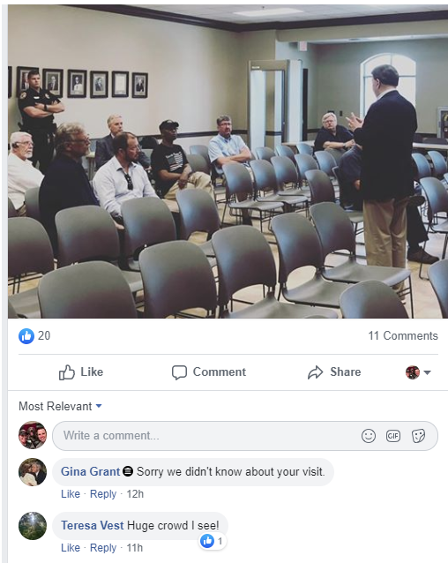
Lack of Engagement?
An opportunity for osteopathic physicians and medical students to engage where others are not.

Slide 14


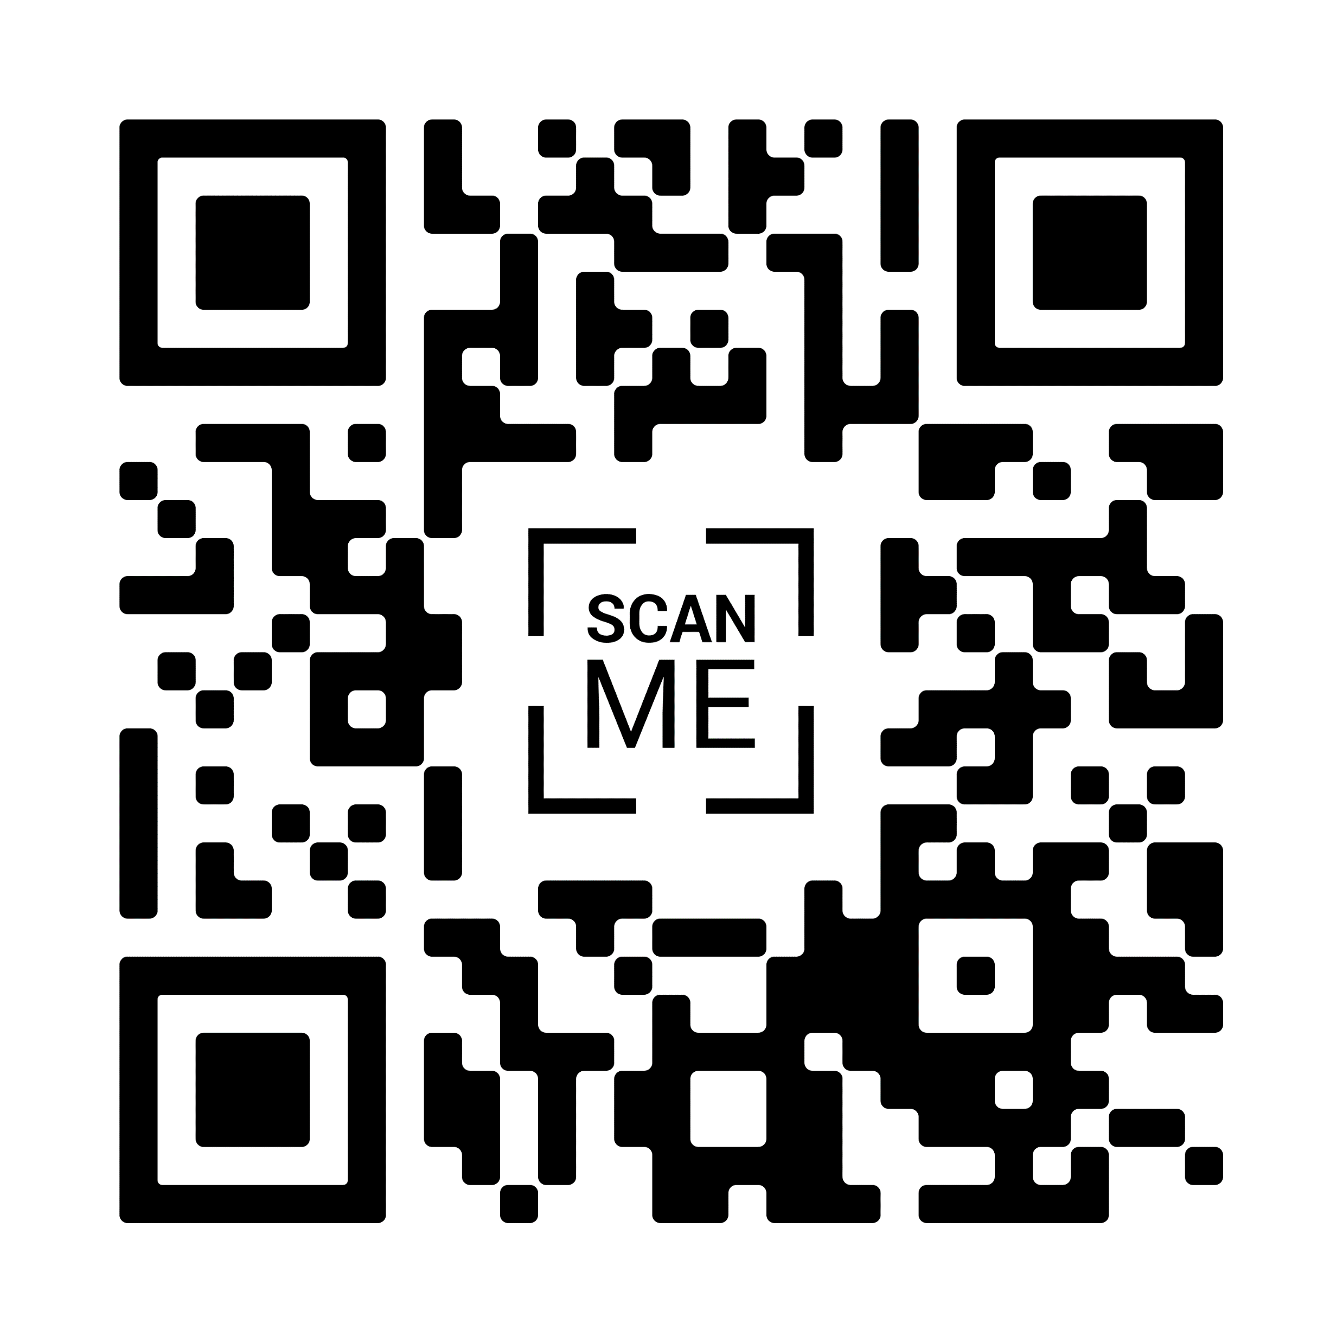


Osteopathic Advocacy Network
Join Today!

Slide 15
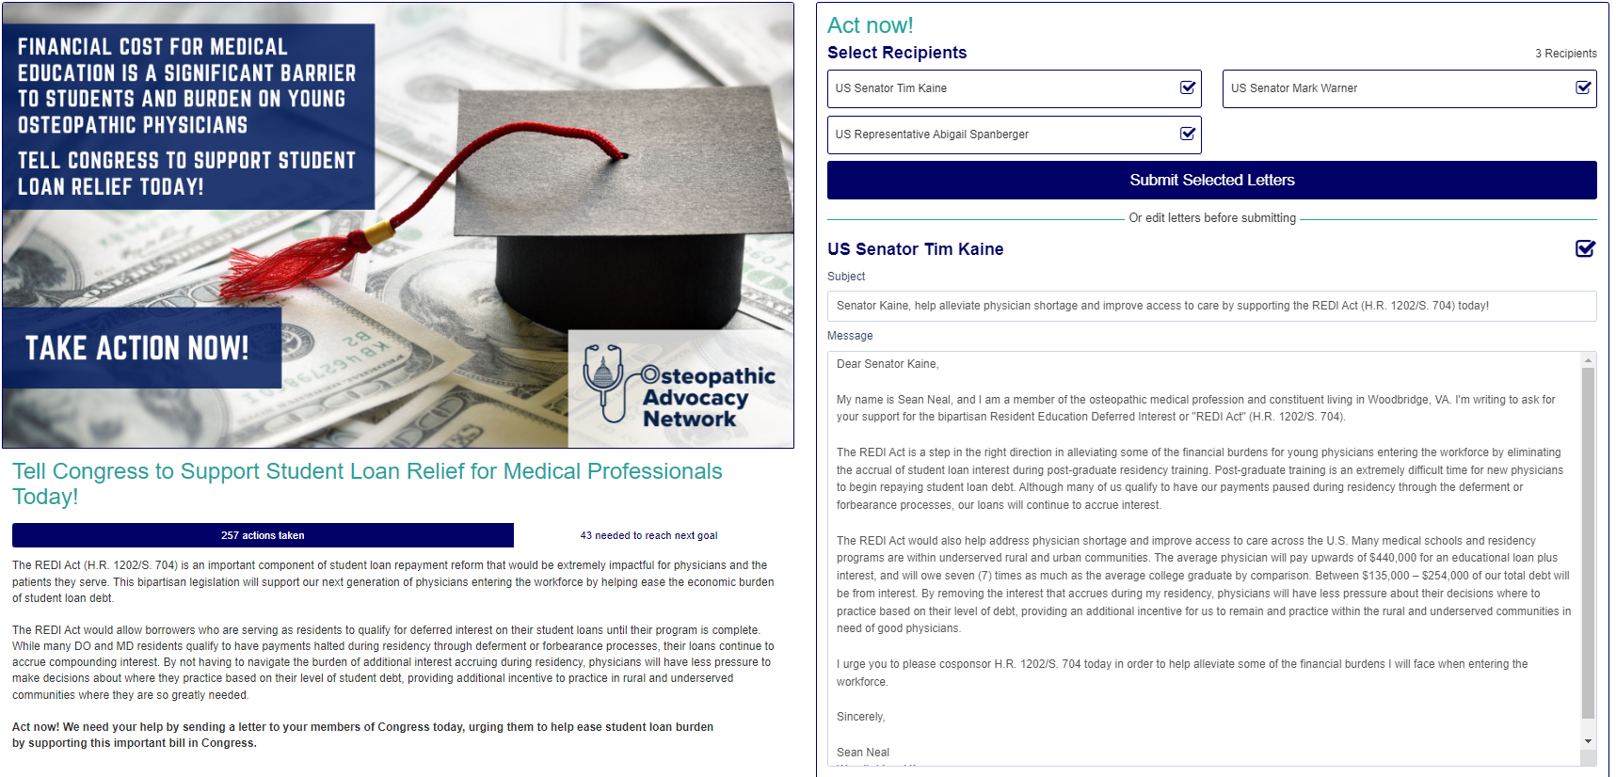
Grassroots Advocacy

Slide 16
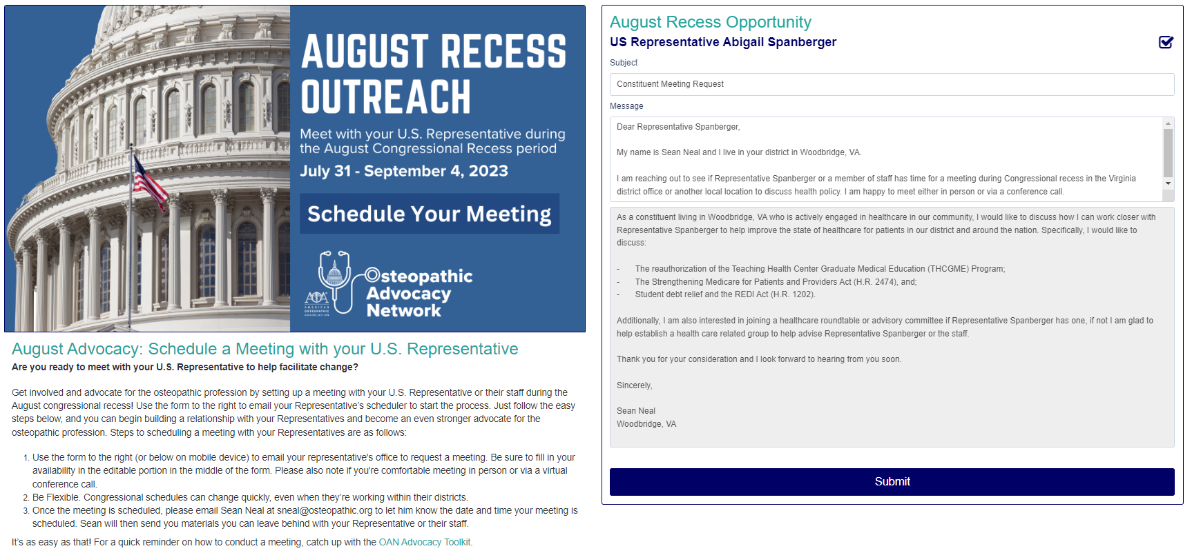
August Recess

Slide 17
Case Study
SUDs Act

Slide 18
The Issue
Identifying problems that impact physicians and patients
Physician Shortages
Opioid Crisis
Crushing Student Debt
A shortage of 85,000 physicians in 2020
40% of all U.S. opioid overdose deaths involve a prescription opioid
Opioid deaths now higher than motor vehicle accidents
Potential impact on primary care
Impact on economy
Shortages impact rural communities more dramatically

Slide 19
Introducing Legislation
The Substance Use Disorder Workforce Loan Repayment Act of 2018
  Creates a loan repayment program for individuals who serve in a substance use disorder treatment job in a mental health professional shortage area, or an area of the country where the drug overdose death rate is higher than the national average.
Student Debt
Opioid Crisis
Physician Shortages

Slide 20
Advocacy Timeline – SUDs Act
October, 2017
AOA collaborates with osteopathic profession to draft SUDs Act
Feb, 2018
SUDs Act introduced in the House of Representatives
March, 2018
SUDs Act introduced in the Senate
June 4, 2018
Action Alert sent to osteopathic advocates to encourage lawmakers to cosponsor SUDs Act
June 11, 2018
House moves to vote on SUDs Act, Action Alert sent to advocates to encourage House to vote yes
August 17, 2018
Bill moves to Senate, Action Alert sent to advocates to request the Senate keep the SUDs Act alive
Sept., 2018
Senate passes watered down version, Action Alert sent to keep House version
Sept., 2018
AOA leads coalition letter to Congress featuring over 40 state and national health organization to advocate for inclusion of AOA endorsed SUDs Act
Sept., 2018
Congress keeps AOA endorsed version of SUDs Act after committee conference
October, 2018
Signed by President and is now law
The AOA Public Policy team and osteopathic advocates conducted more than 225 meetings with Members of Congress and their staff on the SUDs Act

Slide 21
Other Areas of Success
Physician Workforce
Surprise Medical Billing
Physician Payment Cuts
Reauthorization of the Teaching Health Center Graduate Medical Education Program (THCGME)
Telehealth Expansion and Payment Parity
COVID-19 Efforts
The Coronavirus Preparedness and Response Supplemental Appropriations Act (H.R. 6074)
Families First Coronavirus Response Act (H.R. 6201)
The Coronavirus Aid, Relief and Economic Security Act (CARES Act, H.R. 748)
The Paycheck Protection Program and Healthcare Enhancement Act (H.R. 266)
The American Rescue Plan Act (H.R. 1319)
Removed barriers for emergency medical care services
Remove geographic restrictions
Expand originating sites to include the home and other appropriate sites
Medicare Sequester COVID Moratorium Act (H.R. 315)
The practice of surprise medical billing was banned in an end-of-year package

Slide 22
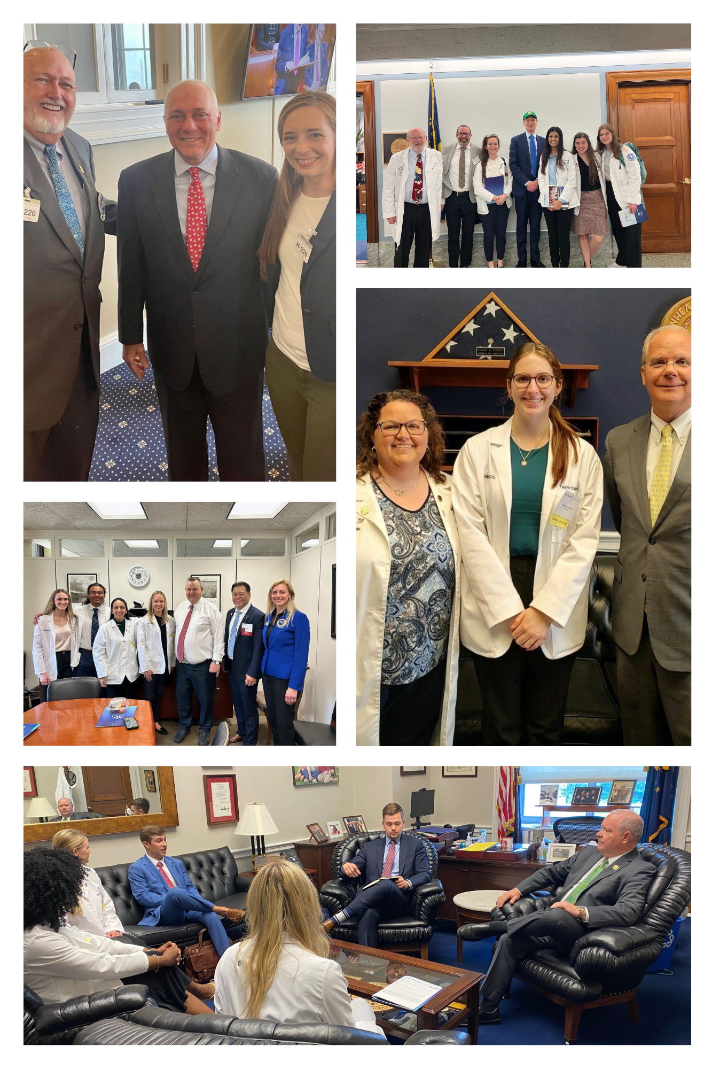
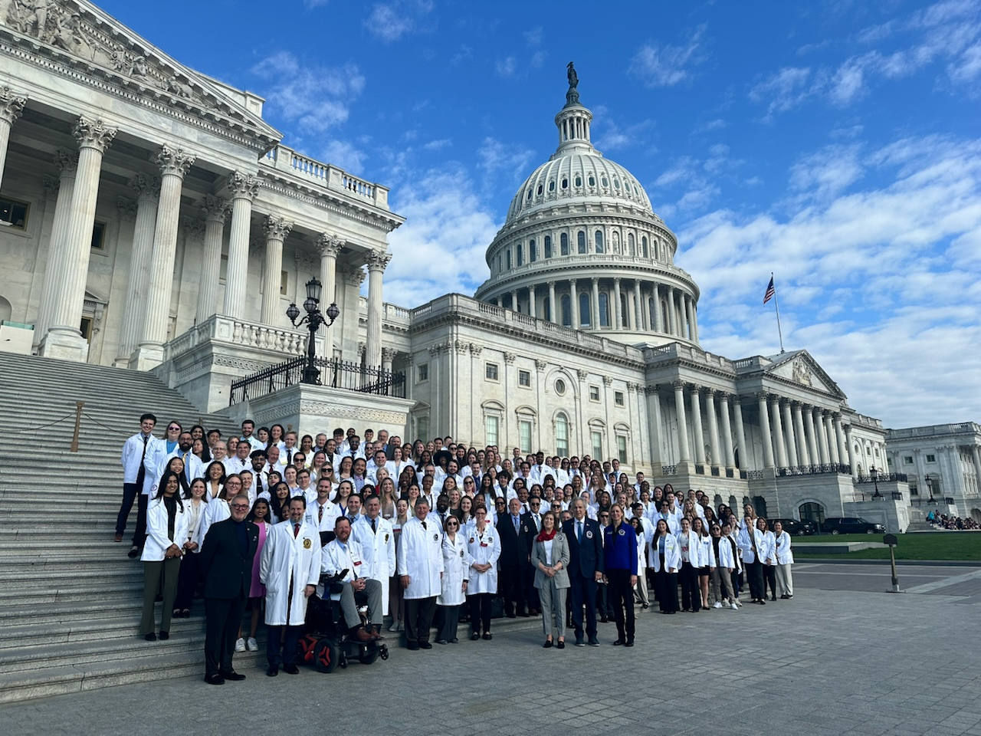
DO Day on Capitol Hill

Slide 23
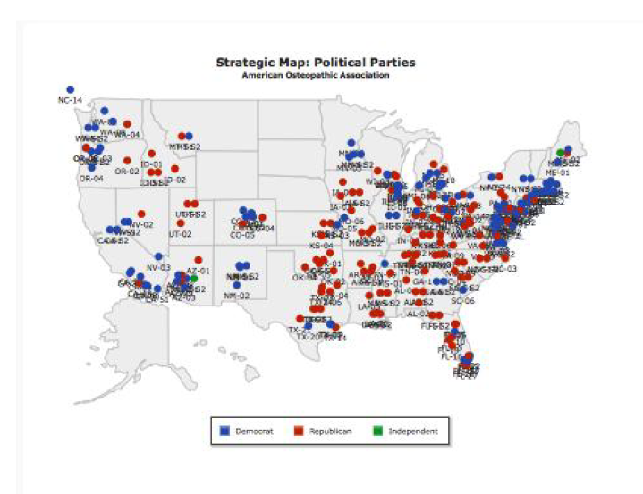
DO Day Meetings
More than 350 participants
42 states
281 meetings scheduled
145 Republicans
133 Democrats
2 Independents

Slide 24
DO Day Update – Legislative Issues
Protecting patient access to care and physician practices by advocating for positive updates to Medicare physician payment through the Strengthening Medicare for Patients and Providers Act (H.R. 2474).
Creating a safe working environment for physicians and other healthcare workers by advocating for the Safety From Violence for Healthcare Employees (SAVE) Act (H.R. 2584/S. 2768).
Alleviating financial burdens of student debt by encouraging Congress to support the REDI Act (S.704/H.R.1202).

Slide 25

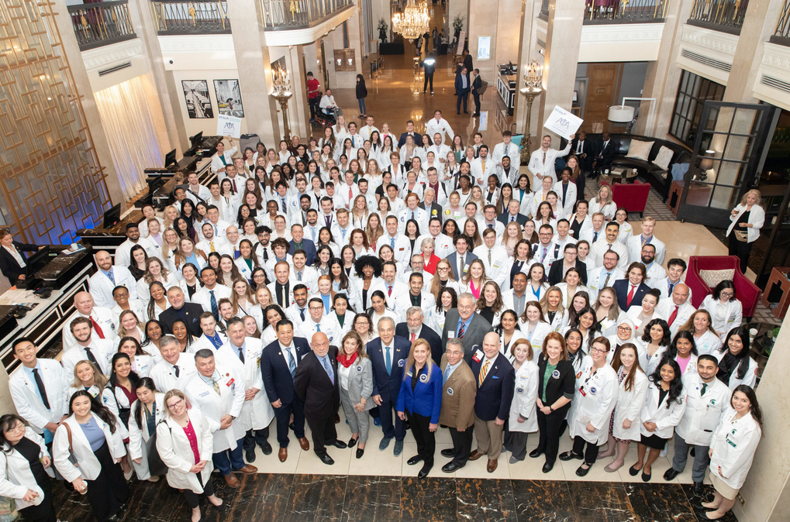
Save-the-Date: DO Day on Capitol Hill 2025
DO Day 2025
Wednesday, March 26 and Thursday, March 27

Slide 26

Apply for an AOA Bureau, Council, or Committee Today!
Apply for a leadership position on the 2024-2025 AOA Bureau, Council and Committees
Help provide input and direction for AOA policy
Application cycle closes Wednesday, May 1

Slide 27
Political Involvement

Slide 28
The Cost of Federal Elections - Timeline
IN BILLIONS USD
113%
jump in total election costs from 2016 to 2020

Slide 29
Winning Candidates are Usually the Top Spenders
SPENDING IN MILLIONS USD
■ Spending by candidates ■ Percent of races won by the top spending candidates
House races
Senate races

Slide 30
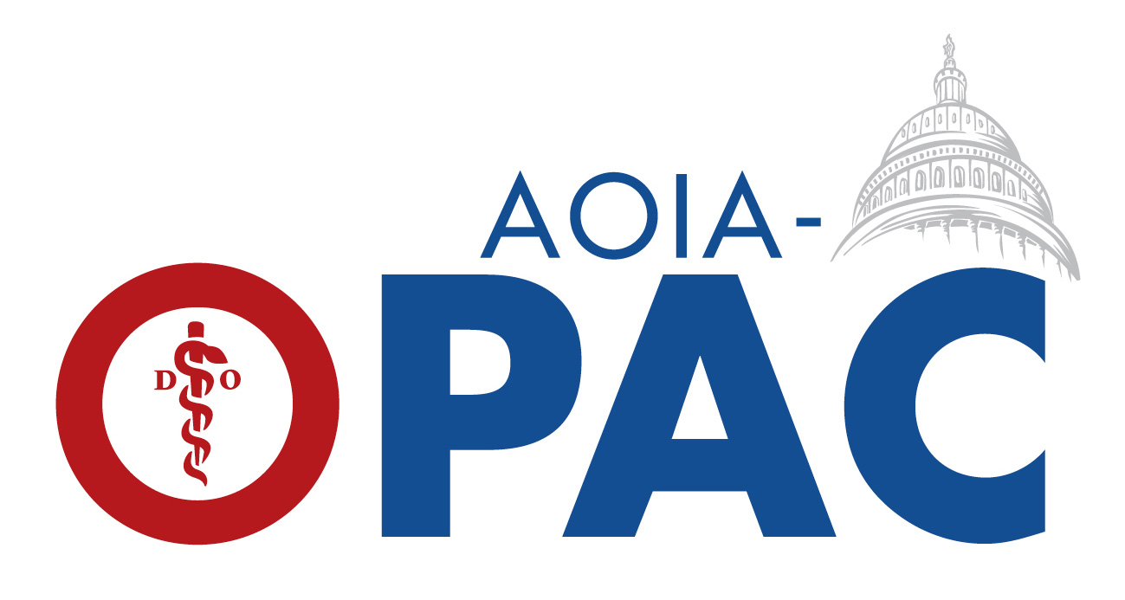
The Osteopathic Political Action Committee

Slide 31

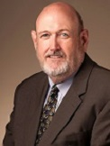
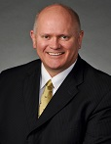
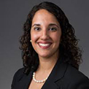


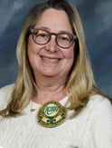

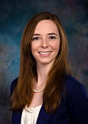
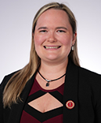
2024 Cycle Members
Ronnie Martin, DO
Chair
Ray Morrison, DO
Vice Chair
Richard Thacker, DO
Treasurer
Sonbol Shahid-Salles, DO
Assistant Treasurer
Jeffrey Grove, DO
Secretary
Kris Nicholoff, JD
Affiliate Member
Jodi Benett, DO
Member at Large
Jantzen Faulkner, OMS
Student Member
Alexis Cates, DO
Coalitions Officer
Brianne Howerton, DO
Academic Member

Slide 32
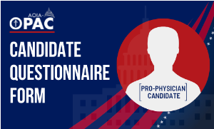
Candidate Questionnaire
Introductory Questions
Has your campaign conducted polling?
Do other healthcare PACs support you?
What are your top priorities?
What are the challenges that physicians and patients face in your district?
By Issue
Do you support expanding funding for GME?
Do you support student debt relief or forgiveness programs?
Do you support expanding telehealth services?
Do you support legislation to expand the scope of practice for non-physician clinicians?
Do you support medical liability reform?

Slide 33
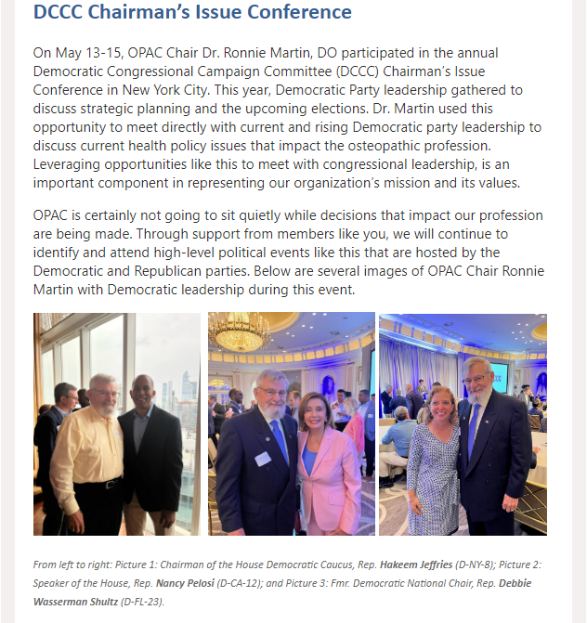
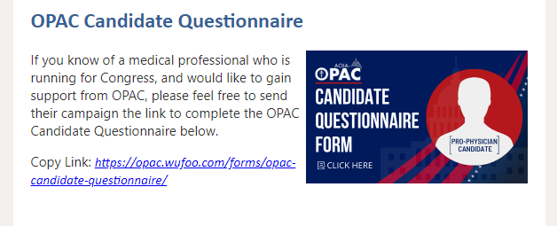
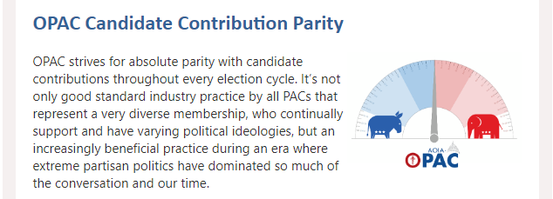
Communications

Slide 34
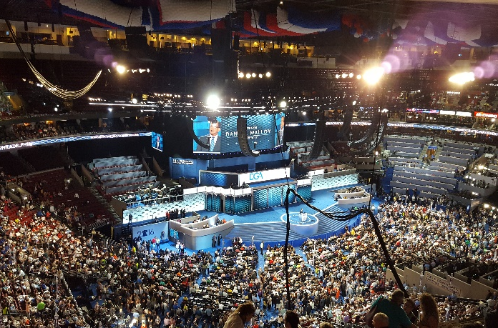
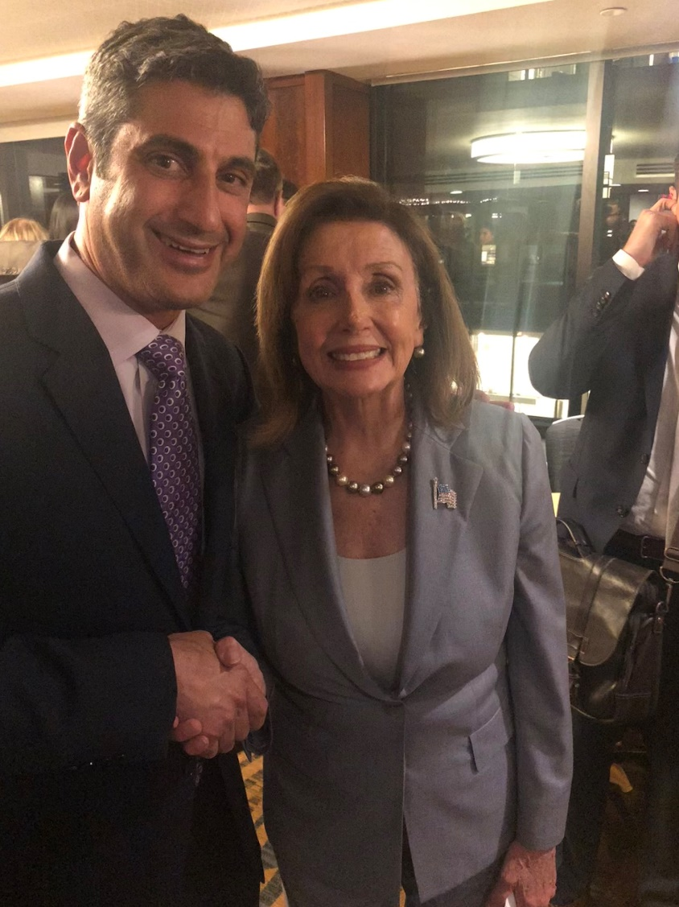
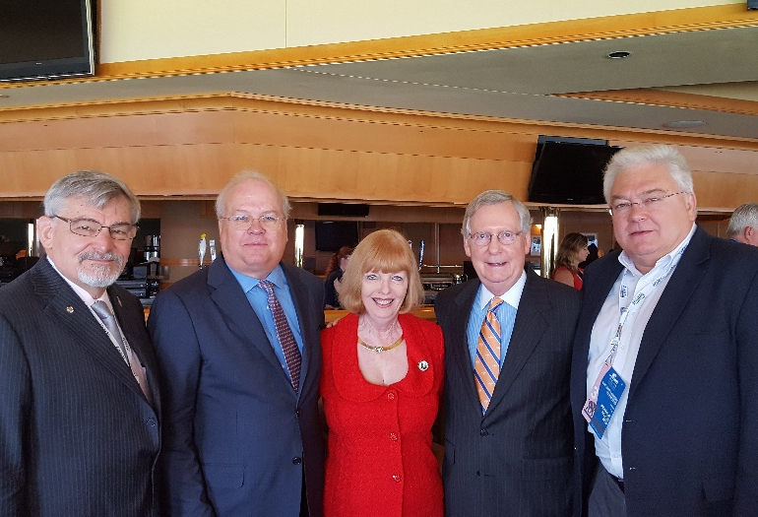
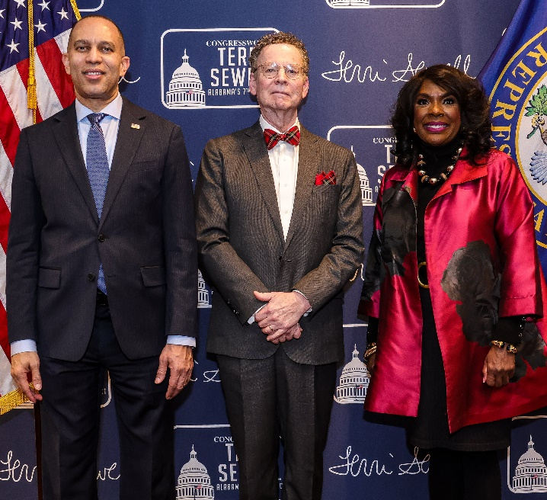
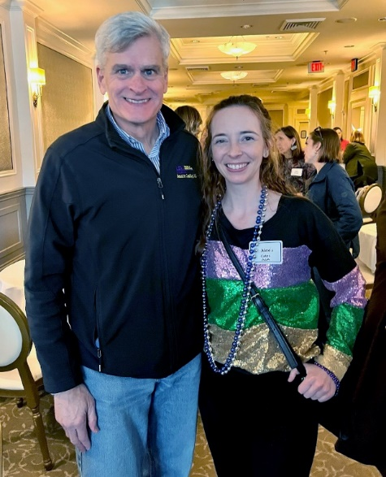
A Seat at the Table

Slide 35
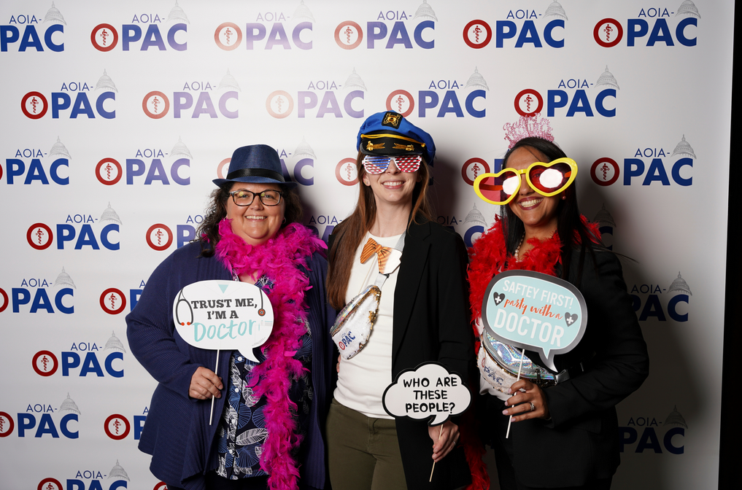
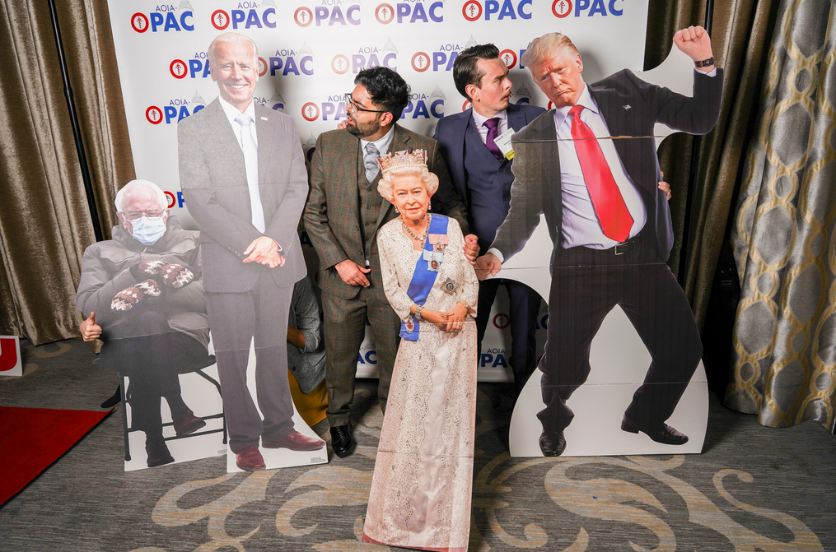
Work Hard, Play Hard

Slide 36
Thank you!
Sean Neal
Em: sneal@osteopathic.org

