Slide 1
Needle stick Injuries
Prevention, education, and Safety

Slide 2
Educational Video - Needle Stick Injuries
https://www.worksafebc.com/en/resources/health-safety/videos/preventing-needlesticks?lang=en

Slide 3
OSUMC Needle Sticks & Exposures
2020
29 Total Needle Sticks
5 Total Splashes
13 Resident Needle Sticks
1 Resident bodily fluid exposure/splash
2021
27 Total Needle Sticks
16 Total Splashes
10 Resident needle Sticks
4 Resident bodily fluid exposures/splash
2022
31 Total Needle Sticks
14 Total Splashes
13 Resident needle sticks
6 Resident bodily fluid exposures/splashes
2023
33 Total Needle Sticks
11 Total Splashes
17 Resident needle sticks
4 Resident bodily fluid exposures/splash

Slide 4
Prevent needlestick injuries
Needlestick injuries can be avoided by eliminating the unnecessary use of needles, using devices with safety features, and promoting education and safe work practices for handling needles and related systems.
As a healthcare professional, you can protect yourself from a needlestick injury by:
Avoiding the use of needles where safe and effective alternatives are available
Helping your employer select and evaluate devices with safety features that reduce the risk of needlestick injury
Using devices with safety features provided by your employer
Avoiding recapping needles
Planning for safe handling and disposal of needles before using them
Promptly disposing of used needles in conveniently placed and appropriate sharps disposal containers
Reporting all needlestick and sharps-related injuries promptly to ensure that you receive appropriate follow-up care
Telling your employer about any needlestick hazards you observe and promptly reporting any needlesticks and near-misses
Participating in training related to infection prevention
Getting a hepatitis B vaccination
https://www.cdc.gov/

Slide 5
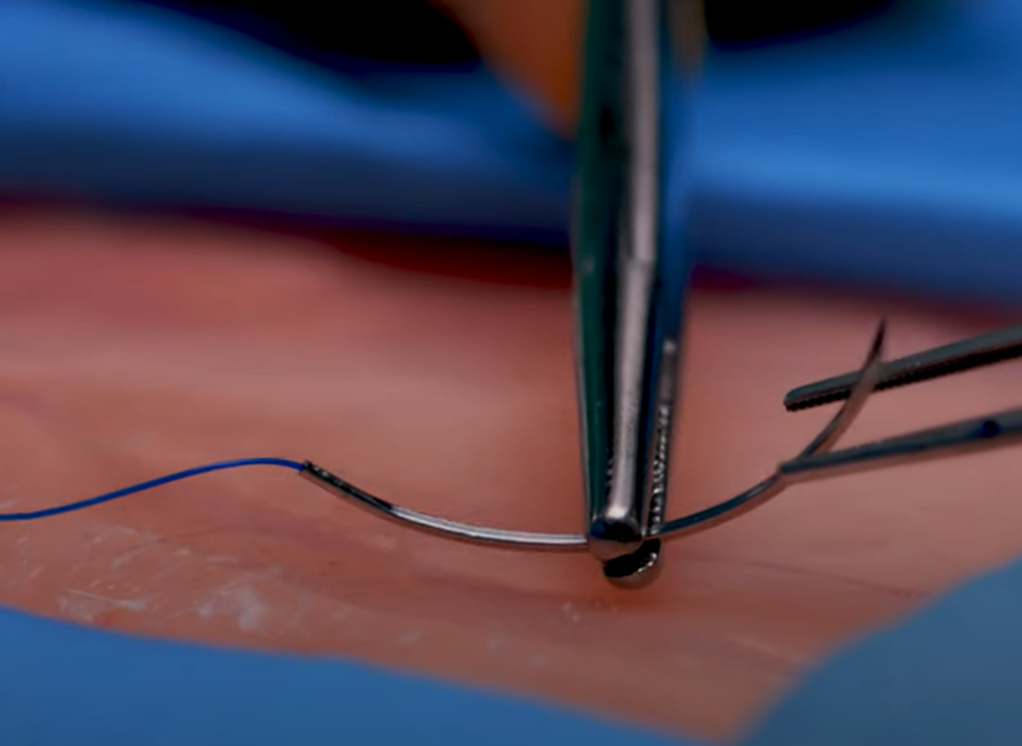
Preventing Surgical Sharps Injuries
Be aware of the environment- handle all sharps cautiously including: Suture, scalpels, sternal wires, trocars, hypodermic needles, sharp retractors, drill bits, needle tipped bovie tips, etc.
Suturing:
Ensure the incision field is clear of other surgical team member’s hands
When suturing, the non-dominant hand should be holding forceps to pick up the suture as it comes through the skin (photo A)
Never pick up the suture with hands- always use an instrument
When not using the needle it should be safely guarded against the needle driver (photo B)
Ensure the tip of needle is protected when passing
All sharps that are not in use should be passed to the Surgical Tech or placed on a table or mayo stand away from the field
When using a scalpel enact the safety cover before passing
Bovies should be placed in the hard holster when not in use
A
B

Slide 6
Please clink the link below:
How To - Suture Safety #ubcmedicine - YouTube

Slide 7
What to do if you experience a needlestick injury
If you experienced a needlestick injury or were exposed to the blood or other body fluid of a patient during the course of your work, immediately follow these steps:
Wash needlesticks and cuts with soap and water
Flush splashes to the nose, mouth, or skin with water
Irrigate eyes with clean water, saline, or sterile irrigants
Report the incident to your supervisor
Immediately seek medical treatment
-Contact EHS Immediately during business hours
918-599-5108
-ED Charge nurse for after hours/weekends

Slide 8
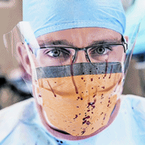
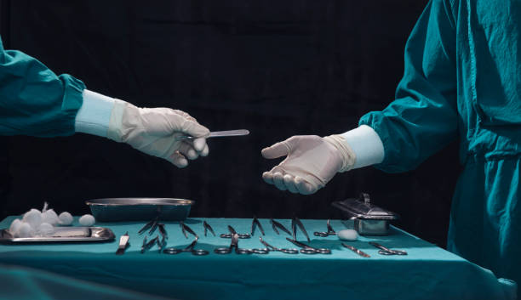
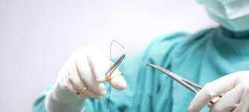
Common ways employees have needle sticks or exposures
Recapping needles
Scalpel
Splashes
Passing sharps
Suturing

Slide 9
Educational Video - Needle Stick Injuries
https://www.google.com/url?sa=t&rct=j&q=&esrc=s&source=video&cd=&cad=rja&uact=8&ved=2ahUKEwjOhbyRjvr-AhX_mWoFHdCUBtgQtwJ6BAgIEAI&url=https%3A%2F%2Fwww.youtube.com%2Fwatch%3Fv%3DPEI9QmGErWs&usg=AOvVaw1qTImo0PPJRPRO_flmfSlc

Slide 10
Questions?
Phone: 918-599-5108
Email: mrind@osumc.net

